Slide 1
Unit :-1(Introduction and ER model)
Introduction to database systems
File System vs. Database Systems
Database system structure
Views of data in a database system
Data models and Database languages
ER model:-
Introduction to Entity-Relationship data model.
Elements of an ER model.
Constructing ER diagrams.
Modeling of constraints
Reduction of ER diagrams to tables

Slide 2
Introduction to database systems
What is Data?
Data is nothing but facts and statistics stored or free flowing over a network, generally it's raw and unprocessed.
For example: When you visit any website, they might store you IP address, that is data, in return they might add a cookie in your browser, marking you that you visited the website, that is data, your name, it's data, your age, it's data.

Slide 3
Data becomes information when it is processed, turning it into something meaningful. Like, based on the cookie data saved on user's browser, if a website can analyse that generally men of age 20-25 visit us more, that is information, derived from the data collected.

Slide 4
What is a Database?
A Database is a collection of related data organized in a way that data can be easily accessed, managed and updated.
Database can be software based or hardware based, with one sole purpose, storing data.

Slide 5
What is DBMS?
A DBMS is software that allows creation, definition and manipulation of database, allowing users to store, process and analyse data easily.
DBMS provides us with an interface or a tool, to perform various operations like creating database, storing data in it, updating data, creating tables in the database and a lot more.

Slide 6
Characteristics of Database Management System
A database management system has following characteristics:
Data stored into Tables: Data is never directly stored into the database. Data is stored into tables, created inside the database.
Reduced Redundancy: In the modern world hard drives are very cheap, but earlier when hard drives were too expensive, unnecessary repetition of data in database was a big problem. But DBMS follows Normalisation which divides the data in such a way that repetition is minimum.

Slide 7
Cont…
Data Consistency: On Live data, i.e. data that is being continuosly updated and added, maintaining the consistency of data can become a challenge. But DBMS handles it all by itself.
Support Multiple user and Concurrent Access: DBMS allows multiple users to work on it(update, insert, delete data) at the same time and still manages to maintain the data consistency.

Slide 8
Cont..
Query Language: DBMS provides users with a simple Query language, using which data can be easily fetched, inserted, deleted and updated in a database.
Security: The DBMS also takes care of the security of data, protecting the data from un-authorised access. In a typical DBMS, we can create user accounts with different access permissions, using which we can easily secure our data by restricting user access.

Slide 9
File System vs. Database Systems
File Management System, better known as File System is the most ancient and still the most popular way to keep your data files organised on your drives.
File Systems is the traditional way to keep your data organised in a way which is easy for physical access, whether it’s on your shelf or on the drives.

Slide 10
Cont..
Earlier people used to keep records and maintain data in registers and any alteration/retrieval to this data was difficult. When computers came, same agenda was followed for storing the data on drives.
File System actually stores data in the form of isolated files which have their own set of property table and physical location on the drive and user manually goes to these locations to access the files.

Slide 11
Cont..
It is an easy way to store data in general files like images, text, videos, audios etc., but security is less because only options available to these files are the options given by the operating system such as locks, hidden files and sharing.
These files are hard to maintain when it comes to frequent changes to these files.

Slide 12
Cont..
Data redundancy is more and can’t be controlled easily. Data integration is hard to achieve and also data consistency is not met.
Database Management System, abbreviated as DBMS, is an effective way to store the data when constraints are high and data maintenance and security are the primary concern of the user.

Slide 13
Cont..
DBMS stores data in the form of interrelated tables and files.
These are generally consist of database management system providers that are used to store and manipulate databases, hardware where the data is physically stored and an user friendly software developed to met specific purpose in certain situations, using which user can easily access database without worrying about the underlying schema of the database.

Slide 14
Cont..
Database Management System is great way to manage data as, the data redundancy is minimized due to interrelation of data entities and also provide a procedure for data integration due to centralisation of data in the database.
Security of data is also maximized using password protection, encryption/decryption, granting authorized access and others.

Slide 15
File System vs DBMS – Difference between File System and DBMS
File Management System | Database Management System
File System is a general, easy-to-use system to store general files which require less security and constraints. | Database management system is used when security constraints are high.
Data Redundancy is more in file management system. | Data Redundancy is less in database management system.
Data Inconsistency is more in file system. | Data Inconsistency is less in database management system.
Centralisation is hard to get when it comes to File Management System. | Centralisation is achieved in Database Management System.
User locates the physical address of the files to access data in File Management System. | In Database Management System, user is unaware of physical address where data is stored.
Security is low in File Management System. | Security is high in Database Management System.
File Management System stores unstructured data as isolated data files/entities. | Database Management System stores structured data which have well defined constraints and interrelation.

Slide 16
Database system structure
Sql Commands
Web forms
Application Front Ends
Sql Interface
Concurrency control DBMS
Plan Executor
Parser
Operator Evaluator
Optimizer
Transaction Manager
Lock Manager
Files and Method access
Recovery Manager
Buffer Manager
Disk Space Manager
Index files
System Catalog
Data Files
DATA BASE

Slide 17
Database system structure
Database System Structure are partitioned into modules for different functions.
Some functions (e.g. file systems) may be provided by the operating system. Components include
File Manager manages allocation of disk space and data structures used to represent information on disk.

Slide 18
Cont..
Database Manager: The interface between low-level data and application programs and queries.
Query Processor translates statements in a query language into low-level instructions the database manager understands. (May also attempt to find an equivalent but more efficient form.)
The Query Processor simplifies and facilitates access to data. The Query processor includes the following component.

Slide 19
Database system structure
DDL Interpreter
DML Compiler
Query Evaluation Engine
The DDL interpreter interprets DDL statements and records the definition in the data dictionary.
The DML compiler translates DML statements in a query language into an evaluation plan consisting of low-level instructions that the query evaluation engine understands.
The DML compiler also performs query optimization, which is it picks the lowest cost evaluation plan from among the alternatives. Query evaluation engine executes low level instructions generated by the DML compiler.

Slide 20
Cont..
DML Precompiled converts DML statements embedded in an application program to normal procedure calls in a host language. The precompiled interacts with the query processor.
• DDL Compiler converts DDL statements to a set of tables containing metadata stored in a data dictionary.
In addition, several data structures are required for physical system implementation:

Slide 21
Database system structure
Data Files: store the database itself.
Data Dictionary: stores information about the structure of the database. It is used heavily. Great emphasis should be placed on developing a good design and efficient implementation of the dictionary.
Indices: provide fast access to data items holding particular values.

Slide 22
Cont..
Storage Manager
The storage manager is important because database typically require a large amount of storage space. So it is very important efficient use of storage, and to minimize the movement of data to and from disk .
A storage manager is a program module that provides the interface between the low-level data stored in the database and the application programs and the queries submitted to the system. The Storage manager is responsible for the interaction with the file manager.

Slide 23
Database system structure
The Storage manager translates the various DML statements into low level file system commands. Thus the storage manager is responsible for storing, retrieving, and updating data in the database. The storage manager components include the following.
Authorization and Integrity Manager
Transaction Manager
File Manager
Buffer Manger

Slide 24
Cont..
Authorization and Integrity Manger tests for the satisfaction of integrity constraints and checks the authority of users to access data.
Transaction manager ensures that the database remains in a consistent state and allowing concurrent transactions to proceed without conflicting.

Slide 25
Database system structure
The file manager manages the allocation of space on disk storage and the data structures used to represent information stored on disk.
The Buffer manager is responsible for fetching the data from disk storage into main memory and deciding what data to cache in main memory.

Slide 26
Cont…
The storage manager implements the following data structures as part of the physical system implementation. Data File, Data Dictionary, Indices.
Data files stores the database itself. The Data dictionary stores Meta data about the structure of database, in particular the schema of the database.
Indices provide fast access to data items.

Slide 27
VIEWS OF DATA IN DBMS
Its major purpose in DBMS is to provide data abstraction.
What is abstraction:-It shows only necessary data and hiding unnecessary data.
In order to provide the abstraction for end users, dbms provides to see the data at different levels.

Slide 28
Cont..
View level
Logical level
Physical level
View 1
View 2
View 3
Logical Level
Physical Level

Slide 29
Cont…
First the physical level describes that how data stored in DB(database).
It explains what are the data structures used to store a record.
It is also called as the lowest level of abstraction.
The physical level is also called as storage level or Internal Level.

Slide 30
Cont..
Next higher level of abstraction is logical level it describes that what data is stored in it and relationships among data.
This level is also called as conceptual level
The Highest level of abstraction is the View level
IN this it describes which data is to be displayed to the end user.

Slide 31
Data Models and Database Languages
A model is a representation of reality, ‘real world’ objects and events, associations.
A data model represents the organization itself.
It should provide the basic concepts and notations that will allow database designers and end users unambiguously and accurately to communicate their understanding of the organizational data.

Slide 32
Data Models and Database Languages
Data Model can be defined as an integrated collection of concepts for describing and manipulating data, relationships between data, and constraints on the data in an organization.

Slide 33
Cont…
A data models comprises of three components:
The purpose of a data model is to represent data and to make the data understandable.
There have been many data models proposed in the literature.
They fall into three broad categories:
• Object Based Data Models
• Physical Data Models
• Record Based Data Models
The object based and record based data models are used to describe data at the conceptual and external levels, the physical data model is used to· describe data at the internal level.

Slide 34
Object Based Data Models
Object based data models use concepts such as entities, attributes, and relationships.
An entity is a distinct object (a person, place, concept, and event) in the organization that is to be represented in the database.
An attribute is a property that describes some aspect of the object that we wish to record, and a relationship is an association between entities.

Slide 35
Cont..
Some of the more common types of object based data model are:
Entity-Relationship
Object Oriented
Semantic
Functional
The Entity-Relationship model has emerged as one of the main techniques for modeling database design and forms the basis for the database design methodology.

Slide 36
Cont..
The object oriented data model extends the definition of an entity to include, not only the attributes that describe the state of the object but also the actions that are associated with the object, that is, its behavior.
The object is said to encapsulate both state and behavior.
Entities in semantic systems represent the equivalent of a record in a relational system.
They are abstractions ‘used to represent real world (e.g. customer) or conceptual (e.g. bank account) objects.

Slide 37
Cont..
The functional data model is now almost twenty years old.
The original idea was to’ view the database as a collection of extensionally defined functions and to use a functional language for querying the database.

Slide 38
Physical Data Models
Physical data models describe how data is stored in the computer, representing information such as record structures, record ordering, and access paths.

Slide 39
Record Based Logical Models
Record based logical models are used in describing data at the logical and view levels.
Record based models are so named because the database is structured in fixed format records of several types.
Each record type defines a fixed number of fields, or attributes, and each field is usually of a fixed length.

Slide 40
Cont..
The three most widely accepted record based data models are:
Hierarchical Model
Network Model
Relational Model
The relational model has gained favor over the other two in recent years. The network and hierarchical models are still used in a large number of older databases.

Slide 41
Database Languages
A DBMS must provide appropriate languages and interfaces for each category of users to express database queries and updates.
Database Languages are used to create and maintain database on computer.
There are large numbers of database languages like Oracle, MySQL, MS Access, dBase, FoxPro etc.

Slide 42
Cont..
SQL statements commonly used in Oracle and MS Access can be categorized as data definition language (DDL), data control language (DCL) and data manipulation language (DML).
Data Definition Language (DDL)
Data Manipulation Language (DML)
Data Control Language (DCL)

Slide 43
Data Definition Language (DDL)
It is a language that allows the users to define data and their relationship to other types of data.
It is mainly used to create files, databases, data dictionary and tables within databases.
It is also used to specify the structure of each table, set of associated values with each attribute, integrity constraints, security and authorization information for each table and physical storage structure of each table on disk.

Slide 44
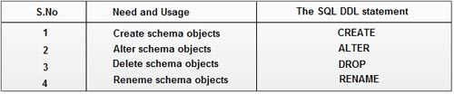
The following table gives an overview about usage of DDL statements in SQL

Slide 45
Data Manipulation Language (DML)
It is a language that provides a set of operations to support the basic data manipulation operations on the data held in the databases.
It allows users to insert, update, delete and retrieve data from the database.
The part of DML that involves data retrieval is called a query language.

Slide 46
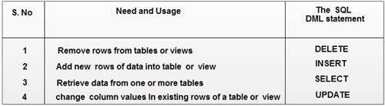
The following table gives an overview about the usage of DML statements in SQL:

Slide 47
Data Control Language (DCL)
DCL statements control access to data and the database using statements such as GRANT and REVOKE. A privilege can either be granted to a User with the help of GRANT statement.
The privileges assigned can be SELECT, ALTER, DELETE, EXECUTE, INSERT, INDEX etc.
In addition to granting of privileges, you can also revoke (taken back) it by using REVOKE command.

Slide 48

Cont..
The following table gives an overview about the usage of DCL statements in SQL:

Slide 49
(ER-Model)-Introduction to Entity-Relationship data model
ER model stands for an Entity-Relationship model. It is a high-level data model.
This model is used to define the data elements and relationship for a specified system.
It develops a conceptual design for the database. It also develops a very simple and easy to design view of data.
In ER modeling, the database structure is portrayed as a diagram called an entity-relationship diagram.

Slide 50
Cont..
For example, Suppose we design a school database. In this database, the student will be an entity with attributes like address, name, id, age, etc.
The address can be another entity with attributes like city, street name, pin code, etc and there will be a relationship between them.

Slide 51
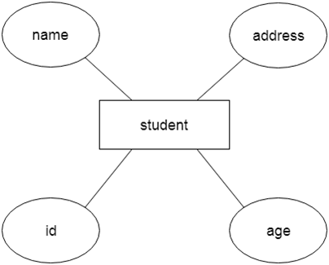
Cont..

Slide 52
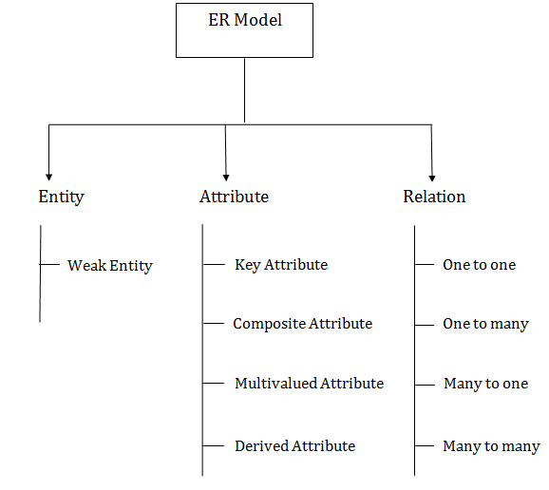
Component of ER Diagram

Slide 53
Cont..
Entity:
An entity may be any object, class, person or place. In the ER diagram, an entity can be represented as rectangles.
Consider an organization as an example- manager, product, employee, department etc. can be taken as an entity.

Slide 54

Cont…
a. Weak Entity
An entity that depends on another entity called a weak entity.
The weak entity doesn't contain any key attribute of its own.
The weak entity is represented by a double rectangle.

Slide 55

Cont..
2. Attribute
The attribute is used to describe the property of an entity.
Eclipse is used to represent an attribute.

Slide 56
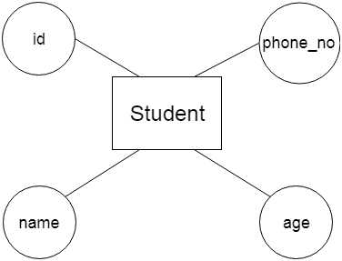
Cont..
For example, id, age, contact number, name, etc. can be attributes of a student.

Slide 57
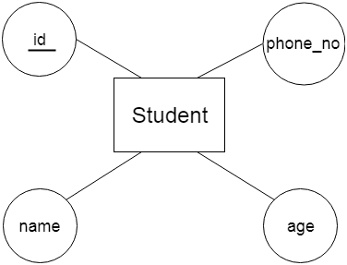
Cont..
a. Key Attribute
The key attribute is used to represent the main characteristics of an entity.
It represents a primary key. The key attribute is represented by an ellipse with the text underlined.

Slide 58
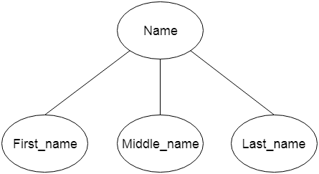
Cont…
b. Composite Attribute
An attribute that composed of many other attributes is known as a composite attribute.
The composite attribute is represented by an ellipse, and those ellipses are connected with an ellipse.

Slide 59
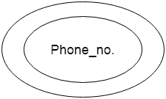
Cont..
Multivalued Attribute
An attribute can have more than one value. These attributes are known as a multivalued attribute. The double oval is used to represent multivalued attribute.
For example, a student can have more than one phone number.

Slide 60
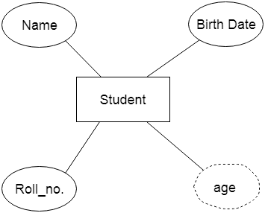
Cont…
d. Derived Attribute
An attribute that can be derived from other attribute is known as a derived attribute. It can be represented by a dashed ellipse.
For example, A person's age changes over time and can be derived from another attribute like Date of birth.

Slide 61

Cont..
Relationship
A relationship is used to describe the relation between entities.
Diamond or rhombus is used to represent the relationship.

Slide 62

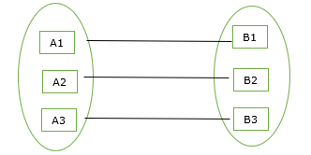
Cont…
When only one instance of an entity is associated with the relationship, then it is known as one to one relationship.
Eg:-1:1 relationship:-
In a traditional American marriage, a man can be married to only one woman; a woman can be married to only one man.

Slide 63
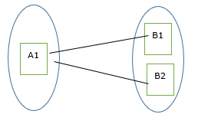
Cont..
One-to-many relationship
When only one instance of the entity on the left, and more than one instance of an entity on the right associates with the relationship then this is known as a one-to-many relationship.
Eg:-A child has exactly one biological father; a father can have many biological children.
FATHER
Can have
CHILDREN
1 M

Slide 64

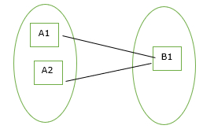
Cont..
Many-to-one relationship
When more than one instance of the entity on the left, and only one instance of an entity on the right associates with the relationship then it is known as a many-to-one relationship.
Eg:- Student enrolls for only one course, but a course can have many students.

Slide 65
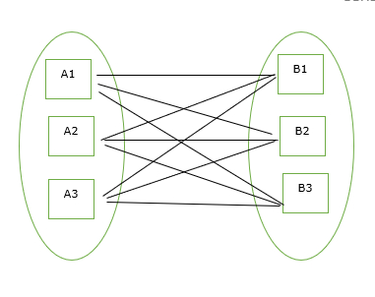

Cont…
Many-to-many relationship
When more than one instance of the entity on the left, and more than one instance of an entity on the right associates with the relationship then it is known as a many-to-many relationship.
For eg:
Employee can assign by many projects and project can have many employees.
A student can enroll in many classes; a class can have many enrolled students.

Slide 66
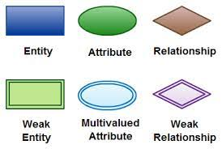
Elements of an ER model
Elements in ER diagrams:-
There are three basic elements in an ER Diagram: entity, attribute, relationship. There are more elements which are based on the main elements.

Slide 67
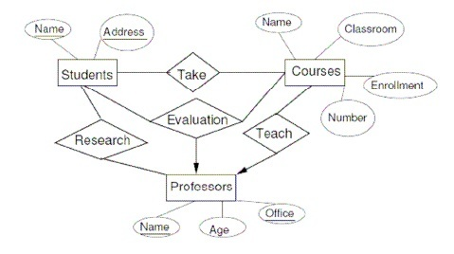
Our Academic Example:

Slide 68
Modeling of key Constraints
Keys are attributes or sets of attributes that uniquely identify an entity within its entity set.
Single-value constraints require that a value be unique in certain contexts.
Referential integrity constrains require that a value referred to actually exists in the database.
Domain constraints specify what set of values an attribute can take.
General constraints are arbitrary constraints that should hold in the database. Constraints are part of the schema of a database.

Slide 69
What is Constraint??
Constraints are the predefined set of rules and restrictions applied on the tables or columns for restricting unauthorised values to be inserted into the tables.
They are responsible for ensuring the column's data accuracy, integrity, and reliability inside the table.
Constraints also tell that the data will be inserted into the table when the inserted data satisfies the constraint rule.

Slide 70
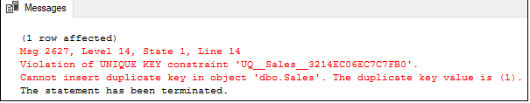
Key Constraints or Uniqueness Constraints :
These are called uniqueness constraints since it ensures that every tuple in the relation should be unique.
Null values are not allowed in the primary key, hence Not Null constraint is also a part of key constraint.
Example:
EID | NAME | PHONE
01 | hafeena | 212213123213
02 | haseena | 822394721343
01 | aksana | 234343423343
In the above table, EID is the primary key, and first and the last tuple has the same value in EID ie 01, so it is violating the key constraint.

Slide 71
Single Value Constraints
An entity (or object) may have at most one value for a given attribute or relationship.
Eg:- Person: name, social-security number ,Company: stock price.
In E/R, every attribute has at most one value.
If we have a single-valued constraint, we can either:
1. Require that the value exist (see referential integrity shortly)
2. Allow null values.

Slide 72
Referential integrity Constraint
The Referential integrity constraints is specified between two relations or tables and used to maintain the consistency among the tuples in two relations.
Referential Integrity constraints in DBMS are based on the concept of Foreign Keys
A foreign key is an important attribute of a relation which should be referred to in other relationships.
Referential integrity constraint state happens where relation refers to a key attribute of a different or same relation. However, that key element must exist in the table.

Slide 73
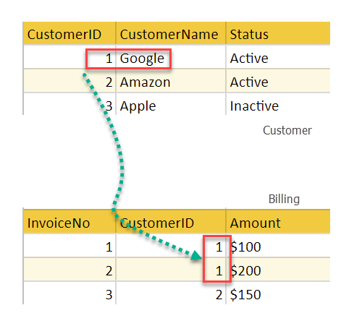
Example
In the above example, we have 2 relations, Customer and Billing.
Tuple for CustomerID =1 is referenced twice in the relation Billing. So we know CustomerName=Google has billing amount $300

Slide 74
Domain integrity constraint
A domain integrity constraint is a set of rules that restricts the kind of attributes or values a column or relation can hold in the database table.
For example, we can specify if a particular column can hold null values or not, if the values have to be unique or not, the data type or size of values that can be entered in the column, the default values for the column, etc.

Slide 75
Cont…
For example, we want to create a “customer_details” table, with information such as customer id, customer name, the number of items purchased, date of purchase, etc.
So, in order to ensure domain integrity, we can specify the customer_id has to be unique, the quantity of items purchased has to be an integer number only and the date of purchase has to be a date or timestamp, etc. This can be achieved in the following manner while creating the table.
CREATE TABLE customer_details
(
customer_id character varying(255) NOT NULL,
customer_name character varying(255) NOT NULL,
quantity integer NOT NULL,
date_purchased date
);

Slide 76
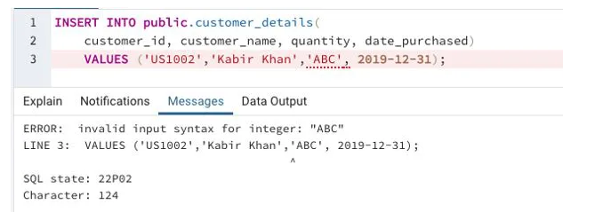
Cont..
INSERT INTO public.customer_details(
customer_id, customer_name, quantity, date_purchased)
VALUES ('US1002','Kabir Khan','ABC', 2019-12-31);
we can see that for the ‘quantity’ attribute when we tried to insert a character value instead of an integer, the domain constraint enables the server to throw an error.

Slide 77
Reduction of ER diagrams to tables.
After designing an ER Diagram
ER diagram is converted into the tables in relational model.
This is because relational models can be easily implemented by RDBMS like MySQL , Oracle etc.
Following rules are used for converting an ER diagram into the tables-

Slide 78
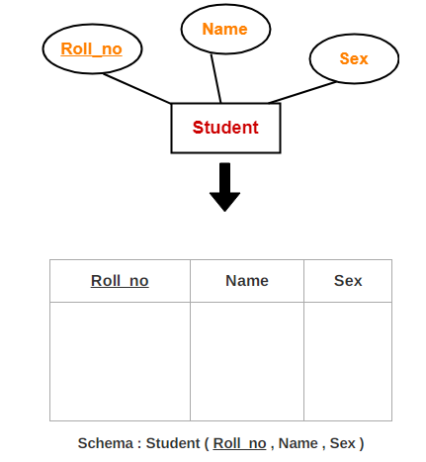
Rule-01: For Strong Entity Set With Only key attributes Attributes-
A strong entity set with only simple attributes will require only one table in relational model.
Attributes of the table will be the attributes of the entity set.
The primary key of the table will be the key attribute of the entity set.

Slide 79
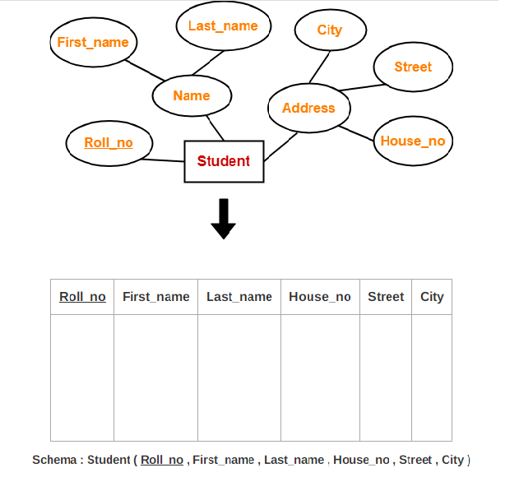
Rule-02: For Strong Entity Set With Composite Attributes-
A strong entity set with any number of composite attributes will require only one table in relational model.
While conversion, simple attributes of the composite attributes are taken into account and not the composite attribute itself.

Slide 80
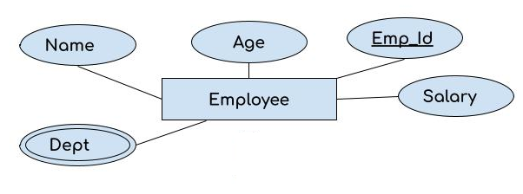
Rule-03: For Strong Entity Set With Multi Valued Attributes-
A strong entity set with any number of multi valued attributes will require two tables in relational model.
One table will contain all the simple attributes with the primary key.
Other table will contain the primary key and all the multi valued attributes.

Slide 81
Cont..
Emp_id | First_N | Last_N | Age | Salary
Emp_id | Dept

Slide 82
Relationship Set to Table conversion
While converting the relationship set to a table, the primary attributes of the two entity sets becomes the table attributes and if the relationship set has any attribute that also becomes the attribute of the table.
In the following example, we have two entity sets Employee and Department. These entity sets are associated to each other using the Works relationship set.

Slide 83
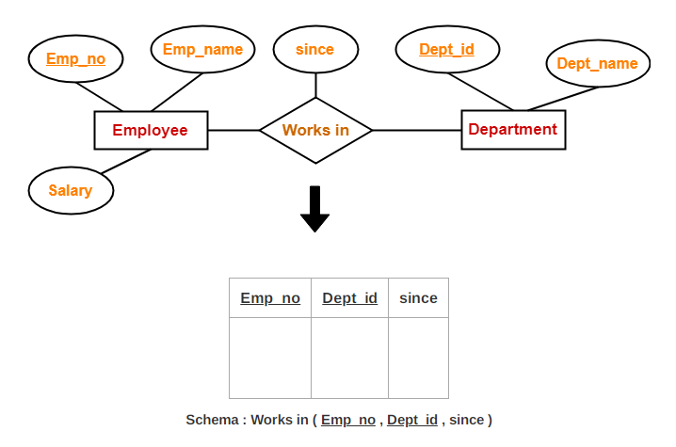
Cont..
To convert this relationship set Works to the table, we take the primary attributes of each entity set, these are Emp_Id and Dept_Id and all the attributes of the relationship set and form a table.

