Slide 1
Unit:- VI Transactions
Transaction Concept:-
A transaction is a unit of program execution that accesses and possibly updates various data items.
A transaction must see a consistent database.
During transaction execution the database may be inconsistent.
When the transaction is committed, the database must be consistent.

Slide 2
Transaction Concept
Two main issues to deal with:
→ Failures of various kinds, such as hardware failures and system crashes.
→ Concurrent execution of multiple transactions.

Slide 3
ACID PROPERTIES
To preserve integrity of data, the database system must ensure:
Atomicity. Either all operations of the transaction are properly reflected in the database or none are.
Consistency. Execution of a transaction in isolation preserves the consistency of the database.

Slide 4
Cont…
Isolation. Although multiple transactions may execute concurrently, each transaction must be unaware of other concurrently executing transactions. Intermediate transaction results must be hidden from other concurrently executed transactions.
→ That is, for every pair of transactions Ti and Tj , it appears to Ti that either Tj , finished execution before Ti started, or Tj started execution after Ti finished.

Slide 5
Cont..
Durability:- After a transaction completes successfully, the changes it has made to the database persist, even if there are system failures.

Slide 6
Example of Fund Transfer
Transaction to transfer $50 from account A to account B:
1. read(A)
2. A := A – 50
3. write(A)
4. read(B)
5. B := B + 50
6. write(B)
Consistency requirement: – the sum of A and B is unchanged by the execution of the transaction.
Atomicity requirement :-— if the transaction fails after step 3 and before step 6, the system should ensure that its updates are not reflected in the database, else an inconsistency will result.

Slide 7
Cont..
Durability requirement :— once the user has been notified that the transaction has completed (i.e., the transfer of the $50 has taken place), the updates to the database by the transaction must persist despite failures.
Isolation requirement — if between steps 3 and 6, another transaction is allowed to access the partially updated database, it will see an inconsistent database (the sum A + B will be less than it should be).

Slide 8
Cont..
Can be ensured trivially by running transactions serially, that is one after the other. However, executing multiple transactions concurrently has significant benefits, as we will see.

Slide 9
Transaction State
Active, the initial state; the transaction stays in this state while it is executing
Partially committed, after the final statement has been executed.
Failed, after the discovery that normal execution can no longer proceed.
Aborted, after the transaction has been rolled back and the database restored to its state prior to the start of the transaction. Two options after it has been aborted:
→restart the transaction – only if no internal logical error
→ kill the transaction
Committed, after successful completion.

Slide 10
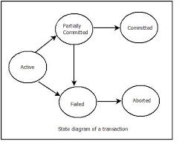
Transaction State (Cont.)

Slide 11
Concurrency in DBMS
Concurrency Control:-
Concurrency Control is the management procedure that is required for controlling concurrent execution of the operations that take place on a database.
But before knowing about concurrency control, we should know about concurrent execution.

Slide 12
Concurrent Execution in DBMS
In a multi-user system, multiple users can access and use the same database at one time, which is known as the concurrent execution of the database.
It means that the same database is executed simultaneously on a multi-user system by different users.

Slide 13
Cont….
While working on the database transactions, there occurs the requirement of using the database by multiple users for performing different operations, and in that case, concurrent execution of the database is performed.
The thing is that the simultaneous execution that is performed should be done in an interleaved manner, and no operation should affect the other executing operations, thus maintaining the consistency of the database.

Slide 14
Cont….
Thus, on making the concurrent execution of the transaction operations, there occur several challenging problems that need to be solved.

Slide 15
Problems with Concurrent Execution
In a database transaction, the two main operations are READ and WRITE operations.
So, there is a need to manage these two operations in the concurrent execution of the transactions as if these operations are not performed in an interleaved manner, and the data may become inconsistent.
So, the following problems occur with the Concurrent Execution of the operations:

Slide 16
Problem 1: Lost Update Problems (W - W Conflict)
The problem occurs when two different database transactions perform the read/write operations on the same database items in an interleaved manner (i.e., concurrent execution) that makes the values of the items incorrect hence making the database inconsistent.
For example:
Consider the below diagram where two transactions T_{X} and T_{Y}, are performed on the same account A where the balance of account A is $300.

Slide 17
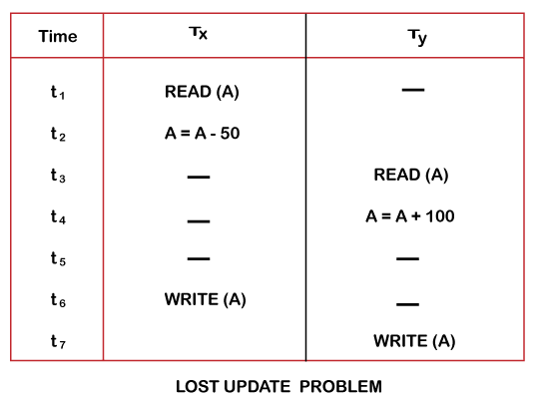
Cont…

Slide 18
At time t1, transaction T_{X} reads the value of account A, i.e., $300 (only read).
At time t2, transaction T_{X} deducts $50 from account A that becomes $250 (only deducted and not updated/write).
Alternately, at time t3, transaction T_{Y} reads the value of account A that will be $300 only because T_{X} didn't update the value yet.
At time t4, transaction T_{Y} adds $100 to account A that becomes $400 (only added but not updated/write).
At time t6, transaction T_{X} writes the value of account A that will be updated as $250 only, as T_{Y} didn't update the value yet.
Similarly, at time t7, transaction T_{Y} writes the values of account A, so it will write as done at time t4 that will be $400. It means the value written by T_{X} is lost, i.e., $250 is lost.
Hence data becomes incorrect, and database sets to inconsistent.

Slide 19
Dirty Read Problems (W-R Conflict)
The dirty read problem occurs when one transaction updates an item of the database, and somehow the transaction fails, and before the data gets rollback, the updated database item is accessed by another transaction. There comes the Read-Write Conflict between both transactions.
For example:
Consider two transactions T_{X} and T_{Y} in the below diagram performing read/write operations on account A where the available balance in account A is $300:

Slide 20
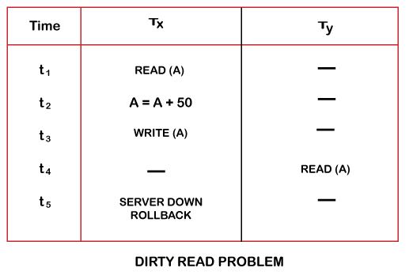
Cont..

Slide 21
Cont..
At time t1, transaction T_{X} reads the value of account A, i.e., $300.
At time t2, transaction T_{X} adds $50 to account A that becomes $350.
At time t3, transaction T_{X} writes the updated value in account A, i.e., $350.
Then at time t4, transaction T_{Y} reads account A that will be read as $350.
Then at time t5, transaction T_{X} rollbacks due to server problem, and the value changes back to $300 (as initially).
But the value for account A remains $350 for transaction T_{Y} as committed, which is the dirty read and therefore known as the Dirty Read Problem.

Slide 22
Unrepeatable Read Problem (W-R Conflict)
Also known as Inconsistent Retrievals Problem that occurs when in a transaction, two different values are read for the same database item.
For example:
Consider two transactions, T_{X} and T_{Y}, performing the read/write operations on account A, having an available balance = $300. The diagram is shown below:

Slide 23
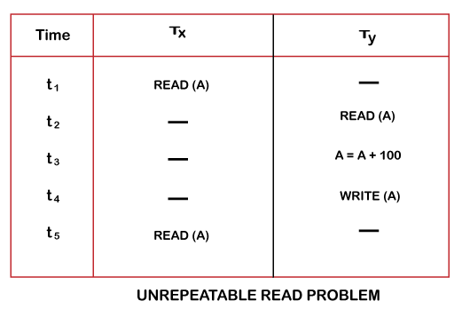
Unrepeatable Read Problem (W-R Conflict)

Slide 24
At time t1, transaction T_{X} reads the value from account A, i.e., $300.
At time t2, transaction T_{Y} reads the value from account A, i.e., $300.
At time t3, transaction T_{Y} updates the value of account A by adding $100 to the available balance, and then it becomes $400.
At time t4, transaction T_{Y} writes the updated value, i.e., $400.
After that, at time t5, transaction T_{X} reads the available value of account A, and that will be read as $400.
It means that within the same transaction T_{X}, it reads two different values of account A, i.e., $ 300 initially, and after updation made by transaction T_{Y}, it reads $400. It is an unrepeatable read and is therefore known as the Unrepeatable read problem.

Slide 25
Thus, in order to maintain consistency in the database and avoid such problems that take place in concurrent execution, management is needed, and that is where the concept of Concurrency Control comes into role.

Slide 26
Concurrency Control
Concurrency Control is the working concept that is required for controlling and managing the concurrent execution of database operations and thus avoiding the inconsistencies in the database.
Thus, for maintaining the concurrency of the database, we have the concurrency control protocols.

Slide 27
Concurrency Control Protocols
The concurrency control protocols ensure the atomicity, consistency, isolation, durability and serializability of the concurrent execution of the database transactions. Therefore, these protocols are categorized as:
Lock Based Concurrency Control Protocol
Time Stamp Concurrency Control Protocol
Validation Based Concurrency Control Protocol

Slide 28
Lock Based Concurrency Control Protocol
In this type of protocol, any transaction cannot read or write data until it acquires an appropriate lock on it.
Lock based protocols help to eliminate the concurrency problem in DBMS for simultaneous transactions by locking or isolating a particular transaction to a single user.
There are two types of lock:
1. Shared lock
2. Exclusive lock

Slide 29
Shared Lock
It is also known as a Read-only lock.
In a shared lock, the data item can only read by the transaction.
It can be shared between the transactions because when the transaction holds a lock, then it can't update the data on the data item.

Slide 30
2. Exclusive lock:
In the exclusive lock, the data item can be both reads as well as written by the transaction.
This lock is exclusive, and in this lock, multiple transactions do not modify the same data simultaneously.

Slide 31
There are four types of lock protocols available:
1. Simplistic lock protocol
2. Pre-claiming Lock Protocol
3. Two-phase locking (2PL)
4. Strict Two-phase locking (Strict-2PL)

Slide 32
1. Simplistic lock protocol
It is the simplest way of locking the data while transaction.
Simplistic lock-based protocols allow all the transactions to get the lock on the data before insert or delete or update on it.
It will unlock the data item after completing the transaction.

Slide 33
Pre-claiming Lock Protocol
Pre-claiming Lock Protocols evaluate the transaction to list all the data items on which they need locks.
Before initiating an execution of the transaction, it requests DBMS for all the lock on all those data items.
If all the locks are granted then this protocol allows the transaction to begin. When the transaction is completed then it releases all the lock.
If all the locks are not granted then this protocol allows the transaction to rolls back and waits until all the locks are granted.

Slide 34
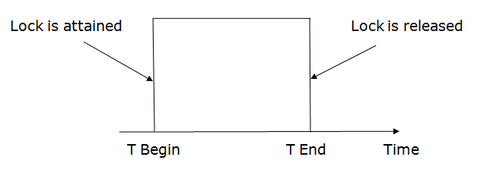

Slide 35
3. Two-phase locking (2PL)
The two-phase locking protocol divides the execution phase of the transaction into three parts.
In the first part, when the execution of the transaction starts, it seeks permission for the lock it requires.
In the second part, the transaction acquires all the locks. The third phase is started as soon as the transaction releases its first lock.
In the third phase, the transaction cannot demand any new locks. It only releases the acquired locks.

Slide 36
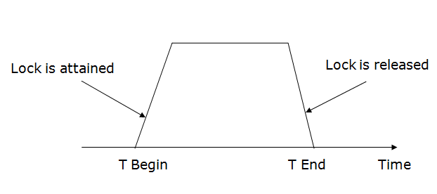
There are two phases of 2PL:
Growing phase: In the growing phase, a new lock on the data item may be acquired by the transaction, but none can be released.
Shrinking phase: In the shrinking phase, existing lock held by the transaction may be released, but no new locks can be acquired.

Slide 37
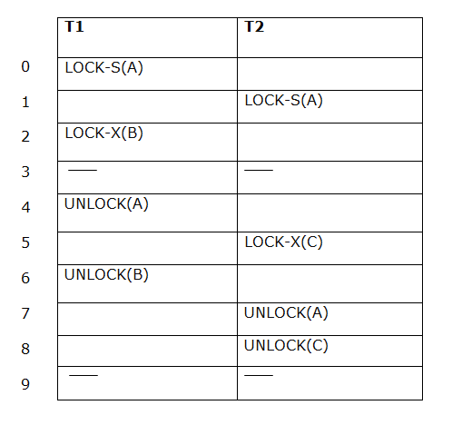
In the below example, if lock conversion is allowed then the following phase can happen:
Upgrading of lock (from S(a) to X (a)) is allowed in growing phase.
Downgrading of lock (from X(a) to S(a)) must be done in shrinking phase.
Example:

Slide 38
The following way shows how unlocking and locking work with 2-PL.
Transaction T1:
Growing phase: from step 1-3
Shrinking phase: from step 5-7
Lock point: at 3
Transaction T2:
Growing phase: from step 2-6
Shrinking phase: from step 8-9
Lock point: at 6

Slide 39
4. Strict Two-phase locking (Strict-2PL)
The first phase of Strict-2PL is similar to 2PL. In the first phase, after acquiring all the locks, the transaction continues to execute normally.
The only difference between 2PL and strict 2PL is that Strict-2PL does not release a lock after using it.
Strict-2PL waits until the whole transaction to commit, and then it releases all the locks at a time.
Strict-2PL protocol does not have shrinking phase of lock release.

Slide 40
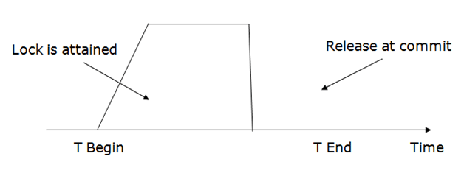

Slide 41
Timestamp Ordering Protocol
The Timestamp Ordering Protocol is used to order the transactions based on their Timestamps. The order of transaction is nothing but the ascending order of the transaction creation.
The priority of the older transaction is higher that's why it executes first. To determine the timestamp of the transaction, this protocol uses system time or logical counter.
The lock-based protocol is used to manage the order between conflicting pairs among transactions at the execution time. But Timestamp based protocols start working as soon as a transaction is created.

Slide 42
Cont..
Let's assume there are two transactions T1 and T2. Suppose the transaction T1 has entered the system at 007 times and transaction T2 has entered the system at 009 times. T1 has the higher priority, so it executes first as it is entered the system first.
The timestamp ordering protocol also maintains the timestamp of last 'read' and 'write' operation on a data.

Slide 43
Basic Timestamp ordering protocol works as follows:
1. Check the following condition whenever a transaction Ti issues a Read (X) operation:
If W_TS(X) >TS(Ti) then the operation is rejected.
If W_TS(X) <= TS(Ti) then the operation is executed.
Timestamps of all the data items are updated.
2. Check the following condition whenever a transaction Ti issues a Write(X) operation:
If TS(Ti) < R_TS(X) then the operation is rejected.
If TS(Ti) < W_TS(X) then the operation is rejected and Ti is rolled back otherwise the operation is executed.

Slide 44
Where,
TS(TI) denotes the timestamp of the transaction Ti.
R_TS(X) denotes the Read time-stamp of data-item X.
W_TS(X) denotes the Write time-stamp of data-item X.

Slide 45
Validation Based Protocol
Validation phase is also known as optimistic concurrency control technique. In the validation based protocol, the transaction is executed in the following three phases:
Read phase: In this phase, the transaction T is read and executed. It is used to read the value of various data items and stores them in temporary local variables. It can perform all the write operations on temporary variables without an update to the actual database.

Slide 46
Validation phase: In this phase, the temporary variable value will be validated against the actual data to see if it violates the serializability.
Write phase: If the validation of the transaction is validated, then the temporary results are written to the database or system otherwise the transaction is rolled back.

Slide 47
Here each phase has the following different timestamps:
Start(Ti): It contains the time when Ti started its execution.
Validation (T_{i}): It contains the time when Ti finishes its read phase and starts its validation phase.
Finish(Ti): It contains the time when Ti finishes its write phase.

Slide 48
Serializability
When multiple transactions are running concurrently then there is a possibility that the database may be left in an inconsistent state.
Serializability is a concept that helps us to check which schedules are serializable.
A serializable schedule is the one that always leaves the database in consistent state.

Slide 49
What is a serializable schedule?
A serializable schedule always leaves the database in consistent state.
A serial schedule is always a serializable schedule because in serial schedule, a transaction only starts when the other transaction finished execution.
However a non-serial schedule needs to be checked for Serializability.

Slide 50
Cont…
A non-serial schedule of n number of transactions is said to be serializable schedule, if it is equivalent to the serial schedule of those n transactions.
A serial schedule doesn’t allow concurrency, only one transaction executes at a time and the other starts when the already running transaction finished.

Slide 51
Cont…
A schedule is serialized if it is equivalent to a serial schedule. A concurrent schedule must ensure it is the same as if executed serially means one after another.
It refers to the sequence of actions such as read, write, abort, commit are performed in a serial manner.

Slide 52
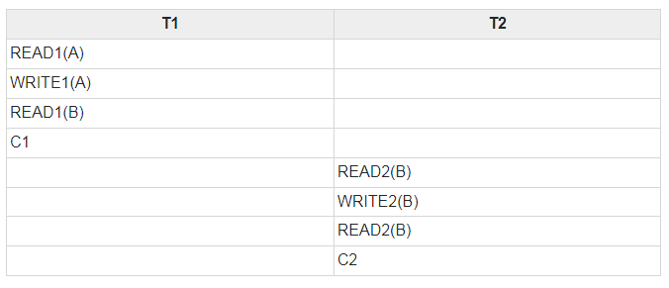
Example
Let’s take two transactions T1 and T2,
If both transactions are performed without interfering each other then it is called as serial schedule, it can be represented as follows −

Slide 53
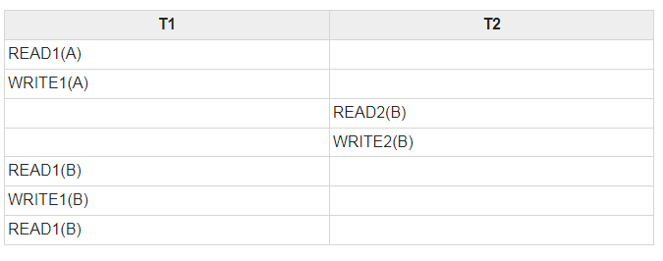
Cont…
Non serial schedule − When a transaction is overlapped between the transaction T1 and T2.
Example
Consider the following example −

Slide 54
A Serial schedule doesn’t support concurrent execution of transactions while a non-serial schedule supports concurrency.
We also learned in Serializability that a non-serial schedule may leave the database in inconsistent state so we need to check these non-serial schedules for the Serializability.

Slide 55
Types of Serializability
There are two types of Serializability.
1. Conflict Serializability
2. View Serializability

Slide 56
Conflict Serializability
Conflict Serializability is one of the type of Serializability, which can be used to check whether a non-serial schedule is conflict serializable or not.
What is Conflict Serializability?
A schedule is called conflict serializable if we can convert it into a serial schedule after swapping its non-conflicting operations.

Slide 57
Conflicting operations
Two operations are said to be in conflict, if they satisfy all the following three conditions:
1. Both the operations should belong to different transactions.
2. Both the operations are working on same data item.
3. At least one of the operation is a write operation.

Slide 58
Examples
Example 1: Operation W(X) of transaction T1 and operation R(X) of transaction T2 are conflicting operations, because they satisfy all the three conditions mentioned above. They belong to different transactions, they are working on same data item X, one of the operation in write operation.
Example 2: Similarly Operations W(X) of T1 and W(X) of T2 are conflicting operations.
Example 3: Operations W(X) of T1 and W(Y) of T2 are non-conflicting operations because both the write operations are not working on same data item so these operations don’t satisfy the second condition.

Slide 59
Examples Cont..
Example 4: Similarly R(X) of T1 and R(X) of T2 are non-conflicting operations because none of them is write operation.
Example 5: Similarly W(X) of T1 and R(X) of T1 are non-conflicting operations because both the operations belong to same transaction T1.

Slide 60
What is View Serializability?
View Serializability is a process to find out that a given schedule is view serializable or not.
To check whether a given schedule is view serializable, we need to check whether the given schedule is View Equivalent to its serial schedule.

Slide 61
A schedule is view-serializability if it is viewed equivalent to a serial schedule.
The rules it follows are as follows −
T1 is reading the initial value of A, then T2 also reads the initial value of A.
T1 is the reading value written by T2, then T2 also reads the value written by T1.
T1 is writing the final value, and then T2 also has the write operation as the final value.

Slide 62
Recoverability of Schedule
Sometimes a transaction may not execute completely due to a software issue, system crash or hardware failure.
In that case, the failed transaction has to be rollback.
But some other transaction may also have used value produced by the failed transaction.
So we also have to rollback those transactions.

Slide 63
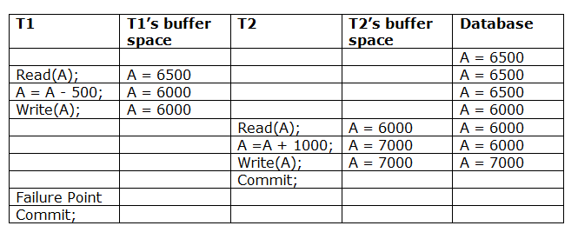
Irrecoverable schedule
The schedule will be irrecoverable if Tj reads the updated value of Ti and Tj committed before Ti commit.

Slide 64
Example Cont…
The above table 1 shows a schedule which has two transactions.
T1 reads and writes the value of A and that value is read and written by T2.
T2 commits but later on, T1 fails. Due to the failure, we have to rollback T1.
T2 should also be rollback because it reads the value written by T1, but T2 can't be rollback because it already committed.
So this type of schedule is known as irrecoverable schedule.

Slide 65
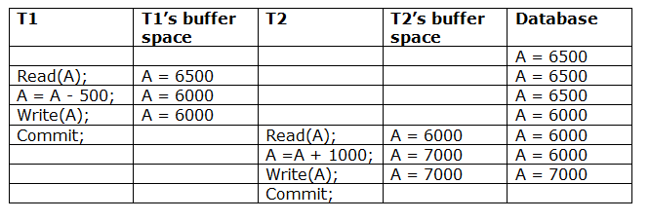
Recoverable with cascading rollback
The schedule will be recoverable with cascading rollback if Tj reads the updated value of Ti.
Commit of Tj is delayed till commit of Ti.

Slide 66
Example Cont…
The above table shows a schedule with two transactions.
Transaction T1 reads and writes A, and that value is read and written by transaction T2.
But later on, T1 fails. Due to this, we have to rollback T1.
T2 should be rollback because T2 has read the value written by T1.
As it has not committed before T1 commits so we can rollback transaction T2 as well. So it is recoverable with cascade rollback.

Slide 67
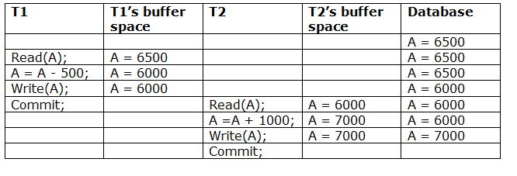
Cascade less recoverable schedule.
The above Table shows a schedule with two transactions.
Transaction T1 reads and write A and commits, and that value is read and written by T2.
So this is a cascade less recoverable schedule.

