Slide 1
Relational Database Design
The Relational database model was conceived by E.F. Codd in 1969, then a researcher at IBM.
It is commonly thought that the word relational in the relational model comes from the fact that we relate together tables in a relational database.
The benefits of a database that has been designed according to the relational model are numerous. Some of them are:

Slide 2
Relational Database Design
Data Entry
Data retrieval
Database follows well formulated model.
Information stored in the database.
Changes to the database schema.

Slide 3
Anomalies in DBMS
Anomalies are caused when there is too much redundancy in the database's information.
Database anomalies :Databases are designed to collect data and sort or present it in specific ways to the end users
The normalization process was created largely in order to reduce the negative effects of creating tables that will introduce anomalies into the database.

Slide 4
Anomalies in DBMS
There are three types of Data Anomalies: Update Anomalies, Insertion Anomalies, and Deletion Anomalies.
An update anomaly is a data inconsistency that results from data redundancy and a partial update. For example, each employee in a company has a department associated with them as well as the student group they participate in.

Slide 5
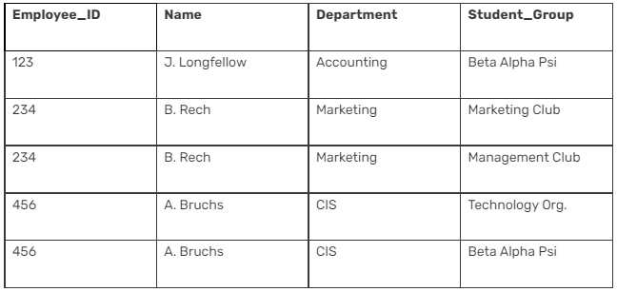
Anomalies in DBMS
If A. Bruchs’ department is an error it must be updated at least 2 times or there will be inconsistent data in the database. If the user performing the update does not realize the data is stored redundantly, the update will not be done properly.

Slide 6
Anomalies in DBMS
A deletion anomaly is the unintended loss of data due to deletion of other data.
For example, if the student group Beta Alpha Psi disbanded and was deleted from the table above, J. Longfellow and the Accounting department would cease to exist.
This results in database inconsistencies and is an example of how combining information that does not really belong together into one table can cause problems.

Slide 7
Anomalies in DBMS
An insertion anomaly is the inability to add data to the database due to absence of other data. For example, assume Student_Group is defined so that null values are not allowed.
If a new employee is hired but not immediately assigned to a Student_Group then this employee could not be entered into the database.
This results in database inconsistencies due to omission.

Slide 8
Relational Data Base Design
Relational database design (RDD) models information and data into a set of tables with rows and columns.
Each row of a relation/table represents a record, and each column represents an attribute of data.
The Structured Query Language (SQL) is used to manipulate relational databases.

Slide 9
Relational Data Base Design
The design of a relational database is composed of four stages, where the data are modeled into a set of related tables.
The stages are:
Define relations/attributes
Define primary keys
Define relationships
Normalization

Slide 10
Relational Data Base Design
Relational databases differ from other databases in their approach to organizing data and performing transactions.
In an RDD, the data are organized into tables and all types of data access are carried out via controlled transactions.
Relational database design satisfies the ACID (atomicity, consistency, integrity and durability) properties required from a database design. Relational database design mandates the use of a database server in applications for dealing with data management problems.

Slide 11
Relational Data Base Design
The four stages of an RDD are as follows:
Relations and attributes: The various tables and attributes related to each table are identified. The tables represent entities, and the attributes represent the properties of the respective entities.
Primary keys: The attribute or set of attributes that help in uniquely identifying a record is identified and assigned as the primary key

Slide 12
Relational Data Base Design
Relationships: The relationships between the various tables are established with the help of foreign keys. Foreign keys are attributes occurring in a table that are primary keys of another table. The types of relationships that can exist between the relations (tables) are:
  One to one
  One to many
  Many to many

Slide 13
Relational Data Base Design
An entity-relationship diagram can be used to depict the entities, their attributes and the relationship between the entities in a diagrammatic way.
Normalization: This is the process of optimizing the database structure. Normalization simplifies the database design to avoid redundancy and confusion. The different normal forms are as follows:
  First normal form
  Second normal form
  Third normal form
  Boyce-Codd normal form
  Fifth normal form

Slide 14
Relational Data Base Design
By applying a set of rules, a table is normalized into the above normal forms in a linearly progressive fashion.
The efficiency of the design gets better with each higher degree of normalization.
Redudancy:-Data redudancy occurs in database systems which have a field that is repeated in two or more tables.
Data redudancy will leads to data anomalies and corruption and generally should be avoided by design.

Slide 15
Features of Good Relational Designs
The goal of the relational database design is to generate a set of relation having
1)Minimum Redudancy:-
Redudancy means storage of the same data in more than one location or we can say that the same data are repeated in multiple tuples in the same relation or in multiple relations.
c1
c2
c3
r1
X | Y | Z
X | Y | Z
S | T | N
X | Y | T
X | Y | S
A | B | C
A | B | W
Redudancy
r2
r3

Slide 16
Disadvantages of Redundancy
1)Wastage of Storage Space
2)Insertion, Deletion & Manipulation anamoly can arise
So relational database should be designed in such a way that it should have minimum redundancy.

Slide 17
Lesser Null values in tuples
It may happen in a relation that values of all attributes of a tuple are not known.
For those null values can be stored.
Disadvantages of NULL Value:-It wastage storage
space.
NAME | AGE | CONTACT NO
MITHUNA | 4 | 325992541545
AFNAN | 2 | NULL VALUE

Slide 18
Cont…
Difficult to interpret them(Join operations).
Difficult in applying aggregate functions such as count avg etc.
So, in a good database design, the attributes whose values may frequently be null are avoided.

Slide 19
Atomic Domains and First Normal Form
A relation is in first normal form (abbreviated INF) if the domains of all its attributes are atomic, and the value of any attribute in a tuple is a single value from its domain.
1st Normal Form Definition
A database is in first normal form if it satisfies the following conditions:
Contains only atomic values
There are no repeating groups

Slide 20
A repeating group means that a table contains two or more columns that are closely related. For example, a table that records data on a book and its author(s) with the following columns: [Book ID], [Author 1], [Author 2], [Author 3] is not in 1NF because [Author 1], [Author 2], and [Author 3] are all repeating the same attribute.
1st Normal Form Example
How do we bring an unnormalized table into first normal form? Consider the following example:

Slide 21
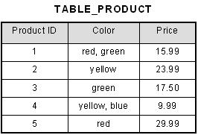
This table is not in first normal form because the [Color] column can contain multiple values. For example, the first row includes values "red" and "green."
To bring this table to first normal form, we split the table into two tables and now we have the resulting tables:

Slide 22
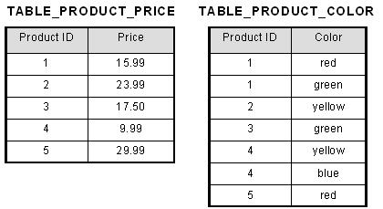
Now first normal form is satisfied, as the columns on each table all hold just one value.

Slide 23
Dependency theory-functional dependencies
Functional Dependency (FD) determines the relation of one attribute to another attribute in a database management system (DBMS) system.
Functional dependency helps you to maintain the quality of data in the database.
A functional dependency is denoted by an arrow →.

Slide 24

Dependency theory-functional dependencies
The functional dependency of X on Y is represented by X → Y.
Functional Dependency plays a vital role to find the difference between good and bad database design.
In this example, if we know the value of Employee number, we can obtain Employee Name, city, salary, etc. By this, we can say that the city, Employee Name, and salary are functionally depended on Employee number.

Slide 25
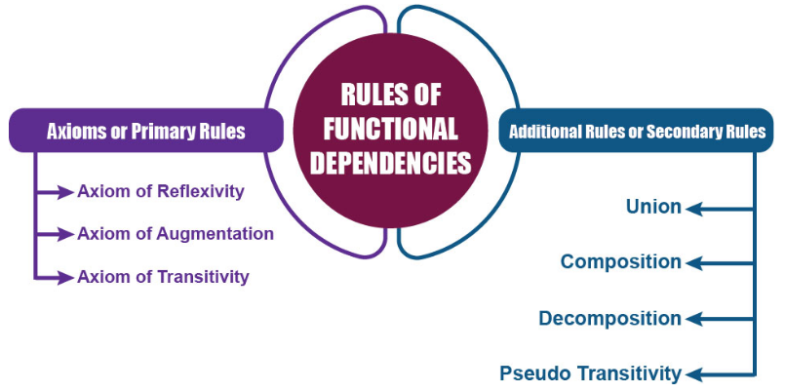
Rules of Functional Dependency
Following are the rules of functional dependencies:-

Slide 26
Armstrong’s Axioms for FD
Inference Rule (IR):
The Armstrong's axioms are the basic inference rule.
Armstrong's axioms are used to conclude functional dependencies on a relational database.
The inference rule is a type of assertion. It can apply to a set of FD(functional dependency) to derive other FD.
Using the inference rule, we can derive additional functional dependency from the initial set.

Slide 27
Rules of Functional Dependencies
Below given are the Three most important rules for Functional Dependency
Reflexive rule –. If X is a set of attributes and Y is_subset_of X, then X holds a value of Y.
Augmentation rule: When x -> y holds, and c is attribute set, then ac -> bc also holds. That is adding attributes which do not change the basic dependencies.
Transitivity rule: This rule is very much similar to the transitive rule in algebra if x -> y holds and y -> z holds, then x -> z also holds. X -> y is called as functionally that determines y.

Slide 28
Key terms
Here, are some key terms for functional dependency:
Key Terms | Description
Axiom | Axioms is a set of inference rules used to infer all the functional dependencies on a relational database.
Decomposition | It is a rule that suggests if you have a table that appears to contain two entities which are determined by the same primary key then you should consider breaking them up into two different tables.
Dependent | It is displayed on the right side of the functional dependency diagram.
Determinant | It is displayed on the left side of the functional dependency Diagram.
Union | It suggests that if two tables are separate, and the PK is the same, you should consider putting them. Together

Slide 29
Types of Functional Dependencies
Multivalued dependency
Trivial functional dependency
Non-trivial functional dependency
Transitive dependency

Slide 30
Multivalued dependency in DBMS
Multivalued dependency occurs in the situation where there are multiple independent multivalued attributes in a single table.
A multivalued dependency is a complete constraint between two sets of attributes in a relation. It requires that certain tuples be present in a relation.
Example:

Slide 31
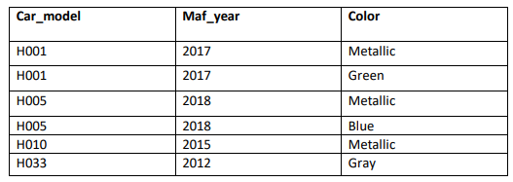
In this example, maf_year and color are independent of each other but dependent on car_model. In this example, these two columns are said to be multivalue dependent on car_model.
This dependence can be represented like this:
car_model -> maf_year
car_model-> colour

Slide 32
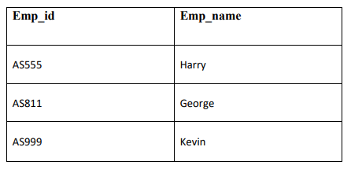
Trivial Functional dependency
The Trivial dependency is a set of attributes which are called a trivial if the set of attributes are included in that attribute.
So, X -> Y is a trivial functional dependency if Y is a subset of X.
For example:
Consider this table with two columns Emp_id and Emp_name. {Emp_id, Emp_name} -> Emp_id is a trivial functional dependency as Emp_id is a subset of {Emp_id,Emp_name}.

Slide 33
Non trivial functional dependency in DBMS
Functional dependency which also known as a nontrivial dependency occurs when A->B holds true where B is not a subset of A.
In a relationship, if attribute B is not a subset of attribute A, then it is considered as a non-trivial dependency.

Slide 34
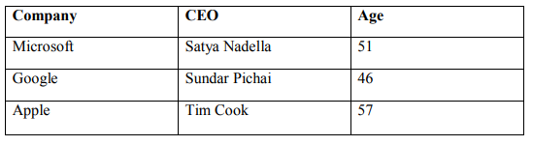
Example: (Company} -> {CEO} (if we know the Company, we knows the CEO name)
But CEO is not a subset of Company, and hence it's non-trivial functional dependency.

Slide 35
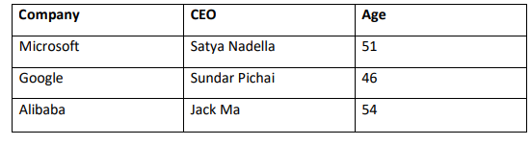
Transitive dependency:
A transitive is a type of functional dependency which happens when t is indirectly formed by two functional dependencies.

Slide 36
{Company} -> {CEO} (if we know the company, we know its CEO's name)
{CEO } -> {Age} If we know the CEO, we know the Age
Therefore according to the rule of rule of transitive dependency:
{ Company} -> {Age} should hold, that makes sense because if we know the company name, we can know his age.
Note: You need to remember that transitive dependency can only occur in a relation of three or more attributes.

Slide 37
Closures of a set of functional dependencies
A Closure is a set of FDs is a set of all possible FDs that can be derived from a given set of FDs.
It is also referred as a Complete set of FDs.
If F is used to donate the set of FDs for relation R, then a closure of a set of FDs implied by F is denoted by F⁺.
Closure method will useful to find all candidate keys in a table.
In a table if you want to find out all the possible candidate keys by using this closure method we can do it.

Slide 38
Let's consider the set F of functional dependencies given below:
R(ABCD)
FD={A->B,B->C,C->D}
Lets start closure method with attribute A
A⁺={ABCD}
Closure of A means what A can determine
A -> A ...By using Rule-4, Self-Determination.
A -> B ...Already given in F.
A -> C ...By using rule-3, Transitivity.
A -> D ...By using rule-3, Transitivity.
Now, by applyiing Rule-6 Union, it is possible to derive A⁺ -> ABCD and it can be denoted using A -> ABCD. All such type of FDs derived from each FD of F form a closure of F.

Slide 39
Lets start closure method with attribute B
B -> B ...By using Rule-4, Self-Determination.
B⁺={B}
B -> C ...Already given in F.
B⁺={B,C}
B -> D ...By using rule-3, Transitivity.
B⁺={B,C,D}
But here B is not determing A So B cannot determine the candidate key.

Slide 40
C⁺, D⁺
Suppose if we so Closure of AB⁺={ABCD}
So AB is not candidate key
So candidate is always minimal. So AB cannot be cadidate key if AB already we know A is a candidate key then any other attribute with candidate key is known as super key.

Slide 41
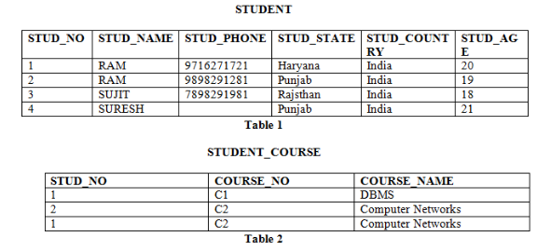
Candidate key

Slide 42
Candidate Key
Candidate Key: The minimal set of attributes that can uniquely identify a tuple is known as a candidate key. For Example, STUD_NO in STUDENT relation.
The value of the Candidate Key is unique and non-null for every tuple.
There can be more than one candidate key in a relation. For Example, STUD_NO is the candidate key for relation STUDENT.
The candidate key can be simple (having only one attribute) or composite as well. For Example, {STUD_NO, COURSE_NO} is a composite candidate key for relation STUDENT_COURSE.

Slide 43
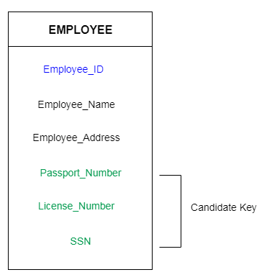
The remaining attributes except for primary key are considered as a candidate key. The candidate keys are as strong as the primary key.
For example: In the EMPLOYEE table, id is best suited for the primary key. Rest of the attributes like SSN, Passport_Number, and License_Number, etc. are considered as a candidate key.

Slide 44
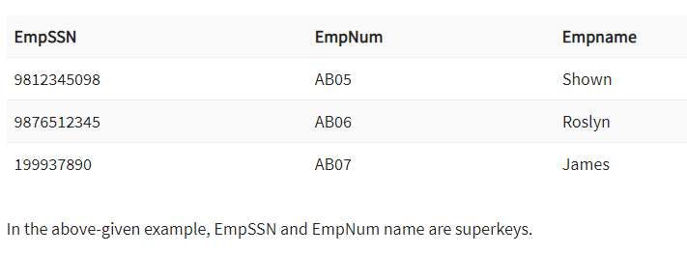
Super Key
What is the Super key?
A superkey is a group of single or multiple keys which identifies rows in a table. A Super key may have additional attributes that are not needed for unique identification.
Super key is a superset of a candidate key.
Example:-

Slide 45
For example: In the above EMPLOYEE table, for(EMPLOEE_ID, EMPLOYEE_NAME) the name of two employees can be the same, but their EMPLYEE_ID can't be the same. Hence, this combination can also be a key.
The super key would be EMPLOYEE-ID, (EMPLOYEE_ID, EMPLOYEE-NAME), etc.

Slide 46
Minimal Cover of FD
A minimal cover of a set of functional dependencies (FD) E is a minimal set of dependencies F that is equivalent to E.
The formal definition is: A set of FD F to be minimal if it satisfies the following conditions
Every dependency in F has a single attribute for its right-hand side.
We cannot replace any dependency X->A in F with a dependency Y->A, where Y is a proper subset of X, and still have a set of dependencies that is equivalent to F.
We cannot remove any dependency from F and still have a set of dependencies that are equivalent to F.

Slide 47
In this how to find the minimal set in functional dependencies that we will see.
There some extra redundant functional dependencies are there that we need to remove it.
We need to follow some steps to minimize the FD.
Steps to find the minimal set:-
1)Split the FDs such that RHS contain Single attribute.
Eg:-FD={A->B,B->C,C->AD}
=>{A->B,B->C,C->A,C->D}

Slide 48
2)Find the redudant FDs and delete them from the set:
Eg:{A->B,B->C,} , So if we perform A⁺ the
A⁺={AC}
=>{A->B,B->C}
3)Find the redudant attributes on L.H.S and delete them
Eg:-AB->C A can be deleted if B⁺ contains ‘A’

Slide 49
Example Problems
FD={A->C,AC->D,E->AD,E->H}
Sol:-Step 1:- {A->C, AC->D,E->A, E->D, E->H}
Step 2:-First will check A->C then assume that in the above FD A->C is not there means
{A->C, AC->D,E->A, E->D, E->H}
So finding A⁺={A} so from the above FD iam unable to determine C from the remaining FD.
So this FD A->C is not redudant. So we cannot remove this.

Slide 50
Then we are going to determine
{A->C, AC->D,E->A, E->D, E->H}
Finding closure of AC⁺={AC},So unable to determine the D from the given FD’s so it is not redundant data. So we cannot remove the AC->D
Then we are going to determine
{A->C, AC->D,E->A, E->D, E->H}
Finding closure of E⁺={EDH}, So unable to determine from the given FD’s so it is not redundant data .so we cannot remove the E->A
{A->C, AC->D,E->A, E->D, E->H}
Finding the closure of E⁺={EHACD}, So here we can determine D in the E closure so it is redundant, so we can remove this FD.
{A->C, AC->D,E->A, E->H}
Finding the closure of E⁺={EACD}, so here unable to determine H from the given FD’s so it is not redundant, we cannot remove this FD
So here we complete the step 2
{A->C, AC->D,E->A, E->H}

Slide 51
Step 3:-
{A->C, AC->D,E->A, E->H}
AC->D so here in A⁺, C⁺ closure we get C then we can remove C
So ill check Closure of A⁺={AC}
C⁺={C}
So we are getting C in A⁺ then I can remove C from AC->D as A->D
{A->C, A->D,E->A, E->H}
Final {A->CD, E->AH}

Slide 52
Examples
Example 1
Minimize {A->C, AC->D, E->H, E->AD}
Example2;-
Minimize {AB->C, D->E, AB->E, E->C}

Slide 53
Normal Forms
Normalization:
Normalization is the process of organizing the data in the database.
Normalization is used to minimize the redundancy from a relation or set of relations. It is also used to eliminate the undesirable characteristics like Insertion, Update and Deletion Anomalies.
Normalization divides the larger table into the smaller table and links them using relationship.
The normal form is used to reduce redundancy from the database table.

Slide 54
Types of Normal Forms
There are the four types of normal forms:
Normal Forms
BCNF
1NF
3NF
2NF

Slide 55
Definition of 1NF, 2NF, 3NF and BCNF
Normal Form | Description
1NF | A relation is in 1NF if it contains an atomic value.
2NF | A relation will be in 2NF if it is in 1NF and all non-key attributes are fully functional dependent on the primary key.
3NF | A relation will be in 3NF if it is in 2NF and no transition dependency exists.
BCNF | BCNF (Boyce Codd Normal Form) is the advanced version of 3NF. A table is in BCNF if every functional dependency X->Y, X is the super key of the table. For BCNF, the table should be in 3NF, and for every FD. LHS is super key.

Slide 56
First Normal Form (1NF)
A relation will be 1NF if it contains an atomic value.
It states that an attribute of a table cannot hold multiple values. It must hold only single-valued attribute.
First normal form disallows the multi-valued attribute, composite attribute, and their combinations.
Example: Relation EMPLOYEE is not in 1NF because of multi-valued attribute EMP_PHONE.

Slide 57
EMPLOYEE table:
EMP_ID | EMP_NAME | EMP-PHONE | EMP-STATE
14 | John | 7272826385, 9064738238 | UP
20 | Harry | 8574783832 | Bihar
12 | Sam | 7390372389, 8589830302 | Punjab
The decomposition of the EMPLOYEE table into 1NF has been shown below:
EMP_ID | EMP_NAME | EMP_PHONE | EMP_STATE
14 | John | 7272826385 | UP
14 | John | 9064738238 | UP
20 | Harry | 8574783832 | Bihar
12 | Sam | 7390372389 | Punjab
12 | Sam | 8589830302 | Paunjab

Slide 58
Second Normal Form (2NF)
In the 2NF, relational must be in 1NF.
In the second normal form, all non-key attributes are fully functional dependent on the primary key
Example: Let's assume, a school can store the data of teachers and the subjects they teach. In a school, a teacher can teach more than one subject.
TEACHER table
TEACHER_ID | SUBJECT | TEACHER_AGE
25 | Chemistry | 30
25 | Biology | 30
47 | English | 35
83 | Math | 38
83 | Computer | 38

Slide 59
In the given table, non-prime attribute TEACHER_AGE is dependent on TEACHER_ID which is a proper subset of a candidate key. That's why it violates the rule for 2NF.
To convert the given table into 2NF, we decompose it into two tables:
TEACHER_DETAIL table TEACHER_SUBJECT table:
TEACHER_ID | TEACHER_AGE
25 | 30
47 | 35
83 | 38
TEACHER_ID | SUBJECT
25 | Chemistry
25 | Biology
47 | English
83 | Math
83 | Computer

Slide 60
Third Normal Form (3NF)
A relation will be in 3NF if it is in 2NF and not contain any transitive partial dependency.
3NF is used to reduce the data duplication. It is also used to achieve the data integrity.
If there is no transitive dependency for non-prime attributes, then the relation must be in third normal form.
A relation is in third normal form if it holds atleast one of the following conditions for every non-trivial function dependency X → Y.

Slide 61
X is a super key.
Y is a prime attribute, i.e., each element of Y is part of some candidate key.
Example:
EMPLOYEE_DETAIL table:
EMP_ID | EMP_NAME | EMP_ZIP | EMP_STATE | EMP_CITY
222 | Harry | 201010 | UP | Noida
333 | Stephen | 02228 | US | Boston
444 | Lan | 60007 | US | Chicago
555 | Katharine | 06389 | UK | Norwich
666 | John | 462007 | MP | Bhopal

Slide 62
Super key in the table above:
{EMP_ID}, {EMP_ID, EMP_NAME}, {EMP_ID, EMP_NAME, EMP_ZIP}....so on .
Candidate key: {EMP_ID}
Non-prime attributes: In the given table, all attributes except EMP_ID are non-prime.
Here, EMP_STATE & EMP_CITY dependent on EMP_ZIP and EMP_ZIP dependent on EMP_ID. The non-prime attributes (EMP_STATE, EMP_CITY) transitively dependent on super key(EMP_ID). It violates the rule of third normal form.
That's why we need to move the EMP_CITY and EMP_STATE to the new <EMPLOYEE_ZIP> table, with EMP_ZIP as a Primary key.

Slide 63
EMPLOYEE table:
EMP_ID | EMP_NAME | EMP_ZIP
222 | Harry | 201010
333 | Stephan | 02228
444 | Lan | 60007
555 | Katharine | 06389
666 | John | 462007
EMPLOYEE_ZIP table:
EMP_ZIP | EMP_STATE | EMP_CITY
201010 | UP | Noida
02228 | US | Boston
60007 | US | Chicago
06389 | UK | Norwich
462007 | MP | Bhopal

Slide 64
Boyce Codd normal form (BCNF)
BCNF is the advance version of 3NF. It is stricter than 3NF.
A table is in BCNF if every functional dependency X → Y, X is the super key of the table.
For BCNF, the table should be in 3NF, and for every FD, LHS is super key.
Example: Let's assume there is a company where employees work in more than one department.

Slide 65
EMPLOYEE table:
EMP_ID | EMP_COUNTRY | EMP_DEPT | DEPT_TYPE | EMP_DEPT_NO
264 | India | Designing | D394 | 283
264 | India | Testing | D394 | 300
364 | UK | Stores | D283 | 232
364 | UK | Developing | D283 | 549
In the above table Functional dependencies are as follows:
EMP_ID → EMP_COUNTRY
EMP_DEPT → {DEPT_TYPE, EMP_DEPT_NO}

Slide 66
Candidate key: {EMP-ID, EMP-DEPT}
The table is not in BCNF because neither EMP_DEPT nor EMP_ID alone are keys.
To convert the given table into BCNF, we decompose it into three tables:
EMP_COUNTRY table:
EMP_ID | EMP_COUNTRY
264 | India
364 | Uk
EMP_DEPT table:
EMP_DEP | DEPT_TYPE | EMP_DEP_NO
Designing | D394 | 283
Testing | D394 | 300
Stores | D283 | 232
Developing | D283 | 549

Slide 67
EMP_DEPT_MAPPING table:
EMP_ID | EMP_DEPT
D394 | 283
D394 | 300
D283 | 232
D283 | 549
Functional dependencies:
EMP_ID → EMP_COUNTRY
EMP_DEPT → {DEPT_TYPE, EMP_DEPT_NO}
Candidate keys:
For the first table: EMP_ID
For the second table: EMP_DEPT
For the third table: {EMP_ID, EMP_DEPT}
Now, this is in BCNF because left side part of both the functional dependencies is a key.

Slide 68
Decomposition and desirable properties of them
What is decomposition?
Decomposition is the process of breaking down in parts or elements.
It replaces a relation with a collection of smaller relations.
It breaks the table into multiple tables in a database.

Slide 69
Cont..
It should always be lossless, because it confirms that the information in the original relation can be accurately reconstructed based on the decomposed relations.
If there is no proper decomposition of the relation, then it may lead to problems like loss of information

Slide 70
Properties of Decomposition
Following are the properties of Decomposition,
1. Lossless Decomposition
2. Dependency Preservation
3. Lack of Data Redundancy
1. Lossless Decomposition:-Decomposition must be lossless. It means that the information should not get lost from the relation that is decomposed.
It gives a guarantee that the join will result in the same relation as it was decomposed.

Slide 71
Example:
Let's take 'E' is the Relational Schema, With instance 'e'; is decomposed into: E1, E2, E3, . . . . En; With instance: e1, e2, e3, . . . . en, If e1 ⋈ e2 ⋈ e3 . . . . ⋈ en, then it is called as 'Lossless Join Decomposition'.
In the above example, it means that, if natural joins of all the decomposition give the original relation, then it is said to be lossless join decomposition.

Slide 72
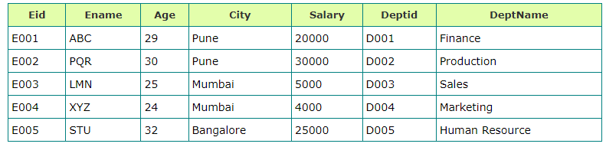
Example: <Employee_Department> Table
Decompose the above relation into two relations to check whether a decomposition is lossless or lossy.
Now, we have decomposed the relation that is Employee and Department.

Slide 73
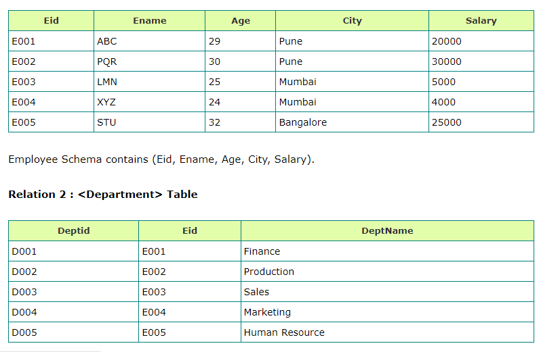

Slide 74
Department Schema contains (Deptid, Eid, DeptName).
So, the above decomposition is a Lossless Join Decomposition, because the two relations contains one common field that is 'Eid' and therefore join is possible.
Now apply natural join on the decomposed relations.

Slide 75
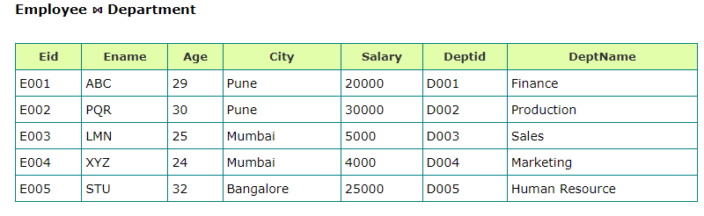
Hence, the decomposition is Loseless Join Decomposition
If the <Employee> table contains (Eid, Ename, Age, City, Salary) and <Department> table contains (Deptid and DeptName), then it is not possible to join the two tables or relations, because there is no common column between them. And it becomes Lossy Join Decomposition.

Slide 76
2. Dependency Preservation
Dependency is an important constraint on the database.
Every dependency must be satisfied by at least one decomposed table.
If {A->B} holds, then two sets are functional dependent. And, it becomes more useful for checking the dependency easily if both sets in a same relation.
This decomposition property can only be done by maintaining the functional dependency.
In this property, it allows to check the updates without computing the natural join of the database structure.

Slide 77
3. Lack of Data Redundancy
Lack of Data Redundancy is also known as a Repetition of Information.
The proper decomposition should not suffer from any data redundancy.
The careless decomposition may cause a problem with the data.
The lack of data redundancy property may be achieved by Normalization process.

