Slide 1
UNIT-5

Slide 2
TEST MANAGEMENT
People and organizational issues in testing – Organization structures for testing teams – testing services – Test Planning – Test Plan Components – Test Plan Attachments – Locating Test Items – test management – test process – Reporting Test Results – The role of three groups in Test Planning and Policy Development – Introducing the test specialist
– Skills needed by a test specialist – Building a Testing Group.

Slide 3
This chapter focuses on preparing the reader to address two fundamental maturity goals at level 2 of the TMM:
developing organizational goals/ policies relating to testing and debugging, and
test planning.
Testing is a managed process.
According to R. Thayer, a managed process is one that is planned, monitored, directed, staffed, and organized.

Slide 4
The test specialist has a key role in developing and implementing these managerial components.
Concepts and tools are introduced to build test management skills, thus supporting the reader in his/her development as a test specialist.
The development, documentation, and institutionalization of goals and related policies is important to an organization.
The goals/policies may be business-related, technical, or political in nature. They are the basis for decision making;
Therefore setting goals and policies requires the participation and support of upper management.

Slide 5
Examples
Business goal: to increase market share 10% in the next 2 years in the area of financial software.
Technical goal: to reduce defects by 2% per year over the next 3 years.
Business/technical goal: to reduce hotline calls by 5% over the next 2 years.
Political goal: to increase the number of women and minorities in high management positions by 15% in the next 3 years.

Slide 6
Organization structures for testing teams
A goal can be described as (i) a statement of intent, or (ii) a statement of a accomplishment that an individual or an organization wants to achieve.

Slide 7
At the top level are general organizational goals.
There are intermediate-level goals that may be associated with a particular organizational functional unit.
Individual projects have specific goals. These usually reflect organizational goals.
There are personal-level goals as well. Each individual in an organization has a set of goals for self-improvement so that he or she can more effectively contribute to the project, functional unit, and organization as a whole.

Slide 8
Goal statements can express expectations in quantitative terms .
Goals 1 and 2 express what is to be achieved in a more quantitative manner than goals 3 and 4.
One-hundred percent of testing activities are planned.
The degree of automation for regression testing is increased from 50% to 80% over the next 3 years.
Testing activities are performed by a dedicated testing group.
Testing group members have at least a bachelor-level degree and have taken a formal course in software testing.

Slide 9
Quantitative goals are more useful. These are measurable goals, and give an organization, group, or individual the means to evaluate progress toward achieving the goal.
Toward testing domain, goal statements should provide a vision - with respect to quality of process and product.

Slide 10
A policy can be defined as a high-level statement of principle or course of action that is used to govern a set of activities in an organization.
A policy provides the vision and framework for decision making.
A policy statement should be formulated by a team or task force consisting of upper management, executive personnel, and technical staff.
In the case of testing, a testing policy statement is used to guide the course of testing activities and test process evolution. It should be agreed upon as workable by all concerned.

Slide 11
Testing Policy : Organization X
1. Delivering software of the highest quality is our company goal. The presence of defects has a negative impact on software quality. Defects affect the correctness, reliability, and usability of a software product, thus rendering it unsatisfactory to the client.

Slide 12
2.A set of testing standards must be available to all interested parties on an intraorganization. The standards contain descriptions of all test-related documents, prescribed templates, and the methods, tools, and procedures to be used for testing.

Slide 13
3. In our organization the following apply to all software development/ maintenance projects:
Execution-based tests must be performed at several levels such as unit , integration, system, and acceptance tests as appropriate for each software product.
Systematic approaches to test design must be employed that include application of both white and black box testing methods.
Reviews of all major product deliverables such as requirements and design documents, code, and test plans are required.
Testing must be planned for all projects. Plans must be developed for all levels of execution based testing as well as for reviews of deliverables.

Slide 14
Testing activities must be monitored using measurements and milestones to ensure that they are proceeding according to plan.
Testing activities must be integrated into the software life cycle and carried out in parallel with other development activities. The extended modified V-model as shown in the testing standards document has been adopted to support this goal.
Defects uncovered during each test must be classified and recorded.
There must be a training program to ensure that the best testing practices are employed by the testing staff.

Slide 15
Because testing is an activity that requires special training and an impartial view of the software, it must be carried out by an independent testing group. Communication lines must be established to support cooperation between testers and developers to ensure that the software is reliable, safe, and meets client requirements.
Testing must be supported by tools, and, test- related measurements must be collected and used to evaluate and improve the testing process and the software product.
Resources must be provided.

Slide 16
Clients/developer/tester communication is important
A permanent committee consisting of managerial and technical staff must be appointed.

Slide 17
Debugging Policy : Organization X
Testing and debugging are two separate processes. Testing is the process used to detect (reveal) defects. Debugging is the process dedicated to locating the defects, repairing the code, and retesting the software.
Debugging is a timely activity, all project schedules must allow for adequate time to make repairs, and retest the repaired software.

Slide 18
Debugging tools, and the training necessary to use the tools.
Developers/testers and SQA staff must define and document a set of defect classes and defect severity levels.

Slide 19
All defects identified for each project must be cataloged according to class and severity level and stored as a part of the project history.
Measurement - total number of defects, total number of defects/ KLOC, and time to repair a defect are saved for each project.

Slide 20
Test planning
A plan is a document that provides a framework or approach for achieving a set of goals.
Test plans - very complex and detailed documents.

Slide 21
Plans can be strictly business oriented
Test plans tend to be more technically oriented.
Models such as the V-model, or the Extended/ Modified V-model , help to support test planning.

Slide 22
A plan describes
what specific tasks must be accomplished,
who is responsible for each task,
what tools, procedures, and techniques must be used,
how much time and effort is needed, and
what resources are essential.

Slide 23
A plan also contains milestones.
Milestones are tangible events that are expected to occur at a certain time in the project’s lifetime.
Managers use them to determine project status.

Slide 24
The planner usually includes the following essential high-level items.
Overall test objectives.
What to test (scope of the tests).
Who will test
How to test
When to test
When to stop testing

Slide 25
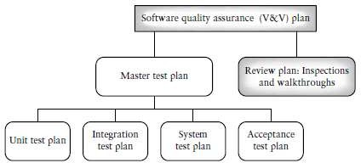
A hierarchy of plans that includes several levels of quality assurance and test plans.
The complexity of the hierarchy depends on the type, size, risk-proneness, and the mission/safety criticality of software.

Slide 26
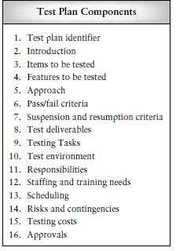
Test plan components

Slide 27
1 . Test Plan Identifier
Organizational standards should describe the format for the test plan identifier and how to specify versions.
2 . Introduction
In this section the test planner gives an overall description of the project, and the soft ware items and/or features to be tested.

Slide 28
. Items to Be Tested
procedures, classes, modules, libraries, subsystems, and systems
. Features to Be Tested
Features may be described as distinguishing characteristics of a software component or system.
- performance,reliability, portability, and functionality requirements
. Approach
Provides broad coverage of the issues to be addressed when testing the target software.
Testing activities are described.

Slide 29
. Item Pass/Fail Criteria
The tester must have a set of criteria to decide on whether the test has been passed or failed upon execution.
A failure occurs when the actual output produced by the software does not agree with what was expected, under the conditions specified by the test.
. Suspension and Resumption Criteria
Criteria to suspend and resume testing are described

Slide 30
8 . Test Deliverables
Deliverables - Test plan along with its associated test design specifications, test procedures, and test cases.
Deliverables may also include other documents that result from testing such as test logs, test transmittal reports, test incident reports, and a test summary report.

Slide 31
9 . Testing Tasks
A Work Breakdown Structure is a hierarchical or treelike representation of all the tasks that are required to complete a project.
10. The Testing Environment
- describes the software and hardware needs for the testing effort

Slide 32
11. Responsibilities
The staff who will be responsible for test-related tasks should be identified. This includes personnel who will be:
transmitting the software-under-test;
  developing test design specifications, and test cases;
  executing the tests and recording results;
  tracking and monitoring the test efforts;
checking results;
  interacting with developers;
  managing and providing equipment;
  developing the test harnesses;
  interacting with the users/customers.

Slide 33
Staffing and Training Needs - describe the staff and the skill levels needed
Scheduling - Task durations should be established and recorded
Risks and Contingencies - Risks should be: (i) identified, (ii) evaluated in terms of their probability of occurrence, (iii) prioritized, and
(iv) contingency plans should be developed
that can be activated if the risk occurs.

Slide 34
15. Testing Costs
Test costs that should included in the plan are:
costs of planning and designing the tests; costs of acquiring the hardware and software
necessary for the tests (includes development of
the test harnesses);
  costs to support the test environment;
  costs of executing the tests;
  costs of recording and analyzing test results;
  tear-down costs to restore the environment.

Slide 35
Test plan attachments
A test design specification should have the following components according to the IEEE standard .
Test Design Specification Identifier
Give each test design specification a unique identifier and a
reference to its associated test plan.
Features to Be Tested
Test items, features, and combination of features covered by this test design specification are listed.
Approach Refinements
In the test plan a general description of the approach to be used to test each item was described.

Slide 36
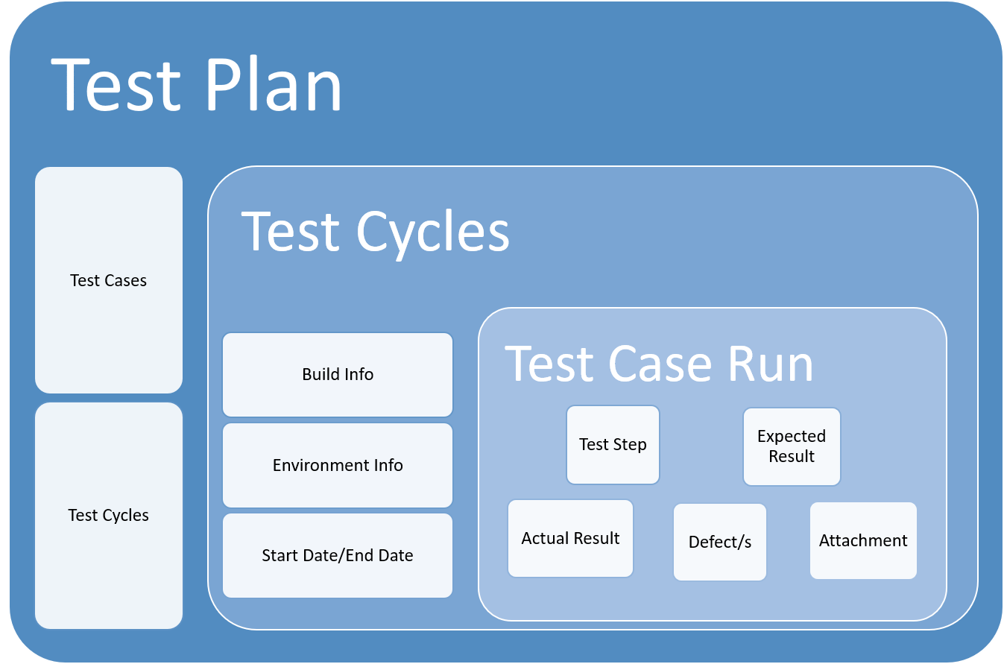

Slide 37
Test Case Identification
Each test design specification is associated with a set of test cases and a set of set procedures. The test cases contain input/output information, and the test procedures contain the steps necessary to execute the tests. A test case may be associated with more than one test design specification.
Pass/Fail Criteria
Criteria to be used for determining whether the item has passed/failed a test is given.

Slide 38
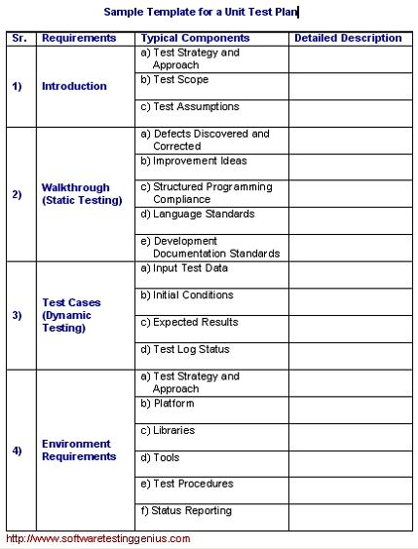

Slide 39
Test Case Specifications
This series of documents attached to the test plan defines the test cases required to execute the test items named in the associated test design specification.
Test Case Specification Identifier
Test Items
Input Specifications
Output Specifications
Special Environmental Needs
Special Procedural Requirements
Intercase Dependencies

Slide 40
Locating test items
Suppose a tester is ready to run tests on an item on the date described in the test plan. He needs to be able to locate the item and have knowledge of its current status.
version/revision number of the item;
location of the item;
persons responsible for the item (e.g., the developer); (iv)references to item documentation and the test plan it is
related to;
status of the item;
approvals—space for signatures of staff who approve the transmittal.

Slide 41
Reporting test results
Test Log
It is a diary of the events that take place during the test.
It gives the developer a snapshot of the events associated with a failure.

Slide 42
Test Log Identifier
Each test log should have a unique identifier.
Description
In the description section the tester should identify the items being tested, their version/revision number, and their associated Test Item/Transmittal Report.

Slide 43
Activity and Event Entries
Execution description: Provide a test procedure
Procedure results: For each execution, record the results and the location of the output. Also report pass/fail status.
Environmental information: Provide any environmental conditions specific to this test.

Slide 44
Anomalous events: Any events occurring before/after an unexpected event should be recorded. If a tester is unable to start or complete a test procedure, details relating to these happenings should be recorded (e.g., a power failure or operating system crash).
Incident report identifiers: Record the identifiers of incident reports generated while the test is being executed.

Slide 45
Test Incident Report
The tester should record in a test incident report (sometimes called a problem report) any event that occurs during the execution of the tests that is unexpected, unexplainable, and that requires a follow-up investigation.

Slide 46
Test Incident Report identifier: to uniquely identify.
Summary: to identify the test items involved, the test procedures, test cases, and test log associated with this report.
Incident description: this should describe time and date, testers, observers, environment, inputs, expected outputs, actual outputs, procedure step, environment, and attempts to repeat.
Impact: what impact will this incident have on the testing effort, the test plans, the test procedures, and the test cases? A severity rating should be inserted here.

Slide 47
Test Summary Report
This report is prepared when testing is complete. It is a summary of
the results of the testing efforts.
Test Summary Report identifier: to uniquely identify this report.
Variances: these are descriptions of any variances of the test items from their original design. Deviations and reasons for the deviation from the test plan, test procedures, and test designs are discussed.
Comprehensiveness assessment: the document author discusses the comprehensiveness of the test effort as compared to test objectives and test completeness criteria as described in the test plan. Any features or combination of features that were not as fully tested as was planned should be identified.

Slide 48
4. Summary of results: the document author summarizes the testing results. All resolved incidents and their solutions should be described. Unresolved incidents should be recorded.
Evaluation: in this section the author evaluates each test item based on test results. Did it pass/fail the tests? If it failed, what was the level of severity of the failure?
Summary of activities: all testing activities and events are summarized.
Resource consumption, actual task durations, and hardware and software tool usage should be recorded.
Approvals: the names of all persons who are needed to approve this document are listed with space for signatures and dates.

Slide 49
The role of three groups in test planning and policy development
managers,
developers/ testers, and
users/clients.

Slide 50
Developers:
Working with management to develop testing and debugging policies and goals.
Familiarizing themselves with the approved set of testing/debugging goals and policies, keeping up-to-date with revisions, and making suggestions for changes when appropriate.

Slide 51
Developing test plans, setting testing goals for each project at each level of test that reflect organizational testing goals and policies.
Carrying out testing activities that are in compliance with organizational policies.

Slide 52
Users and clients :play an indirect role in the formation of an organization‘s testing goals and polices since these goals and policies reflect the organizations efforts to ensure customer/client/user satisfaction.
Successful organizations are sensitive to customer/client/user needs.

Slide 53
Upper management:
Establishing an organizationwide test planning committee with funding.
Ensuring that the testing policy statement and quality standards support test planning with commitment of resources, tools, templates, and training.
Ensuring that the testing policy statement contains a formal mechanism for user input to the test planning process, especially for acceptance and usability testing.

Slide 54
Ensuring that all projects are in compliance with the test planning policy.
Ensuring that all developers/testers complete all the necessary posttest documents such as test logs and test incident reports.
Project managers support the test planning maturity goal by preparing the test plans for each

Slide 55
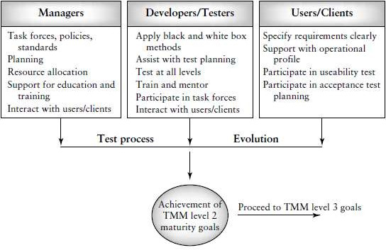

Slide 56
Introducing the test specialist
maintenance and application of test policies;
  development and application of test-related standards;
participating in requirements, design, and code reviews;
  test planning;
  test design;
  test execution;
  test measurement;
test monitoring (tasks, schedules, and costs);

Slide 57
defect tracking, and maintaining the defect repository;
  acquisition of test tools and equipment;
  identifying and applying new testing techniques, tools, and methodologies;
mentoring and training of new test personnel;
  test reporting.
The staff members of such a group are called test specialists or test engineers.

Slide 58
Skills needed by a test specialist
On the personal and managerial level a test specialist must have:
organizational, and planning skills;
  the ability to keep track of, and pay attention to, details;
  the determination to discover and solve problems;
the ability to work with others and be able to resolve conflicts;
  the ability to mentor and train others;
  the ability to work with users and clients;
  strong written and oral communication skills;
  the ability to work in a variety of environments;
the ability to think creatively

Slide 59
On the technical level testers need to have:
An education that includes an understanding of general software engineering principles, practices, and methodologies;
  strong coding skills and an understanding of code structure and behavior;
  a good understanding of testing principles and practices;
a good understanding of basic testing strategies, methods, and techniques;
  the ability and experience to plan, design, and execute test cases and test procedures on multiple levels (unit, integration, etc.);
  a knowledge of process issues;
  knowledge of how networks, databases, and operating systems are organized and how they work;

Slide 60
a knowledge of configuration management;
  a knowledge of test-related documents and the role each documents plays in the testing process;
  the ability to define, collect, and analyze test- related measurements;
  the ability, training, and motivation to work with testing tools and equipment;
a knowledge of quality issues.

Slide 61
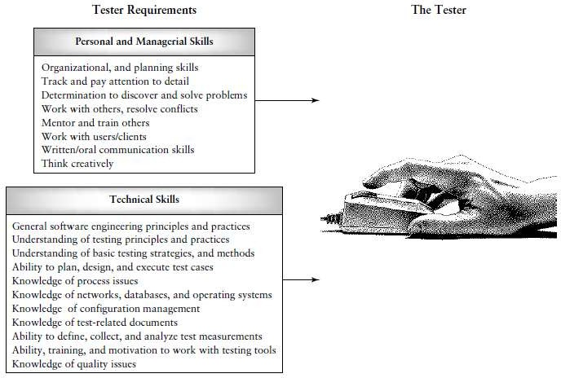

Slide 62
Building a testing group
organizing, staffing, and directing were major activities
Staffing activities include filling positions, assimilating new personnel, education and training, and staff evaluation.
Directing includes providing leadership, building teams, facilitating communication, motivating personnel, resolving conflicts, and delegating authority.
Organizing includes selecting organizational structures, creating positions, defining responsibilities, and delegating authority.

Slide 63
Establishing a specialized testing group is a major decision for an organization.
upper management - decision to establish a test group and commit resources to the group.
When hiring staff - educational and skill levels required for each testing position and develop formal job descriptions to fill the test group slots.
When the job description has been approved and distributed, the interviewing process takes place.

Slide 64
Interviews should be structured and of a problem-solving nature.
The interviewer should prepare an extensive list of questions to determine the interviewee‘s technical background as well as his or her personal skills and motivation.
Zawacki has developed a general guide for selecting technical staff members that can be used by test managers .
Dustin describes the kinds of questions that an interviewer should ask when selecting a test specialist.

Slide 65
When the team has been selected and is up and working on projects, the team manager is responsible for keeping the test team positions filled.
He must continually evaluate team member performance.
Bartol and Martin have written a paper that contains guidelines for evaluation of employees that can be applied to any type of team and organization .

Slide 66
They describe four categories for employees based on their performance:
retain,
likely to retain,
likely to release,
and release.
For each category, appropriate actions need to be taken by the manager to help employee and employer.

Slide 67
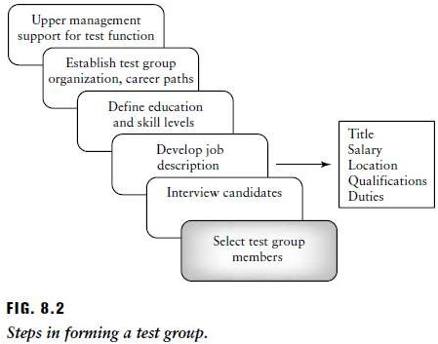

Slide 68
By investing in a test organization a company has access to a group of specialists who have the responsibilities and motivation to:
maintain testing policy statements;
  plan the testing efforts;
  monitor and track testing efforts so that they are on time and within budget;
  measure process and product attributes;
provide management with independent product and process quality information;
  design and execute tests with no duplication of effort;
  automate testing;
  participate in reviews to insure quality; are meet.

Slide 69
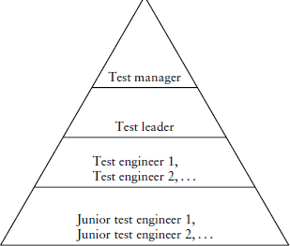
The duties of the team members

Slide 70
The duties of the team members
The Test Manager
In most organizations with a testing function, the test manager (or test director) is the central person concerned with all aspects of testing and quality issues.
The test manager is usually responsible for test policy making, customer interaction, test planning, test documentation, controlling and monitoring of tests, training, test tool acquisition, participation in inspections and walkthroughs, reviewing test work, the test repository, and staffing issues such as hiring, firing, and evaluation of the test team members.

Slide 71
The Test Lead
The test lead assists the test manager and works with a team of test engineers on individual projects.
He or she may be responsible for duties such as test planning, staff supervision, and status reporting.
The test lead also participates in test design, test execution and reporting, technical reviews, customer interaction, and tool training.

Slide 72
The Test Engineer
The test engineers design, develop, and execute tests, develop test harnesses, and set up test laboratories and environments.
They also give input to test planning and support maintenance of the test and defect repositories.

Slide 73
The Junior Test Engineer
The junior test engineers are usually new hires.
They gain experience by participating in test design, test execution, and test harness development.
They may also be asked to review user manuals and user help facilities defect and maintain the test and defect repositories.

