Slide 1
TEST AUTOMATION
UNIT-6

Slide 2
What is Automation Testing?
INTRODUCTION
Automation testing is a Software testing technique to test and compare the actual outcome with the expected outcome. This can be achieved by writing test scripts or using any automation testing tool. Test automation is used to automate repetitive tasks and other testing tasks which are difficult to perform manually.

Slide 3
Testing Tools not only helps us to perform regression tests but also helps us to automate data set up generation, product installation, GUI interaction, defect logging, etc. Automation tools are used for both Functional and Non-Functional testing.

Slide 4
What is Manual Testing?
Manual testing is the process of testing the software manually to find the defects. Tester should have the perspective of an end user and to ensure all the features are working as mentioned in the requirement document. In this process, testers execute the test cases and generate the reports manually without using any automation tools.
skills required: Manual testers should have a working knowledge of the application. But no coding knowledge is necessary
Types of Manual Testing:
Black Box Testing
White Box Testing
Unit Testing
System Testing
Integration Testing
Acceptance Testing

Slide 5
Manual testing is good for:
One-off and ad-hoc testing
Exploratory testing
Visual testing
Usability testing
Debugging

Slide 6
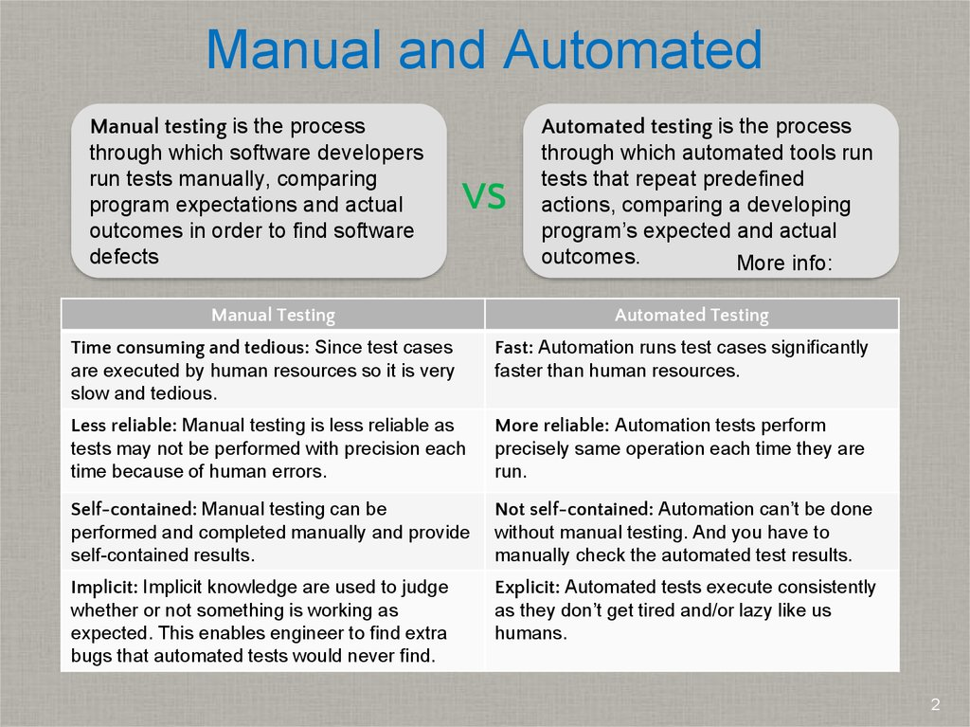

Slide 7
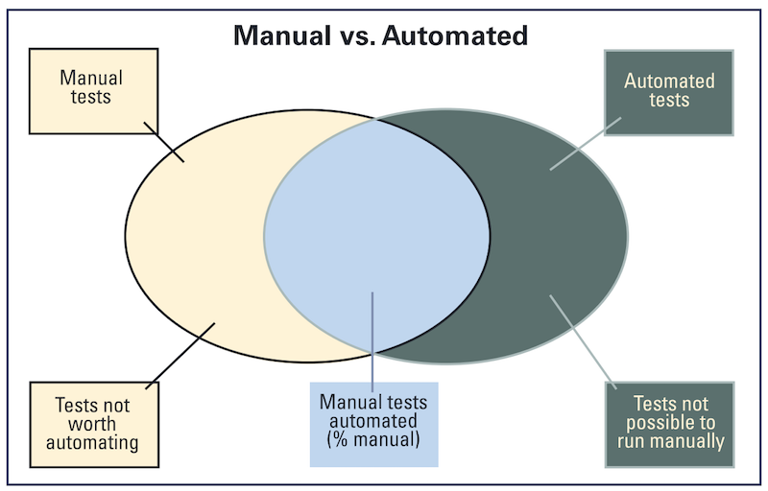

Slide 8
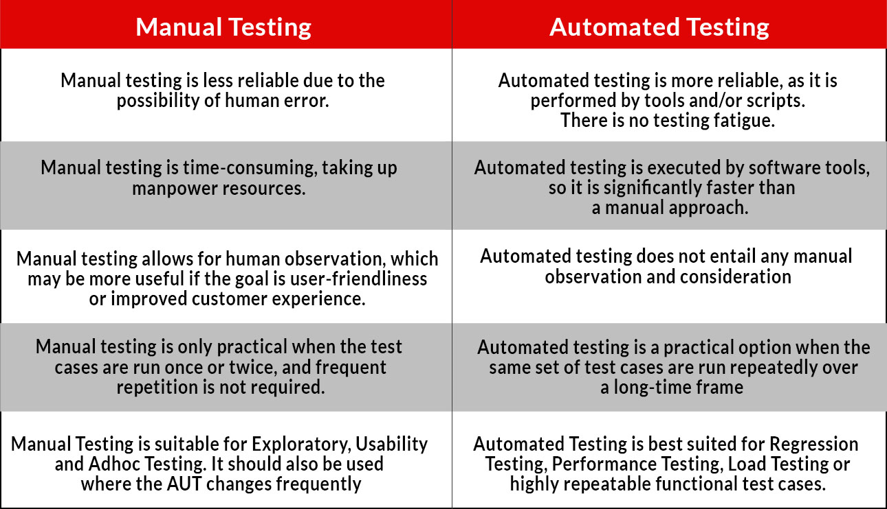

Slide 9
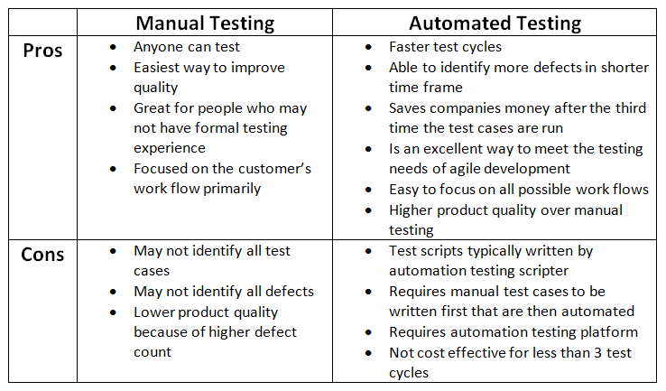

Slide 10
1.What skills are needed for Automated Testing
The skills required depends on what generation of automation the company is in.
1) Capture / playback and test harness tools (first generation).
2) Data driven tools (second generation).
3) Action driven (third generation).

Slide 11
The three generations upon which the skills depend are described below one by one
1) Capture / Playback and Test Harness Tools:
One of the most boring and time-consuming activity during testing life cycle is to rerun
manual tests number of times. Here, capture/playback tools are of great help to the testers.
These tools do this by recording and replaying the test input scripts. As a result, tests can be replayed without attendant for long hours specially during regression testing. Also these recorded test scripts can be edited as per need i.e., whenever changes are made to the software.

Slide 12
These tools can even capture human operations e.g., mouse activity, keystrokes etc. A capture / playback tool can be either intrusive or non-intrusive. Intrusive capture / playback tools are also called native tools as they along with software-under-test (SUT), reside on the same machine.

Slide 13
Non-intrusive capture / playback tools on the other hand, reside on the separate machine and is connected to the machine containing software to be tested using special hardware. One advantage of these tools is to capture errors which users frequently make and which developers cannot reproduce.
Test harness tools are the category of capture / playback tools used for capturing and replaying sequence of tests. These tools enable running large volume of tests unattended and help in generating reports by using comparators. These tools are very important at CMM level – 2 and above.

Slide 14
2) Data-driven Tools:
This method help in developing test scripts that generates the set of input conditions and corresponding expected output. The approach takes as much time and effort as the product. However, changes to application do not require the automated test cases to be changed as long as the input conditions and expected output are still valid. This generation of automation focuses on input and output conditions using the black box testing approach.

Slide 15
3) Action-driven Tools:
This technique enables a layman to create automated tests. There are no input and expected output conditions required for running the tests. All actions that appear on the application are automatically tested, based on a generic set of controls defined for automation.
From the above approaches / generations of automation, it is clear that different levels of skills are needed based on the generation of automation selected.

Slide 16
Scope of Automation in Testing
Automation is the process of evaluating the AUT(Application under Test) against the specification with the help of a tool. In this article we are gong to discuss the Scope of automation in testing.
Depending on the nature of testing there are two main branches under automation.
1.Functional testing with automation.
2.Performance testing with automation.

Slide 17
1.Functional Testing with the help of Automation:
Functional automated testing has emerged as a key area in most of the testing processes. The main area where the functional testing tools are used is for regression test case execution.
Mostly in the agile scrum methodology where frequent releases are happening, it is almost impossible to execute all the regression test cases manually with the short span of time

Slide 18
Automation gives a high ROI(Return of Investment) in this area since it is a one time effort for generating the scripts.
Maintenance to the existing scripts will be considerably less if the automation follows a good framework which exactly suits the nature of application.
It is advisable to keep at least 60 to 70 % of regression cases to be automated for being adherent to the timelines of test case execution.
Automating test cases is not desirable if it is a onetime testing.

Slide 19
2.Performance Testing with the help of Automation:
Performance testing is the process of evaluating the application performance which is being a critical requirement of every application now a days. Performance testing is almost impossible by manual means.
There are different tools used across organizations for evaluating application performance. There are different divisions under performance testing based on the nature of testing.

Slide 20
Load and Stress testing:
Load testing is performed to confirm that application can withstand the maximum load which is mentioned in the SRS.
Here the application will be tested with the specified load without overloading the application. But in stress testing, here the intention is to find out the maximum load the application can accommodate.
Application will be tested with more load than the specified limit in order to find out the break point

Slide 21
load and stress testing, large number of concurrent users is needed and multiple computers are required.
In manual testing it is difficult and almost impossible to run the severe load for several days to identify problems in the application.
While using automation the testing software (tool) monitors the CPU and memory usage of each test computer.
The tool generates artificial loads by creating virtual users and which will produce a guaranteed test accuracy. The tools can generate number of virtual users on a single computer.
Automation help us to find out defects as we can run the test using multiple users, multiple environments on several days.

Slide 22
Automation is an effective means of eliminating/reducing manual effort during regression and functional test case execution.
Also the chances of defect escape will be reduced considerably , since human mistakes will not occur once the script is fully developed.
Hence the automation is more economical considering the fact of time and quality.

Slide 23
Define the scope of Automation
The scope of automation is the area of your Application Under Test which will be automated. Following points help determine scope:
The features that are important for the business
Scenarios which have a large amount of data
Common functionalities across applications
Technical feasibility
The extent to which business components are reused
The complexity of test cases
Ability to use the same test cases for cross-browser testing

Slide 24
Benefits of Automation Testing
Reduces Repetitive Tasks
Increases Coverage
Test Automation helps in Performance Testing
Automation Testing equals Reusability

Slide 25
Benefits of Automation Testing
Fast: Runs tests significantly faster than human users.
Repeatable: Testers can test how the website or software reacts after repeated execution of the same operation.
Reusable: Tests can be re-used on different versions of the software.
Reliable: Tests perform precisely the same operation each time they are run thereby eliminating human error.
Comprehensive: Testers can build test suites of tests that covers every feature in software software application.
Programmable: Testers can program sophisticated tests that bring hidden information.

Slide 26
Planning, Design, and Development
During this phase, you create an Automation strategy & plan, which contains the following details-
Automation tools selected
Framework design and its features
In-Scope and Out-of-scope items of automation
Automation testbed preparation
Schedule and Timeline of scripting and execution
Deliverables of Automation Testing

Slide 27
Test Execution
Automation Scripts are executed during this phase. The scripts need input test data before there are set to run. Once executed they provide detailed test reports.
Execution can be performed using the automation tool directly or through the Test Management tool which will invoke the automation tool.
Example: Quality center is the Test Management tool which in turn it will invoke QTP for execution of automation scripts. Scripts can be executed in a single machine or a group of machines. The execution can be done during the night, to save time.

Slide 28
Maintenance
As new functionalities are added to the System Under Test with successive cycles, Automation Scripts need to be added, reviewed and maintained for each release cycle.
Maintenance becomes necessary to improve the effectiveness of Automation Scripts.

Slide 29
Design and Architecture for Automation
Automation Frameworks
What Is an Automation Framework?
An automation framework is a platform developed by integrating various hardware and software resources and various tools and services based on a qualified set of set of assumptions.
It enables efficient design and development of automated test scripts and reliable analysis of issues for the system under test.

Slide 30
Framework for Automation
A framework is set of automation guidelines which help in
Maintaining consistency of Testing
Improves test structuring
Minimum usage of code
Less Maintenance of code
Improve re-usability
Non Technical testers can be involved in code
The training period of using the tool can be reduced
Involves Data wherever appropriate

Slide 31
What Is the Purpose of an Automation Framework?
An automation framework is primarily designed to do the following:
Enhance efficiency during the design and development of automated test scripts by enabling the reuse of components or code
Provide a structured development methodology to ensure uniformity of design across multiple test scripts to reduce dependency on individual test-case developers
Provide reliable issue detection and efficient root-cause analysis with minimum human intervention for the system under test.

Slide 32
Reduce dependence on subject matter experts by automatically selecting the test to execute according to test scenarios and dynamically refining the test scope according to changes in the test strategy or conditions of the system under test
Improve the utilization of various resources in each cycle to enable maximum returns on effort and also ensure an uninterrupted automated testing process with minimum human intervention

Slide 33
The Automation Framework Design Challenge: Balance Quality, Time, and Resources
The challenge is to build a fit-for-purpose automation framework that is capable of keeping up with quickly changing automation testing technologies and changes in the system under test.
The challenge is accentuated by the various combinations that are possible using the wide gamut of available automation tools.
Making the right choices in the preliminary design stage is the most critical step of the process, since this can be the differentiator between a successful framework and failed investment.

Slide 34
Therefore, it is very important to benchmark the framework, the associated development time, and the required resources to ensure the framework's quality justifies the use of the framework.
There are four types of frameworks used in automation software testing:
1.Data Driven Automation Framework
2.Keyword Driven Automation Framework
3.Modular Automation Framework
4.Hybrid Automation Framework

Slide 35
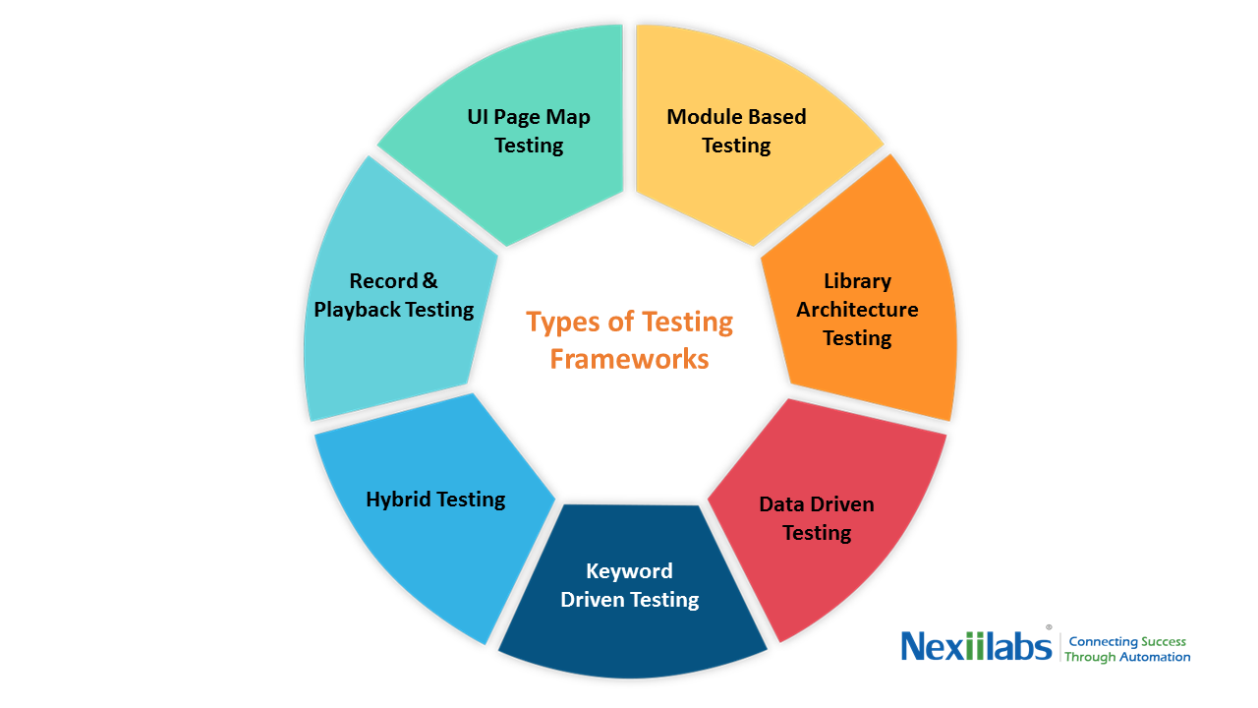

Slide 36
The Data-Driven Testing Framework.
In this Framework , while Test Case logic resides in Test Scripts, the Test Data is separated and kept outside the Test Scripts. Test Data is read from the external files (Excel Files, Text Files, CSV Files, ODBC Sources, DAO Objects, ADO Objects) and are loaded into the variables inside the Test Script. Variables are used both for Input values and for Verification values. Test Scripts themselves are prepared either using Linear Scripting or Test Library Framework.
Ex: Developing the Flight Reservation Login script using this method will involve two steps.

Slide 37
Step 1:Create a Test - Data file which could be Excel , CSV , or any other database source.
AgentName | Password
Jimmy | Mercury
Tina | MERCURY
Bill | MerCURY
Step 2:Develop Test Script and make references to your Test- Data source.
SystemUtil.Run "flight4a.exe","","","open" Dialog("Login").WinEdit("Agent Name:").Set DataTable("AgentName", dtGlobalSheet) Dialog("Login").WinEdit("Password:").Set DataTable("Password", dtGlobalSheet) Dialog("Login").WinButton("OK").Click 'Check Flight Reservation Window has loaded Window("Flight Reservation").Check CheckPoint("Flight Reservation") **Note "dtGlobalSheet" is the default excel sheet provided by QTP.

Slide 38
2.The Keyword-Driven or Table-Driven Testing Framework.
The Keyword-Driven or Table-Driven framework requires the development of data tables and keywords, independent of the test automation tool used to execute them . Tests can be designed with or without the Application. In a keyword-driven test, the functionality of the application-under-test is documented in a table as well as in step-by-step instructions for each test.
There are 3 basic components of a Keyword Driven Framework viz. Keyword , Application Map , Component Function.

Slide 39
What is a Keyword ?
Keyword is an Action that can be performed on a GUI Component. Ex . For GUI Component Textbox some Keywords ( Action) would be InputText, VerifyValue, VerifyProperty and so on.
What is the Application Map?
An Application Map Provides Named References for GUI Components. Application Maps are nothing but "Object Repositry“
What is Component Function?
Component Functions are those functions that actively manipulate or interrogate the GUI component. An example of a function would be click on web button with all error handling , enter data in a Web Edit with all error handling. Component functions could be application dependent or independent.

Slide 40
Ex: To understand Keyword View lets take the same example. It invovles 2 steps
Step 1: Creating Data Table (Different from Test-Data Table created in Data Driven Framework). This Data Table contains Action to be performed on GUI Objects and corresponding arguments if any. Each row respresents one Test Step.

