Slide 1
Data Warehousing and Online Analytical Processing

Slide 2
Introduction
Data warehouses(DWs) generalize and consolidate data in multidimensional space.
The construction of DWs involves data cleaning, data integration, and data transformation, and can be viewed as an important preprocessing step for data mining.
DWs provide online analytical processing (OLAP) tools for the interactive analysis of multidimensional data of varied granularities.
DM functionalities can be integrated with OLAP operations to enhance interactive mining of knowledge at multiple levels of abstraction.
Therefore, data warehousing and OLAP form an essential step in the knowledge discovery process
Notes:
In this chapter, we study
- a well-accepted definition of the Data warehouse
- why more and more organizations are building data warehouses for the analysis of their data (Section 4.1).
- We study the data cube, a multidimensional data model for data warehouses and OLAP, as well as OLAP operations such as roll-up, drilldown, slicing, and dicing (Section 4.2).
- We also look at data warehouse design and usage (Section 4.3).
-We discuss multidimensional data mining, a powerful paradigm that integrates data warehouse and OLAP technology with that of data mining. An overview of data warehouse implementation examines general strategies for efﬁcient data cube computation, OLAP data indexing, and OLAP query processing (Section 4.4).
- Finally, we study data generalization by attribute-oriented induction (Section 4.5). This method uses concept hierarchies to generalize data to multiple levels of abstraction.

Slide 3
Data Warehouse: Basic Concepts
Definition of the DW
Diff b/w Operational DB vs DW
Need for using DWs for Data analysis,
DW architecture: Multitired
Three DW models (Enterprise, Data Mart, Virtual)
Backend utilities for DW (extraction, transformation, loading)
Metadata repository
Data warehousing provides architectures and tools for business executives to systematically organize, understand, and use their data to make strategic decisions.
A data warehouse refers to a data repository that is maintained separately from an organization’s operational databases.
“A data warehouse is a subject-oriented, integrated, time-variant, and nonvolatile collection of data in support of management’s decision making process” - William H. Inmon (Architect of DWs)
The four keywords—subject-oriented, integrated, time-variant, and nonvolatile—distinguish DWs from other data repository systems.

Slide 4
Key Features
Subject-oriented:
  A DW is organized around major subjects such as customer, supplier, product, and sales.
  Rather than concentrating on the day-to-day operations and transaction processing of an organization, a DW focuses on the modeling and analysis of data for decision makers.
Integrated:
  A DW is usually constructed by integrating multiple heterogeneous sources.
  Data cleaning and data integration techniques are applied to ensure consistency in naming conventions, encoding structures, attribute measures, and so on.

Slide 5
Key Features
Time-variant:
  Data are stored to provide information from an historic perspective (e.g., the past 5–10 years).
  Every key structure in the data warehouse contains, either implicitly or explicitly, a time element.
Nonvolatile:
  A DW is always a physically separate store of data transformed from the application data found in the operational environment.
  Due to this separation, a data warehouse does not require transaction processing, recovery, and concurrency control mechanisms.
  It usually requires only two operations in data accessing:
    initial loading of data
    access of data.

Slide 6
A DW is also often viewed as an architecture, constructed by integrating data from multiple heterogeneous sources to support structured and/or ad hoc queries, analytical reporting, and decision making.
This allows “knowledge workers” (e.g., managers, analysts, and executives) to use the warehouse to quickly and conveniently obtain an overview of the data, and to make sound decisions based on information in the warehouse.

Slide 7
How are organizations using the information from data warehouses?
Many organizations use information to support business decision-making activities, including
Increasing customer focus, which includes the analysis of customer buying patterns (such as buying preference, buying time, budget cycles, and appetites for spending);
Repositioning products and managing product portfolios by comparing the performance of sales by quarter, by year, and by geographic regions in order to ﬁne-tune production strategies;
Analyzing operations and looking for sources of proﬁt;
Managing customer relationships, making environmental corrections, and managing the cost of corporate assets.

Slide 8
Heterogeneous Database Integration
It is highly desirable, yet challenging, to integrate such data and provide easy and efﬁcient access to it.
Query-driven approach:
The traditional database approach to heterogeneous database integration is to build wrappers and integrators (or mediators) on top of multiple, heterogeneous databases.
When a query is posed to a client site, a metadata dictionary is used to translate the query into queries appropriate for the individual heterogeneous sites involved.
These queries are then mapped and sent to local query processors.
The results returned from the different sites are integrated into a global answer set.
Dis Adv
  This query-driven approach requires complex information ﬁltering and integration processes, and competes with local sites for processing resources.
  It is inefﬁcient and potentially expensive for frequent queries, especially queries requiring aggregations.

Slide 9
Heterogeneous Database Integration
Update Driven Approach
Data warehousing employs an update driven approach in which information from multiple, heterogeneous sources is integrated in advance and stored in a warehouse for direct querying and analysis.
A data warehouse brings high performance to the integrated heterogeneous database system because data are copied, preprocessed, integrated, annotated, summarized, and restructured into one semantic data store.
Query processing in data warehouses does not interfere with the processing at local sources.
Data warehouses can store and integrate historic information and support complex multidimensional queries

Slide 10
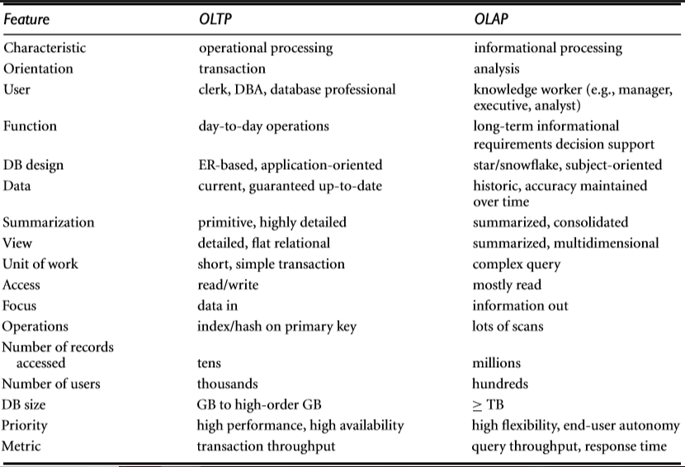
Differences between Operational Database Systems and Data Warehouses

Slide 11
Need for using DWs for Data analysis
“Why not perform OLAP directly on such operational databases instead of spending additional time and resources to construct a separate data warehouse?”
To help promote the high performance of both systems.

Slide 12
Need for using DWs for Data analysis
Operational Databases
Data Warehouse
Designed and tuned from known tasks and workloads like indexing and hashing using primary keys, searching for particular records, and optimizing “canned” queries.
Processing OLAP queries in operational databases would substantially degrade the performance of operational tasks.
Involve the computation of large data groups at summarized levels, and may require the use of special data organization, access, and implementation methods based on multi dimensional views.

Slide 13
Need for using DWs for Data analysis
Operational Databases
Data Warehouse
Supports the concurrent processing of multiple transactions. Concurrency control and recovery mechanisms (e.g., locking and logging) are required to ensure the consistency and robustness of transactions.
Do not typically maintain historic data
Operational databases contain only detailed raw data, such as transactions, which need to be consolidated before analysis.
An OLAP query often needs read-only access of data records for summarization and aggregation.
Decision support requires historic data
Decision support requires consolidation (e.g., aggregation and summarization) of data from heterogeneous sources, resulting in high-quality, clean, integrated data.

Slide 14
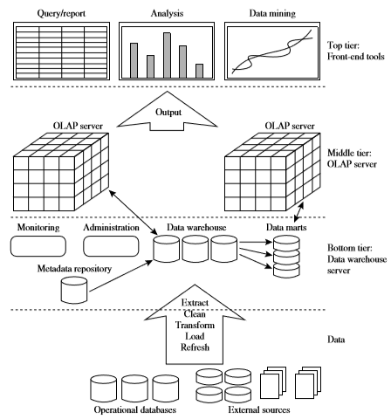
Data Warehousing: A Multitiered (three-tier) Architecture

Slide 15
Three-tier Architecture
Bottom-Tier: is a warehouse database server that is almost always a relational database system.
Back-end tools and utilities are used to feed data into the bottom tier from operational databases or other external sources.
These tools and utilities perform data extraction, cleaning, and transformation, as well as load and refresh functions to update the data warehouse.
The data are extracted using application program interfaces known as gateways.
Examples of gateways include
  ODBC (Open Database Connection)
  OLEDB (Object Linking and Embedding Database) by Microsoft
  JDBC (Java Database Connection)
It also contains a metadata repository, which stores information about the data warehouse and its contents.

Slide 16
Three-tier Architecture
Middle-tier: is an OLAP server that is typically implemented using either
  Relational OLAP(ROLAP) model: an extended relational DBMS that maps operations on multidimensional data to standard relational operations
  Multidimensional OLAP (MOLAP) model: a special-purpose server that directly implements multidimensional data and operations
Top-tier: is a front-end client layer, which contains query and reporting tools, analysis tools, and/or data mining tools (e.g., trend analysis, prediction, and so on).

Slide 17
Data Warehouse Models
From the architecture point of view, there are three data warehouse models:
Enterprise warehouse
Data mart
Virtual warehouse

Slide 18
Enterprise Warehouse
Collects all of the information about subjects spanning the entire organization.
Provides corporate-wide data integration, usually from one or more operational systems or external information providers, and is cross-functional in scope.
Contains detailed data as well as summarized data, and can range in size from a few gigabytes to hundreds of gigabytes, terabytes, or beyond.
May be implemented on traditional mainframes, computer super servers, or parallel architecture platforms.
Requires extensive business modeling and may take years to design and build.

Slide 19
Datamart
Contains a subset of corporate-wide data that is of value to a speciﬁc group of users. Scope is conﬁned to speciﬁc selected subjects.
Ex: a marketing data mart may conﬁne its subjects to customer, item, and sales. The data contained in data marts tend to be summarized.
Implemented on low-cost departmental servers that are Unix/Linux or Windows based.
The implementation cycle of a data mart is more likely to be measured in weeks rather than months or years.
Independent data marts are sourced from data captured from one or more operational systems or external information providers, or from data generated locally within a particular department or geographic area.
Dependent data marts are sourced directly from enterprise data warehouses.

Slide 20
Virtual Warehouse
A virtual warehouse is a set of views over operational databases.
For efﬁcient query processing, only some of the possible summary views may be materialized.
A virtual warehouse is easy to build but requires excess capacity on operational database servers.

Slide 21
Data Warehouse Development Approaches
Top-down development of an enterprise warehouse serves as a systematic solution and minimizes integration problems.
It is expensive, takes a long time to develop, and lacks ﬂexibility due to the difﬁculty in achieving consistency and consensus for a common data model for the entire organization.
Bottomup approach to the design, development, and deployment of independent data marts provides ﬂexibility, low cost, and rapid return of investment.
Problems when integrating various disparate data marts into a consistent enterprise data warehouse.

Slide 22
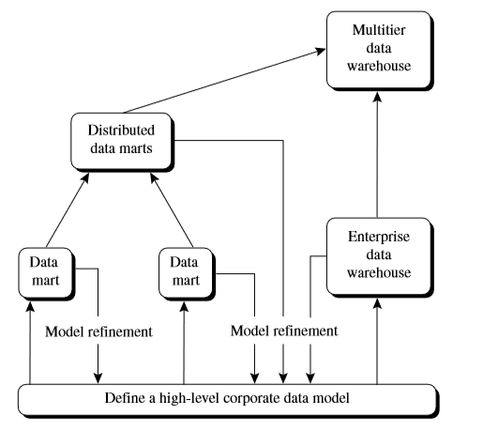
DW Development - Recommended
To implement the warehouse in an incremental and evolutionary manner
First, a high-level corporate data model is deﬁned within a reasonably short period, that provides a corporate-wide, consistent, integrated view of data among different subjects and potential usages.
Second, independent data marts can be implemented in parallel with the enterprise warehouse based on the same corporate data model set noted before.
Third, distributed data marts can be constructed to integrate different data marts via hub servers
Finally, a multi-tier data warehouse is constructed where the enterprise warehouse is the sole custodian of all warehouse data, which is then distributed to the various dependent data marts.

Slide 23
Data Warehouse Back-End tools and Utilities
Data extraction: which typically gathers data from multiple, heterogeneous, and external sources.
Data cleaning: which detects errors in the data and rectiﬁes them when possible.
Data transformation: which converts data from legacy or host format to warehouse format.
Load: which sorts, summarizes, consolidates, computes views, checks integrity, and builds indices and partitions.
Refresh: which propagates the updates from the data sources to the warehouse.
Metadata deﬁnition tools, data warehouse systems usually provide a good set of data warehouse management tools

Slide 24
Metadata Repository
Description of the DW Structure which includes the warehouse schema, view, dimensions, hierarchies, and derived data deﬁnitions, as well as data mart locations and contents.
Operational metadata which include
  Data lineage (history of migrated data and the sequence of transformations applied to it)
  Currency of data (active, archived, or purged)
  Monitoring information (warehouse usage statistics, error reports, and audit trails).
Algorithms used for summarization which include measure and dimension deﬁnition algorithms, data on granularity, partitions, subject areas, aggregation, summarization, and predeﬁned queries and reports.

Slide 25
Metadata Repository
Mapping from the operational environment to the data warehouse which includes source databases and their contents, gateway descriptions, data partitions, data extraction, cleaning, transformation rules and defaults, data refresh and purging rules, and security (user authorization and access control).
Data related to system performance which include indices and proﬁles that improve data access and retrieval performance, in addition to rules for the timing and scheduling of refresh, update, and replication cycles.
Business metadata which include business terms and deﬁnitions, data ownership information, and charging policies.

Slide 26
MULTIDIMENSIONAL DATA MODEL: Data Cube and OLAP
Data warehouses and OLAP tools are based on a multidimensional data model. This model views data in the form of a data cube.
A data cube allows data to be modeled and viewed in multiple dimensions and facts.
Ex: Sales datacube is deﬁned by dimensions(time, item, branch, location)
Facts are numerical measures. Ex. of facts for a sales DW include dollars sold (sales amount in dollars), units sold (number of units sold), and amount budgeted.
The fact table contains the names of the facts, or measures, as well as keys to each of the related dimension tables.

Slide 27
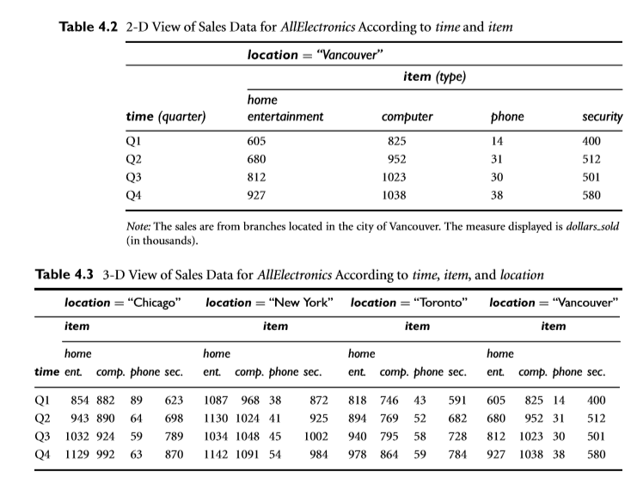
MULTIDIMENSIONAL DATA MODEL

Slide 28
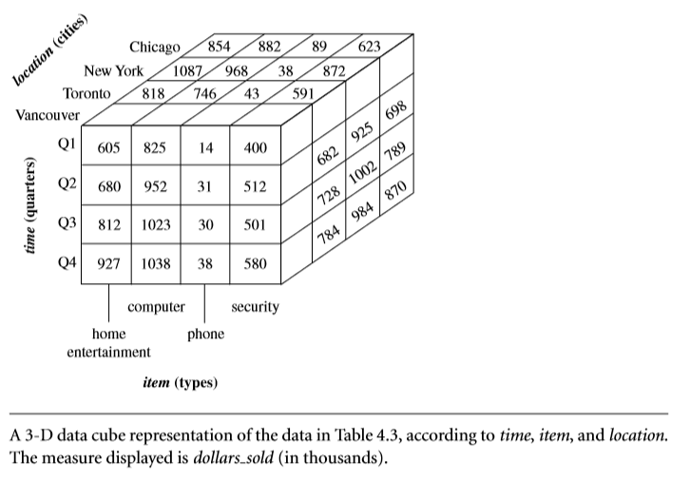
MULTIDIMENSIONAL DATA MODEL

Slide 29
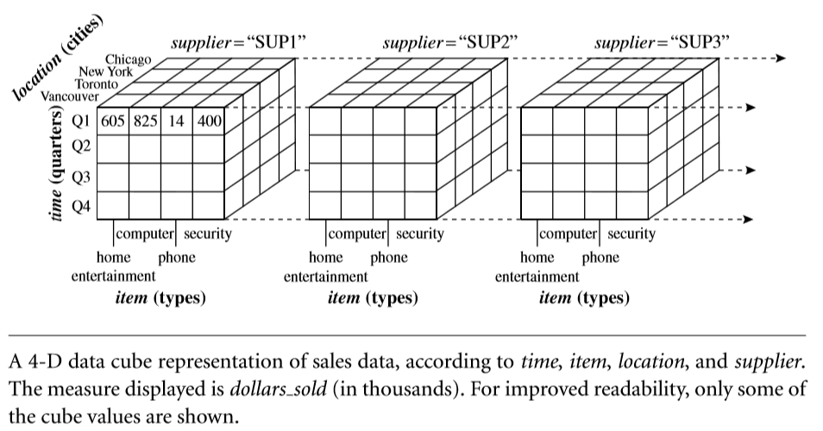
MULTIDIMENSIONAL DATA MODEL

Slide 30
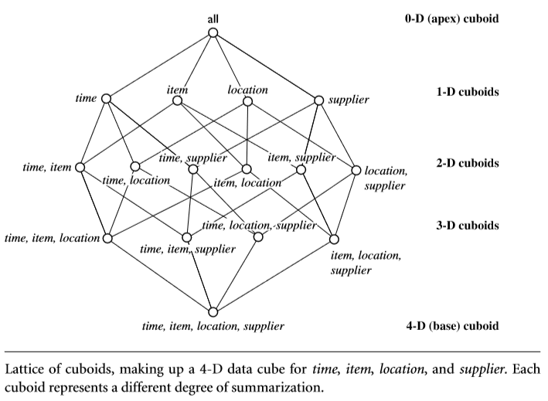
MULTIDIMENSIONAL DATA MODEL

Slide 31
Schemas for Multidimensional Data Models
The E-R data model is commonly used in the design of relational databases, where a database schema consists of a set of entities and the relationships between them.
Such a data model is appropriate for online transaction processing.
A data warehouse, however, requires a concise, subject-oriented schema that facilitates online data analysis.
Most popular data model for a data warehouse is a multidimensional model, which can exist in the form of
  a star schema
  a snowﬂake schema
  a fact constellation schema

Slide 32
Star Schema
The data warehouse contains
(1) A large central table (fact table) containing the bulk of the data, with no redundancy
(2) A set of smaller attendant tables (dimension tables), one for each dimension.
The schema graph resembles a starburst, with the dimension tables displayed in a radial pattern around the central fact table.

Slide 33
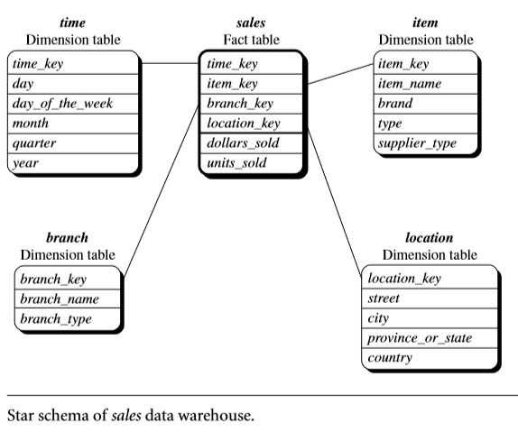
Star Schema
Each dimension is represented by only one table, and each table contains a set of attributes.
The attributes with in a dimension table may form either a hierarchy (total order) or a lattice (partial order)

Slide 34
Snowﬂake Schema
The snowﬂake schema is a variant of the star schema model.
Some dimension tables are normalized to reduce the redundancies, thereby further splitting the data into additional tables.
The resulting schema graph forms a shape similar to a snowﬂake.
Such a table is easy to maintain and saves storage space.
Reduce the effectiveness of browsing, since more joins will be needed to execute a query.
Consequently, the system performance may be adversely impacted.

Slide 35
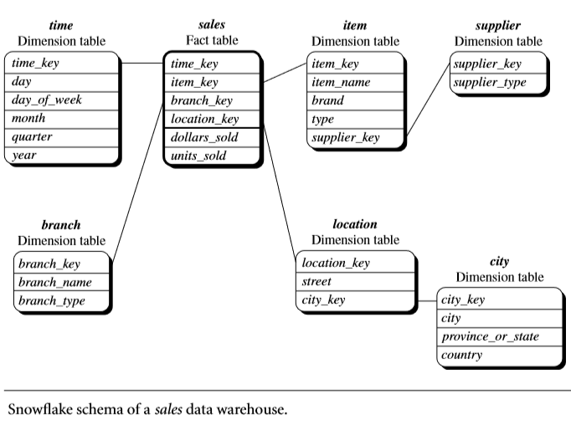
Snowﬂake Schema

Slide 36
Fact Constellation
Sophisticated applications may require multiple fact tables to share dimension tables.
This kind of schema can be viewed as a collection of stars, and hence is called a galaxy schema or a fact constellation.

Slide 37
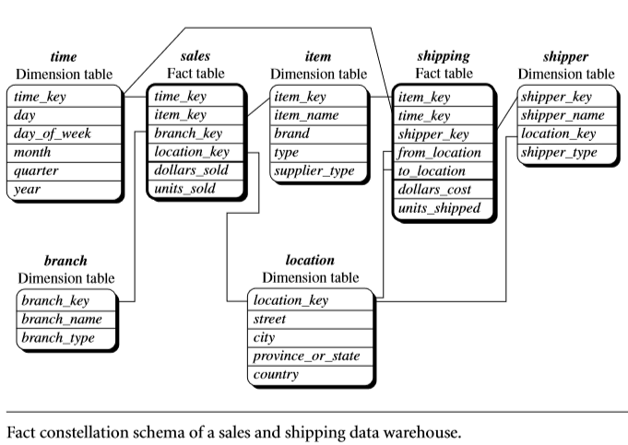
Fact Constellation

Slide 38
Dimensions: The Role of Concept Hierarchies
A concept hierarchy deﬁnes a sequence of mappings from a set of low-level concepts to higher-level, more general concepts.
Ex: concept hierarchy for the dimension location.
Each city can be mapped to the province or state to which it belongs.
The provinces and states can in turn be mapped to the country.
Concept hierarchy for the dimension location, mapping a set of low-level concepts (i.e.,cities) to higher-level, more general concepts (i.e., countries).

Slide 39
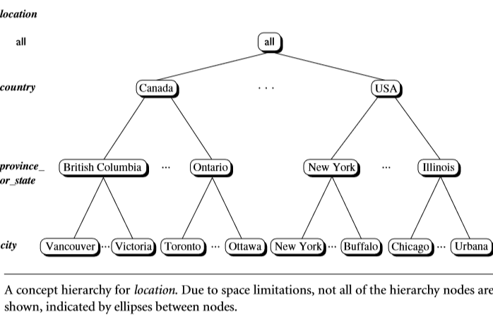
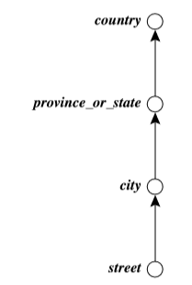
Dimensions: The Role of Concept Hierarchies
Total order concept hierarchy location “street < city < province or state < country.”

Slide 40
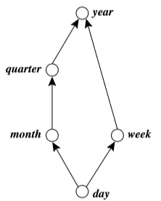
Dimensions: The Role of Concept Hierarchies
Partial order concept hierarchy time based on the attributes day, week, month, quarter, and year
“day < {month < quarter; week} < year”
A concept hierarchy that is a total or partial order among attributes in a database schema is called a schema hierarchy

Slide 41
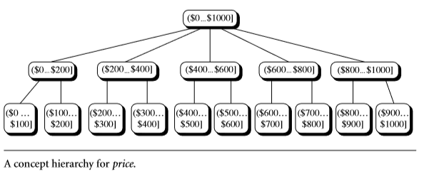
Dimensions: The Role of Concept Hierarchies
Concept hierarchies may also be deﬁned by discretizing or grouping values for a given dimension, resulting in a set-grouping hierarchy
A total or partial order can be deﬁned among groups of values.
An interval ($X...$Y] denotes the range from $X (exclusive) to $Y (inclusive).

Slide 42
Measures: Their Categorization and Computation
A multidimensional point in the data cube space can be deﬁned by a set of dimension–value pairs.
<time =“Q1”, location=“Vancouver”, item=“computer”>
A data cube measure is a numeric function that can be evaluated at each point in the data cube space
A measure value is computed for a given point by aggregating the data corresponding to the respective dimension–value pairs deﬁning the given point.
Measures can be organized into three categories—distributive, algebraic, and holistic—based on the kind of aggregate functions used.

Slide 43
Distributive Measure:
An aggregate function is distributive if it can be computed in a distributed manner as follows
The data are partitioned into n sets. We apply the function to each partition, resulting in n aggregate values.
If the result derived by applying the function to the n aggregate values is the same as that derived by applying the function to the entire data set (without partitioning), the function can be computed in a distributed manner.
Sum(), count(), min(), and max() are distributive aggregate functions

Slide 44
Algebraic Measure:
An aggregate function is algebraic if it can be computed by an algebraic function with M arguments (where M is a bounded positive integer), each of which is obtained by applying a distributive aggregate function.
Ex: avg() can be computed by sum()/count(), where both sum() and count() are distributive aggregate functions.
Similarly, it can be shown that min N() and max N() (which ﬁnd the N minimum and N maximum values, respectively, in a given set) and standard deviation() are algebraic aggregate functions.

Slide 45
Holistic Measures:
An aggregate function is holistic if there is no constant bound on the storage size needed to describe a sub aggregate.
Common examples of holistic functions include median(), mode(), and rank().

Slide 46
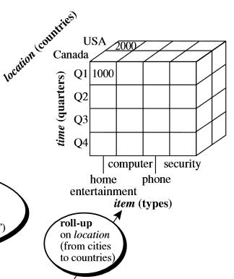
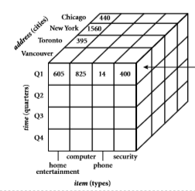
Typical OLAP Operations
Roll-up (Drill-up): The roll-up operation performs aggregation on a data cube, either by climbing up a concept hierarchy for a dimension or by dimension reduction.
The hierarchy was deﬁned as the total order
“street < city < province or state < country.”
The roll-up operation shown aggregates the data by ascending the location hierarchy from the level of city to the level of country.

Slide 47
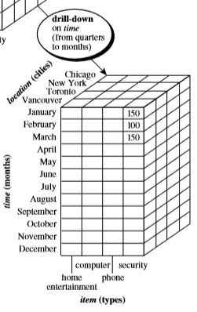
Typical OLAP Operations
Drill-down: It navigates from less detailed data to more detailed data.
Drill-down can be realized by either stepping down a concept hierarchy for a dimension or introducing additional dimensions.
Concept hierarchy for time deﬁned as
“day < month < quarter < year”
Drill-down occurs by descending the time hierarchy from the level of quarter to the more detailed level of month.

Slide 48
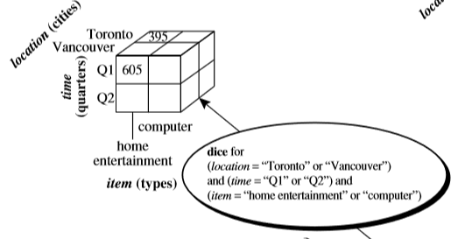
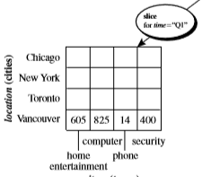
Typical OLAP Operations
Slice and Dice:
The slice operation performs a selection on one dimension of the given cube, resulting in a subcube.
Ex: the sales data are selected from the central cube for the dimension time using the criterion time=“Q1.”
The dice operation deﬁnes a subcube by performing a selection on two or more dimensions.
Ex: Involve three dimensions: (location=“Toronto” or “Vancouver”) and (time=“Q1” or “Q2”) and (item=“home entertainment” or “computer”).

Slide 49
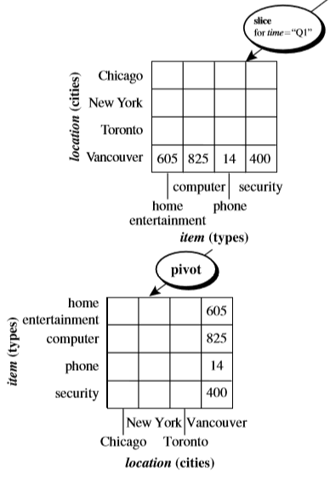
Typical OLAP Operations
Pivot(rotate):
A visualization operation that rotates the data axes in view to provide an alternative data presentation.
Ex: the item and location axes in a 2-D slice are rotated
Other examples include rotating the axes in a 3-D cube, or transforming a 3-D cube into a series of 2-D planes.

