Slide 1
Java Adapter Classes
By
M. BABY ANUSHA,
ASST.PROF IN CSE DEPT.,
RGUKT,NUZVID

Slide 2
Java Adapter Classes
Java adapter classes provide the default implementation of listener interfaces.
If you inherit the adapter class, you will not be forced to provide the implementation of all the methods of listener interfaces. So it saves code.
The adapter classes are found in java.awt.event, java.awt.dnd and javax.swing.event packages.
The Adapter classes with their corresponding listener interfaces are given below.

Slide 3
java.awt.event Adapter classes
Adapter class | Listener interface
WindowAdapter | WindowListener
KeyAdapter | KeyListener
MouseAdapter | MouseListener
MouseMotionAdapter | MouseMotionListener
FocusAdapter | FocusListener
ComponentAdapter | ComponentListener
ContainerAdapter | ContainerListener
HierarchyBoundsAdapter | HierarchyBoundsListener

Slide 4
java.awt.dnd Adapter classes
Adapter class | Listener interface
MouseInputAdapter | MouseInputListener
InternalFrameAdapter | InternalFrameListener
javax.swing.event Adapter classes
Adapter class | Listener interface
DragSourceAdapter | DragSourceListener
DragTargetAdapter | DragTargetListener

Slide 5
Java WindowAdapter : Example
import java.awt.*;
import java.awt.event.*;
public class AdapterExample
{
Frame f;
AdapterExample(){
f=new Frame("Window Adapter");
f.addWindowListener(new WindowAdapter(){
public void windowClosing(WindowEvent e) {
f.dispose();
}
});

Slide 6
Java WindowAdapter : Example
f.setSize(400,400);
f.setLayout(null);
f.setVisible(true);
}
public static void main(String[] args) {
new AdapterExample();
}
}

Slide 7
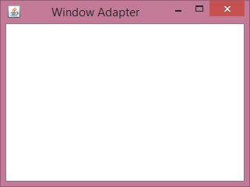
Java WindowAdapter : Example

Slide 8
Java MouseAdapter : Example
import java.awt.*;
import java.awt.event.*;
public class MouseAdapterExample extends MouseAdapte
{
Frame f;
MouseAdapterExample(){
f=new Frame("Mouse Adapter");
f.addMouseListener(this);
f.setSize(300,300);
f.setLayout(null);
f.setVisible(true);
}

Slide 9
Java MouseAdapter : Example
public void mouseClicked(MouseEvent e) {
Graphics g=f.getGraphics();
g.setColor(Color.BLUE);
g.fillOval(e.getX(),e.getY(),30,30);
}
public static void main(String[] args) {
new MouseAdapterExample();
}
}

Slide 10
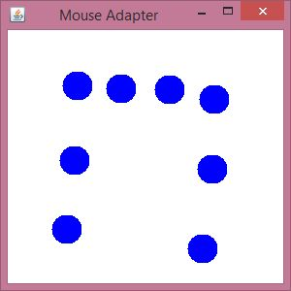
Java MouseAdapter : Example

Slide 11
Java MouseMotionAdapter : Example
import java.awt.*;
import java.awt.event.*;
public class MouseMotionAdapterExample extends MouseMotionAdapter
{
Frame f;
MouseMotionAdapterExample()
{
f=new Frame("Mouse Motion Adapter");
f.addMouseMotionListener(this);
f.setSize(300,300);
f.setLayout(null);
f.setVisible(true);
}

Slide 12
Java MouseMotionAdapter : Example
public void mouseDragged(MouseEvent e)
{
Graphics g=f.getGraphics();
g.setColor(Color.ORANGE);
g.fillOval(e.getX(),e.getY(),20,20);
}
public static void main(String[] args)
{
new MouseMotionAdapterExample();
}
}

Slide 13
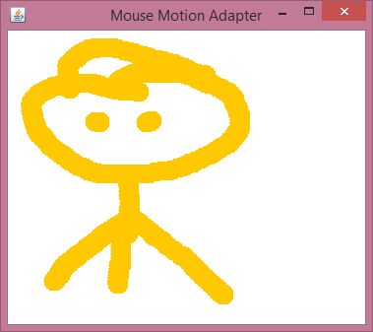
Java MouseMotionAdapter : Example

Slide 14
Java KeyAdapter : Example
import java.awt.*;
import java.awt.event.*;
public class KeyAdapterExample extends KeyAdapter{
Label l;
TextArea area;
Frame f;
KeyAdapterExample(){
f=new Frame("Key Adapter");
l=new Label();
l.setBounds(20,50,200,20);
area=new TextArea();
area.setBounds(20,80,300, 300);
area.addKeyListener(this);

Slide 15
Java KeyAdapter : Example
f.add(l);
f.add(area);
f.setSize(400,400);
f.setLayout(null);
f.setVisible(true);
}
public void keyReleased(KeyEvent e) {
String text=area.getText();
String words[]=text.split("\\s");
l.setText("Words: "+words.length+" Characters:"+text.length());
}
public static void main(String[] args) {
new KeyAdapterExample();
}
}

Slide 16
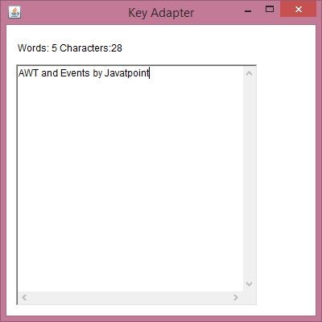
Java KeyAdapter : Example

Slide 17


