Slide 1
AWT Components
By
M. BABY ANUSHA,
ASST.PROF IN CSE DEPT.,
RGUKT,NUZVID

Slide 2
Java AWT Button :
A button is basically a control component with a label that generates an event when pushed.
The Button class is used to create a labeled button that has platform independent implementation.
The application result in some action when the button is pushed.

Slide 3
Java AWT Button :
When we press a button and release it, AWT sends an instance of ActionEvent to that button by calling processEvent on the button.
The processEvent method of the button receives the all the events, then it passes an action event by calling its own method processActionEvent.

Slide 4
Java AWT Button :
To perform an action on a button being pressed and released, the ActionListener interface needs to be implemented.
The registered new listener can receive events from the button by calling addActionListener method of the button.

Slide 5
Java AWT Button :
AWT Button Class Declaration
public class Button extends Component implements Accessible
Button Class Constructors
Button( ) It constructs a new button with an empty string i.e. it has no label.
Button (String text) It constructs a new button with given string as its label.

Slide 6
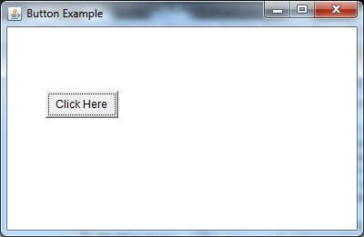
Java AWT Button :

Slide 7
Java AWT Label :
The object of the Label class is a component for placing text in a container.
It is used to display a single line of read only text. The text can be changed by a programmer but a user cannot edit it directly.
It is called a passive control as it does not create any event when it is accessed. To create a label, we need to create the object of Label class.

Slide 8
Java AWT Label :
AWT Label Class Declaration
public class Label extends Component implements Accessible
AWT Label Fields
The java.awt.Component class has following fields:
static int LEFT: It specifies that the label should be left justified.
static int RIGHT: It specifies that the label should be right justified.
static int CENTER: It specifies that the label should be placed in center.

Slide 9
Java AWT Label :
Label()It constructs an empty label.
Label(String text)It constructs a label with the given string (left justified by default).
Label(String text, int alignement)It constructs a label with the specified string and the specified alignment.

Slide 10
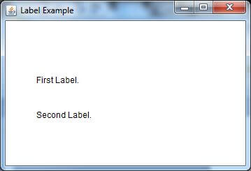
Java AWT Label :

Slide 11
Java AWT TextField :
The object of a TextField class is a text component that allows a user to enter a single line text and edit it.
It inherits TextComponent class, which further inherits Component class.
When we enter a key in the text field (like key pressed, key released or key typed), the event is sent to TextField. Then the KeyEvent is passed to the registered KeyListener.
It can also be done using ActionEvent; if the ActionEvent is enabled on the text field, then the ActionEvent may be fired by pressing return key. The event is handled by the ActionListener interface.

Slide 12
Java AWT TextField :
AWT TextField Class Declaration
public class TextField extends TextComponent
TextField Class constructors
TextField()It constructs a new text field component.
TextField(String text)It constructs a new text field initialized with the given string text to be displayed.
TextField(int columns)It constructs a new textfield (empty) with given number of columns.
TextField(String text, int columns)It constructs a new text field with the given text and given number of columns (width).

Slide 13
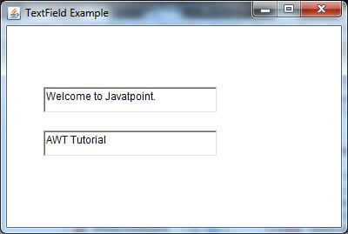
Java AWT TextField :

Slide 14
Java AWT TextArea :
The object of a TextArea class is a multiline region that displays text. It allows the editing of multiple line text. It inherits TextComponent class.
The text area allows us to type as much text as we want. When the text in the text area becomes larger than the viewable area, the scroll bar appears automatically which helps us to scroll the text up and down, or right and left.

Slide 15
Java AWT TextArea :
AWT TextArea Class Declaration
public class TextArea extends TextComponent
Fields of TextArea Class
The fields of java.awt.TextArea class are as follows:
static int SCROLLBARS_BOTH - It creates and displays both horizontal and vertical scrollbars.
static int SCROLLBARS_HORIZONTAL_ONLY - It creates and displays only the horizontal scrollbar.
static int SCROLLBARS_VERTICAL_ONLY - It creates and displays only the vertical scrollbar.
static int SCROLLBARS_NONE - It doesn't create or display any scrollbar in the text area.

Slide 16
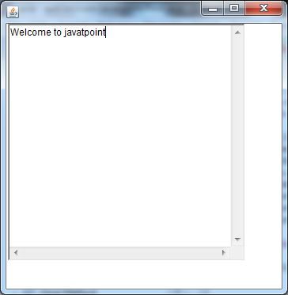
Java AWT TextArea :

Slide 17
Java AWT Checkbox :
The Checkbox class is used to create a checkbox. It is used to turn an option on (true) or off (false).
Clicking on a Checkbox changes its state from "on" to "off" or from "off" to "on".
AWT Checkbox Class Declaration
public class Checkbox extends Component implements
ItemSelectable, Accessible

Slide 18
Java AWT Checkbox :
Checkbox Class Constructors :
Checkbox()It constructs a checkbox with no string as the label.
Checkbox(String label)It constructs a checkbox with the given label.
Checkbox(String label, boolean state)It constructs a checkbox with the given label and sets the given state.

Slide 19
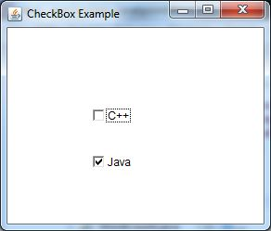
Java AWT Checkbox :

Slide 20
Java AWT CheckboxGroup :
The object of CheckboxGroup class is used to group together a set of Checkbox.
At a time only one check box button is allowed to be in "on" state and remaining check box button in "off" state. It inherits the object class.
AWT CheckboxGroup Class Declaration
public class CheckboxGroup extends Object implements Serializable

Slide 21
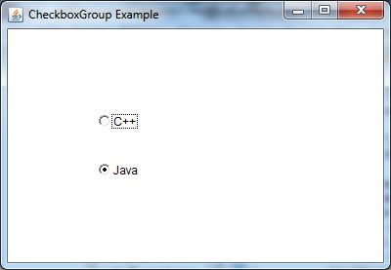
Java AWT CheckboxGroup :

Slide 22
Java AWT Choice :
The object of Choice class is used to show popup menu of choices.
Choice selected by user is shown on the top of a menu. It inherits Component class.
AWT Choice Class Declaration
public class Choice extends Component implements ItemSelectable, Accessible

Slide 23
Java AWT Choice :
Choice Class constructor
Choice()
It constructs a new choice menu.

Slide 24
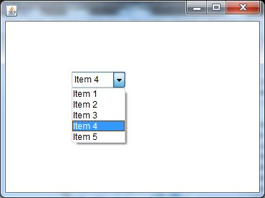
Java AWT Choice :

Slide 25
Java AWT List :
The object of List class represents a list of text items.
With the help of the List class, user can choose either one item or multiple items. It inherits the Component class.
AWT List class Declaration
public class List extends Component implements ItemSelectable, Accessible

Slide 26
AWT List Class Constructors :
1. | List() | It constructs a new scrolling list.
2. | List(int row_num) | It constructs a new scrolling list initialized with the given number of rows visible.
3. | List(int row_num, Boolean multipleMode) | It constructs a new scrolling list initialized which displays the given number of rows.

Slide 27
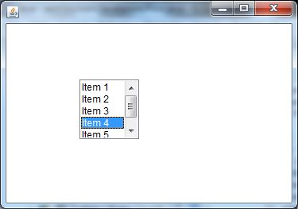
Java AWT List :

Slide 28


