Slide 1
Java AWT MenuItem and Menu
By
M. BABY ANUSHA,
ASST.PROF IN CSE DEPT.,
RGUKT,NUZVID

Slide 2
Java AWT MenuItem and Menu :
The object of MenuItem class adds a simple labeled menu item on menu.
The items used in a menu must belong to the MenuItem or any of its subclass.
The object of Menu class is a pull down menu component which is displayed on the menu bar. It inherits the MenuItem class.

Slide 3
Java AWT MenuItem and Menu :
AWT MenuItem class declaration
public class MenuItem extends MenuComponent implements Accessible
AWT Menu class declaration
public class Menu extends MenuItem implements MenuContainer, Accessible

Slide 4
Java AWT MenuItem and Menu : Example
import java.awt.*;
class MenuExample
{
MenuExample(){
Frame f= new Frame("Menu and MenuItem Example");
MenuBar mb=new MenuBar();
Menu menu=new Menu("Menu");
Menu submenu=new Menu("Sub Menu");
MenuItem i1=new MenuItem("Item 1");
MenuItem i2=new MenuItem("Item 2");
MenuItem i3=new MenuItem("Item 3");
MenuItem i4=new MenuItem("Item 4");
MenuItem i5=new MenuItem("Item 5");

Slide 5
Java AWT MenuItem and Menu : Example
menu.add(i1);
menu.add(i2);
menu.add(i3);
submenu.add(i4);
submenu.add(i5);
menu.add(submenu);
mb.add(menu);
f.setMenuBar(mb);
f.setSize(400,400);

Slide 6
Java AWT MenuItem and Menu : Example
f.setLayout(null);
f.setVisible(true);
}
public static void main(String args[])
{
new MenuExample();
}
}

Slide 7
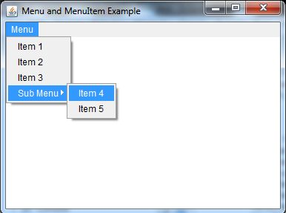
Java AWT MenuItem and Menu : Example

Slide 8


