Slide 1
Creating Multiple Threads or
Multithreading in Java
By
M. BABY ANUSHA,
ASST.PROF IN CSE DEPT.,
RGUKT,NUZVID

Slide 2
Multithreading :
Multithreading in Java is a process of executing multiple threads simultaneously.
A thread is a lightweight sub-process, the smallest unit of processing.
Multiprocessing and multithreading, both are used to achieve multitasking.

Slide 3
Multithreading :
However, we use multithreading than multiprocessing because threads use a shared memory area.
They don't allocate separate memory area so saves memory, and context-switching between the threads takes less time than process.
Java Multithreading is mostly used in games, animation, etc.

Slide 4
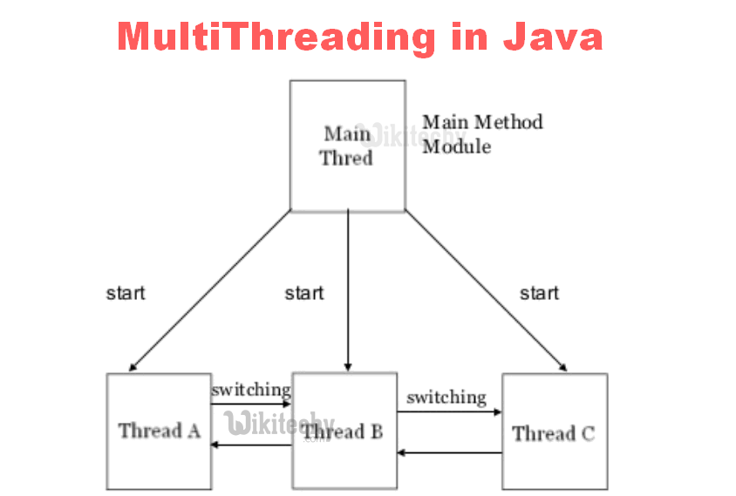

Slide 5
Advantages of Java Multithreading
1) It doesn't block the user because threads are independent and you can perform multiple operations at the same time.
2) You can perform many operations together, so it saves time.
3) Threads are independent, so it doesn't affect other threads if an exception occurs in a single thread.

Slide 6
Multitasking
Multitasking is a process of executing multiple tasks simultaneously. We use multitasking to utilize the CPU. Multitasking can be achieved in two ways:
Process-based Multitasking (Multiprocessing)
Thread-based Multitasking (Multithreading)

Slide 7
Process-based Multitasking (Multiprocessing)
Each process has an address in memory. In other words, each process allocates a separate memory area.
A process is heavyweight.
Cost of communication between the process is high.
Switching from one process to another requires some time for saving and loading registers, memory maps, updating lists, etc.

Slide 8
Thread-based Multitasking (Multithreading)
Threads share the same address space.
A thread is lightweight.
Cost of communication between the thread is low.
Note: At least one process is required for each thread.

Slide 9
Thread Scheduler in Java
Thread scheduler in java is the part of the JVM that decides which thread should run.
There is no guarantee that which runnable thread will be chosen to run by the thread scheduler.
Only one thread at a time can run in a single process.
The thread scheduler mainly uses preemptive or time slicing scheduling to schedule the threads.

Slide 10
Daemon Thread in Java
Daemon thread in java is a service provider thread that provides services to the user thread. Its life depend on the mercy of user threads i.e. when all the user threads dies, JVM terminates this thread automatically.
There are many java daemon threads running automatically e.g. gc, finalizer etc.
You can see all the detail by typing the jconsole in the command prompt. The jconsole tool provides information about the loaded classes, memory usage, running threads etc.

Slide 11
Daemon Thread in Java
Points to remember for Daemon Thread in Java
It provides services to user threads for background supporting tasks. It has no role in life than to serve user threads.
Its life depends on user threads.
It is a low priority thread.

Slide 12
Methods for Java Daemon thread
Methods for Java Daemon thread by Thread class
The java.lang.Thread class provides two methods for java daemon thread.
public void setDaemon(boolean status)
is used to mark the current thread as daemon thread or user thread.
public boolean isDaemon()
is used to check that current is daemon.

Slide 13
ThreadGroup in Java
Java provides a convenient way to group multiple threads in a single object. In such way, we can suspend, resume or interrupt group of threads by a single method call.
Java thread group is implemented by java.lang.ThreadGroup class.
A ThreadGroup represents a set of threads. A thread group can also include the other thread group.

Slide 14
ThreadGroup in Java
The thread group creates a tree in which every thread group except the initial thread group has a parent.
A thread is allowed to access information about its own thread group, but it cannot access the information about its thread group's parent thread group or any other thread groups.

Slide 15
Constructors of ThreadGroup class
There are only two constructors of ThreadGroup class.
ThreadGroup(String name)
creates a thread group with given name.
ThreadGroup(ThreadGroup parent, String name)
creates a thread group with given parent group and name.

Slide 16


