Slide 1
FileHandling in JAVA
By
M. BABY ANUSHA,
ASST.PROF IN CSE DEPT.,
RGUKT,NUZVID

Slide 2
Introduction :
In Java, a File is an abstract data type. A named location used to store related information is known as a File. There are several File Operations like creating a new File, getting information about File, writing into a File, reading from a File and deleting a File.
Before understanding the File operations, it is required that we should have knowledge of Stream and File methods.

Slide 3
File Streams :
A series of data is referred to as a stream. In Java, Stream is classified into two types, i.e., Byte Stream and Character Stream
Byte Stream :
Byte Stream is mainly involved with byte data. A file handling process with a byte stream is a process in which an input is provided and executed with the byte data.

Slide 4
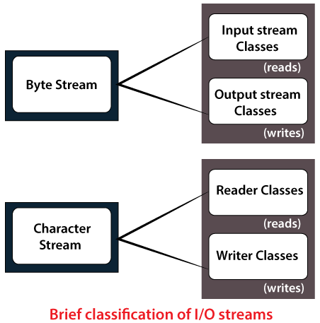

Slide 5
File Streams :
Character Stream :
Character Stream is mainly involved with character data. A file handling process with a character stream is a process in which an input is provided and executed with the character data.

Slide 6
Java File Class Methods :
boolean canRead() :
The canRead() method is used to check whether we can read the data of the file or not.
boolean createNewFile()
The createNewFile() method is used to create a new empty file.
boolean canWrite()
The canWrite() method is used to check whether we can write the data into the file or not.

Slide 7
Java File Class Methods :
boolean exists()
The exists() method is used to check whether the specified file is present or not.
boolean delete()
The delete() method is used to delete a file.
string getName()
The getName() method is used to find the file name.
String getAbsolutePath()
The getAbsolutePath() method is used to get the absolute pathname of the file.

Slide 8
Java File Class Methods :
long length()
The length() method is used to get the size of the file in bytes.
String[] list()
The list() method is used to get an array of the files available in the directory.
boolean mkdir()
The mkdir() method is used for creating a new directory.

Slide 9
File Operations :
We can perform the following operation on a file:
Create a File
Get File Information
Write to a File
Read from a File
Delete a File

Slide 10
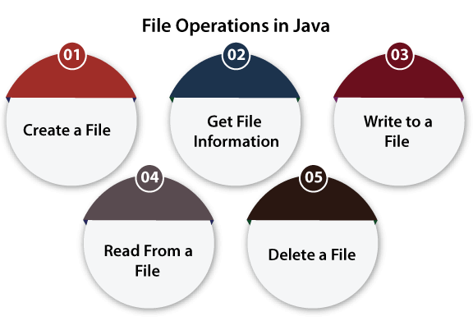

Slide 11
Create a File :
Create a File operation is performed to create a new file. We use the createNewFile() method of file.
The createNewFile() method returns true when it successfully creates a new file and returns false when the file already exists.

Slide 12
Create a File : Example
import java.io.File; // Import the File class
import java.io.IOException; // Import the IOException class to handle errors
public class CreateFile {
public static void main(String[] args) {
try
{
File myObj = new File("filename.txt");
if (myObj.createNewFile()) {
System.out.println("File created: " + myObj.getName());
}
else {
System.out.println("File already exists.");
}
}
catch (IOException e) {
System.out.println("An error occurred.");
e.printStackTrace(); }
} }

Slide 13
Create a File : Example
Output:
File created: filename.txt

Slide 14
Write to a File :
The next operation which we can perform on a file is "writing into a file".
In order to write data into a file, we will use the FileWriter class and its write() method together. We need to close the stream using the close() method to retrieve the allocated resources.

Slide 15
Write To a File : Example
import java.io.FileWriter; // Import the FileWriter class
import java.io.IOException; // Import the IOException class to handle errors
public class WriteToFile {
public static void main(String[] args) {
try {
FileWriter myWriter = new FileWriter("filename.txt");
myWriter.write("Files in Java might be tricky, but it is fun enough!");
myWriter.close();
System.out.println("Successfully wrote to the file.");
}
catch (IOException e) {
System.out.println("An error occurred.");
e.printStackTrace();
}
} }

Slide 16
Write To a File : Example
Output :
Successfully wrote to the file.

Slide 17
Read from a File :
The next operation which we can perform on a file is "read from a file". In order to write data into a file, we will use the Scanner class.
Here, we need to close the stream using the close() method. We will create an instance of the Scanner class and use the hasNextLine() method nextLine() method to get data from the file.

Slide 18
Read a File : Example
import java.io.File; // Import the File class
import java.io.FileNotFoundException; // Import this class to handle errors
import java.util.Scanner; // Import the Scanner class to read text files
public class ReadFile {
public static void main(String[] args) {
try {
File myObj = new File("filename.txt");
Scanner myReader = new Scanner(myObj);
while (myReader.hasNextLine()) {
String data = myReader.nextLine();
System.out.println(data);
}
myReader.close(); }
catch (FileNotFoundException e) {
System.out.println("An error occurred.");
e.printStackTrace();
}
} }

Slide 19
Read a File : Example
Output :
Files in Java might be tricky, but it is fun enough!

Slide 20
Delete a File :
The next operation which we can perform on a file is "deleting a file". In order to delete a file, we will use the delete() method of the file.
We don't need to close the stream using the close() method because for deleting a file, we neither use the FileWriter class nor the Scanner class.

Slide 21
Delete a File : Example
import java.io.File; // Import the File class
public class DeleteFile {
public static void main(String[] args) {
File myObj = new File("filename.txt");
if (myObj.delete()) {
System.out.println("Deleted the file: " + myObj.getName());
}
else{
System.out.println("Failed to delete the file.");
}
} }

Slide 22
Delete a File : Example
Output :
Deleted the file: filename.txt

Slide 23
Java BufferedReader Class :
Java BufferedReader class is used to read the text from a character-based input stream.
It can be used to read data line by line by readLine() method. It makes the performance fast. It inherits Reader class.
Let's see the declaration for Java.io.BufferedReader class:
public class BufferedReader extends Reader

Slide 24
Java BufferedReader class constructors:
BufferedReader(Reader rd)
It is used to create a buffered character input stream that uses the default size for an input buffer.
BufferedReader(Reader rd, int size)
It is used to create a buffered character input stream that uses the specified size for an input buffer.

Slide 25
Java BufferedReader class methods :
int read()
It is used for reading a single character.
int read(char[] cbuf, int off, int len)
It is used for reading characters into a portion of an array.
boolean markSupported()
It is used to test the input stream support for the mark and reset method.

Slide 26
Java BufferedReader class methods :
boolean ready()
It is used to test whether the input stream is ready to be read.
long skip(long n)
It is used for skipping the characters.
void reset()
It repositions the stream at a position the mark method was last called on this input stream.

Slide 27
Java BufferedReader class methods :
void mark(int readAheadLimit)
It is used for marking the present position in a stream.
void close()
It closes the input stream and releases any of the system resources associated with the stream.
String readLine()
It is used for reading a line of text.

Slide 28
Java BufferedReader Example :
import java.io.*;
public class BufferedReaderExample {
public static void main(String args[])throws Exception{
FileReader fr=new FileReader("D:\\testout.txt");
BufferedReader br=new BufferedReader(fr);
int i;
while((i=br.read())!=-1){
System.out.print((char)i);
}
br.close();
fr.close();
}
}

Slide 29
Java BufferedWriter Class:
Java BufferedWriter class is used to provide buffering for Writer instances.
It makes the performance fast. It inherits Writer class. The buffering characters are used for providing the efficient writing of single arrays, characters, and strings.
Let's see the declaration for Java.io.BufferedWriter class:
public class BufferedWriter extends Writer

Slide 30
Java BufferedWriter Class constructors :
BufferedWriter(Writer wrt)
It is used to create a buffered character output stream that uses the default size for an output buffer.
BufferedWriter(Writer wrt, int size)
It is used to create a buffered character output stream that uses the specified size for an output buffer.

Slide 31
Java BufferedWriter Class methods :
void newLine()
It is used to add a new line by writing a line separator.
void write(int c)
It is used to write a single character.
void write(char[] cbuf, int off, int len)
It is used to write a portion of an array of characters.

Slide 32
Java BufferedWriter Class methods :
void write(String s, int off, int len)
It is used to write a portion of a string.
void flush()
It is used to flushes the input stream.
void close()
It is used to closes the input stream

Slide 33
Example of Java BufferedWriter :
import java.io.*;
public class BufferedWriterExample {
public static void main(String[] args) throws Exception {
FileWriter writer = new FileWriter("D:\\testout.txt");
BufferedWriter buffer = new BufferedWriter(writer);
buffer.write("Welcome to javaTpoint.");
buffer.close();
System.out.println("Success");
}
}

Slide 34


