Slide 1
Introduction to GUI Programming
By
M. BABY ANUSHA,
ASST.PROF IN CSE DEPT.,
RGUKT,NUZVID

Slide 2
Introduction :
JAVA provides a rich set of libraries to create Graphical User Interface in platform independent way.
Graphical User Interface (GUI) offers user interaction via some graphical components.
For example our underlying Operating System also offers GUI via window,frame,Panel, Button, Textfield, TextArea, Listbox, Combobox, Label, Checkbox etc.

Slide 3
Graphical User Interface :
These all are known as components. Using these components we can create an interactive user interface for an application.
GUI provides result to end user in response to raised events.GUI is entirely based on events.
For example clicking over a button, closing a window, opening a window, typing something in a textarea etc. These activities are known as events.
GUI makes it easier for the end user to use an application. It also makes them interesting.

Slide 4
Basic Terminologies : GUI
Component
Component is an object having a graphical representation that can be displayed on the screen and that can interact with the user.
For examples buttons, checkboxes, list and scrollbars of a graphical user interface.
Container
Container object is a component that can contain other components. Components added to a container are tracked in a list.

Slide 5
Basic Terminologies : GUI
The order of the list will define the components' front-to-back stacking order within the container. If no index is specified when adding a component to a container, it will be added to the end of the list.
Types of containers:
There are four types of containers in Java AWT:
Window
Panel
Frame
Dialog

Slide 6
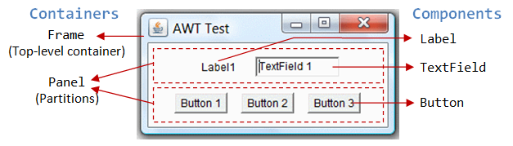
Basic Terminologies : GUI

Slide 7
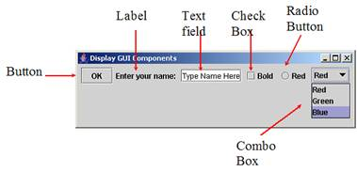
Basic Terminologies : GUI

Slide 8
Basic Terminologies : GUI
Panel
Panel provides space in which an application can attach any other components, including other panels.
Window
Window is a rectangular area which is displayed on the screen. In different window we can execute different program and display different data. Window provide us with multitasking environment.
A window must have either a frame, dialog, or another window defined as its owner when it's constructed.

Slide 9
Basic Terminologies : GUI
Frame
A Frame is a top-level window with a title and a border. The size of the frame includes any area designated for the border.
Frame encapsulates window. It and has a title bar, menu bar, borders, and resizing corners.
Canvas
Canvas component represents a blank rectangular area of the screen onto which the application can draw. Application can also trap input events from the use from that blank area of Canvas component.

Slide 10
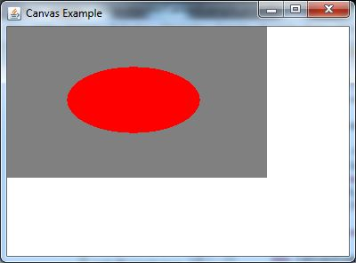
Basic Terminologies : GUI

Slide 11
Useful Methods of Component Class :
public void add(Component c)
Inserts a component on this component.
public void setSize(int width,int height)
Sets the size (width and height) of the component.
public void setLayout(LayoutManager m)
Defines the layout manager for the component.
public void setVisible(boolean status)
Changes the visibility of the component, by default false.

Slide 12
GUI based Applications : Examples
Following are some of the examples for GUI based applications.
Automated Teller Machine (ATM)
Airline Ticketing System
Information Kiosks at railway stations
Mobile Applications
Navigation Systems

Slide 13
Advantages of GUI over CUI :
GUI provides graphical icons to interact while the CUI (Character User Interface) offers the simple text-based interfaces.
GUI makes the application more entertaining and interesting on the other hand CUI does not.
GUI offers click and execute environment while in CUI every time we have to enter the command for a task.
New user can easily interact with graphical user interface by the visual indicators but it is difficult in Character user interface.

Slide 14
Advantages of GUI over CUI :
GUI offers a lot of controls of file system and the operating system while in CUI you have to use commands which is difficult to remember.
Windows concept in GUI allow the user to view, manipulate and control the multiple applications at once while in CUI user can control one task at a time.
GUI provides multitasking environment so as the CUI also does but CUI does not provide same ease as the GUI do.
Using GUI it is easier to control and navigate the operating system which becomes very slow in command user interface. GUI can be easily customized.

Slide 15
Java AWT :
Java AWT (Abstract Window Toolkit) is an API to develop Graphical User Interface (GUI) or windows-based applications in Java.
Java AWT components are platform-dependent i.e. components are displayed according to the view of operating system.
AWT is heavy weight i.e. its components are using the resources of underlying operating system (OS).
The java.awt package provides classes for AWT API such as TextField, Label, TextArea, RadioButton, CheckBox, Choice, List etc.

Slide 16
Why AWT is platform independent?
Java AWT calls the native platform calls the native platform (operating systems) subroutine for creating API components like TextField, CheckBox, button, etc.
For example, an AWT GUI with components like TextField, label and button will have different look and feel for the different platforms like Windows, MAC OS, and Unix.
The reason for this is the platforms have different view for their native components and AWT directly calls the native subroutine that creates those components.

Slide 17
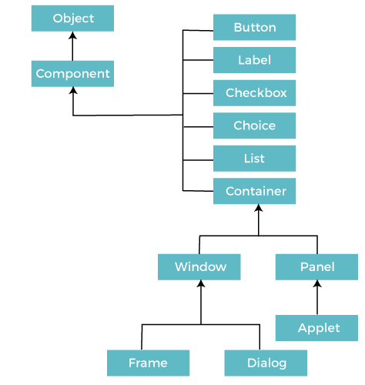
Java AWT Hierarchy :

Slide 18
AWT : Example
import java.awt.*;
public class AWTExample1 extends Frame
{
// initializing using constructor
AWTExample1()
{
// creating a button
Button b = new Button("Click Me!!");
// setting button position on screen
b.setBounds(30,100,80,30);
// adding button into frame
add(b);
// frame size 300 width and 300 height
setSize(300,300);

Slide 19
AWT : Example
// setting the title of Frame
setTitle("This is our basic AWT example");
// no layout manager
setLayout(null);
// now frame will be visible, by default it is not visible
setVisible(true);
}
// main method
public static void main(String args[])
{
// creating instance of Frame class
AWTExample1 f = new AWTExample1();
}
}

Slide 20
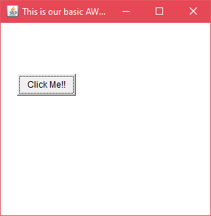
AWT : Example
Output:

Slide 21


