Slide 1
Inter-thread communication in Java
By
M. BABY ANUSHA,
ASST.PROF IN CSE DEPT.,
RGUKT,NUZVID

Slide 2
Introduction
Inter-thread communication or Co-operation is all about allowing synchronized threads to communicate with each other.
Cooperation (Inter-thread communication) is a mechanism in which a thread is paused running in its critical section and another thread is allowed to enter (or lock) in the same critical section to be executed.
It is implemented by following methods of Object class:
wait()
notify()
notifyAll()

Slide 3
Inter-thread communication
1) wait() method
Causes current thread to release the lock and wait until either another thread invokes the notify() method or the notifyAll() method for this object, or a specified amount of time has elapsed.
The current thread must own this object's monitor, so it must be called from the synchronized method only otherwise it will throw exception.

Slide 4
Inter-thread communication
Syntax:
public final void wait()throws InterruptedException
waits until object is notified.
public final void wait(long timeout)throws InterruptedException
waits for the specified amount of time.

Slide 5
Inter-thread communication
2) notify() method
Wakes up a single thread that is waiting on this object's monitor. If any threads are waiting on this object, one of them is chosen to be awakened. The choice is arbitrary and occurs at the discretion of the implementation.
Syntax:
public final void notify()
3) notifyAll() method
Wakes up all threads that are waiting on this object's monitor.
Syntax:
public final void notifyAll()

Slide 6
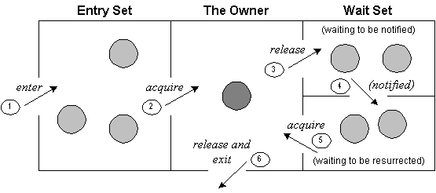
Understanding the process of inter-thread communication

Slide 7
Understanding the process of inter-thread communication
The point to point explanation of the above diagram is as follows:
Threads enter to acquire lock.
Lock is acquired by on thread.
Now thread goes to waiting state if you call wait() method on the object.
Otherwise it releases the lock and exits.

Slide 8
Understanding the process of inter-thread communication
If you call notify() or notifyAll() method, thread moves to the notified state (runnable state).
Now thread is available to acquire lock.
After completion of the task, thread releases the lock and exits the monitor state of the object.

Slide 9
Example of inter thread communication in java
class Customer
{
  int amount=10000;
synchronized void withdraw(int amount)
{
System.out.println("going to withdraw...");
if(this.amount<amount){
System.out.println("Less balance; waiting for deposit...");
try
{
wait();
}
catch(Exception e){}
}

Slide 10
Example of inter thread communication in java
this.amount-=amount;
System.out.println("withdraw completed...");
}
synchronized void deposit(int amount)
{
System.out.println("going to deposit...");
this.amount+=amount;
System.out.println("deposit completed... ");
notify();
}
}

Slide 11
Example of inter thread communication in java
class Test
{
public static void main(String args[]){
final Customer c=new Customer();
new Thread(){
public void run(){c.withdraw(15000);}
}.start();
new Thread(){
public void run(){c.deposit(10000);}
}.start();
}
}

Slide 12
Example of inter thread communication in java
Output:
going to withdraw...
Less balance; waiting for deposit...
going to deposit...
deposit completed...
withdraw completed

Slide 13


