Slide 1
Threads : Java
By
M. BABY ANUSHA,
ASST.PROF IN CSE DEPT.,
RGUKT,NUZVID

Slide 2


What is a Thread?
facility to allow multiple activities to coexist within a single process.
Represents a separate path of execution of a group of statements
Java is the first language to include threading within the language, rather than treating it as a facility of the OS
Video Game example
  one thread for graphics
  one thread for user interaction 3.one thread for networking
Server Example
  Do various jobs 2.Handle Several Clients

Slide 3
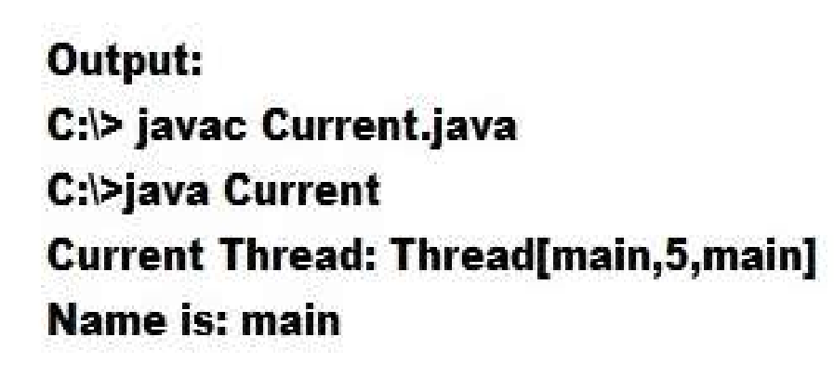
Main Thread
Default Thread in any Java Program
JVM uses to execute program statements
o Program To Find the Main Thread
Class Current
{
public static void main(String args[])
{
Thread t=Thread.currentThread();
System.out.println(“Current Thread: “+t); System.out.println(“Name is: “+t.getName());
}
}

Slide 4
Threads in Java
4
Creating threads in Java:
Extend java.lang.Thread class
run() method must be overridden (similar to main method of sequential program)
run() is called when execution of the thread begins
A thread terminates when run() returns
start() method invokes run()
OR
Implement java.lang.Runnable interface

Slide 5
Thread class:
Thread class:
Thread class provide constructors and methods to create and perform operations on a thread.Thread class extends Object class and implements Runnable interface.Commonly used Constructors of Thread class:
Thread()
Thread(String name)
Thread(Runnable r)
Thread(Runnable r,String name)

Slide 6

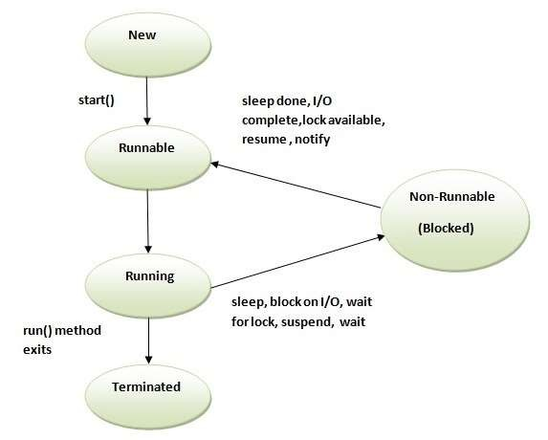
Life cycle of a Thread

Slide 7
New
The thread is in new state if you create an instance of Thread class but before the invocation of start() method.
Runnable
The thread is in runnable state after invocation of start() method, but the thread scheduler has not selected it to be the running thread.
Running
The thread is in running state if the thread scheduler has selected it.
Non-Runnable (Blocked)
This is the state when the thread is still alive, but is currently not eligible to run.
Terminated
A thread is in terminated or dead state when its run() method exits.

Slide 8

Thread Priority
7
Each thread is assigned a default priority of
Thread.NORM_PRIORITY (constant of 5).
You can reset the priority using setPriority(int priority).
Some constants for priorities include:
  Thread.MIN_PRIORITY
  Thread.MAX_PRIORITY
  Thread.NORM_PRIORITY
By default, a thread has the priority level of the thread that created it.

Slide 9
Thread Synchronization
A shared resource may be corrupted if it is accessed simultaneously by multiple threads.
Example: two unsynchronized threads accessing the same bank account may cause conflict.
  Known as a race condition in multithreaded programs.
A thread-safe class does not cause a race condition in the presence of multiple threads.
8

Slide 10
Synchronized
9
Problem : race conditions
Solution : give exclusive access to one thread at a time to code that manipulates a shared object.
Synchronization keeps other threads waiting until the object is available.
The synchronized keyword synchronizes the method so that only one thread can access the method at a time.
public synchronized void xMethod() {
// method body
}
Obj
t1 ( Enters the object ) t2—wait until t1 comes out

Slide 11
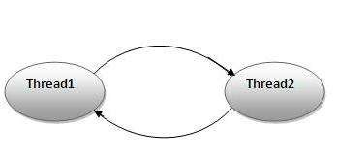
Deadlock :
a part of multithreading
can occur when a thread is waiting for an object lock, that is acquired by another thread and second thread is waiting for an object lock that is acquired by first thread
Since, both threads are waiting for each other to release the lock, the condition is called deadlock

Slide 12
Preventing Deadlock
11
Deadlock can be easily avoided by resource ordering.
With this technique, assign an order on all the objects whose locks must be acquired and ensure that the locks are acquired in that order.
Example:
Thread 1:
lock A
Thread 2:
wait for A
Thread 3:
wait for A
lock B
lock C(when A is locked)
wait for B
wait for C

Slide 13

Advantages of Threads:
easier to program
provide better performance
allow any program to perform multiple tasks at once.
multiple threads can share resources
an Internet-aware language such as Java, this is a very important tool

Slide 14

Thank You !!!

