Slide 1
Unit-2
Biological Data bases

Slide 2
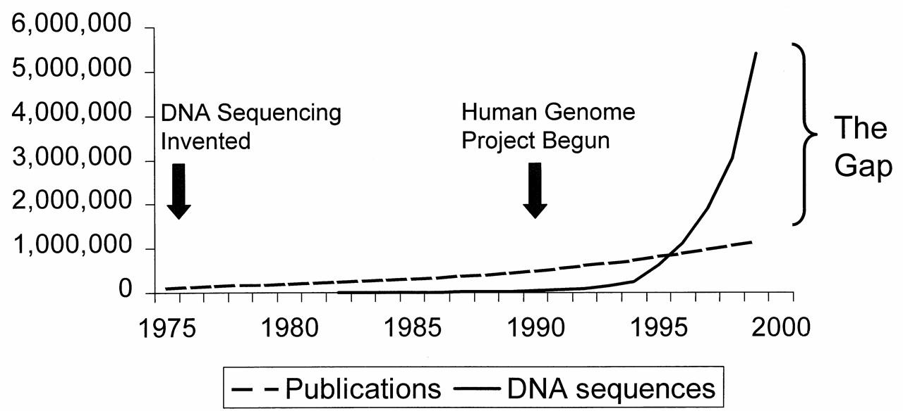
Introduction to biological date base
In 1995, the number of genes in the database started to exceed the number of papers on molecular biology and genetics in the literature!

Slide 3
Introduction to biological data bases
These are the databases consisting of biological data like protein sequencing, molecular structure, DNA sequences, etc in an organized form.
Several computer tools are there to manipulate the biological data like an update, delete, insert, etc. Scientists, and researchers from all over the world enter their experiment data and results in a biological database so that it is available to a wider audience.
Biological databases are free to use and contain a huge collection of a variety of biological data.

Slide 4
Uses of biological Databases:
It helps the researchers to study the available data and form a new thesis, anti-virus, helpful bacteria, medicines, etc.
It helps scientists to understand the concepts of biological phenomena.
The database acts as a storage of information.
It helps remove the redundancy of data.

Slide 5
Types of Biological Databases:
There are basically 3 types of biological databases are as follows.
1.Primary data base
2.Secondary data base
3.Dervied data base

Slide 6
Types of biological data base
Primary data base – 1.nucleotide sequence. Ex:Gene bank,DOBJ,EMBL
2.Protein sequence data base.Ex-Swiss-port,PIR,PRF
Secondary Data base- 1. Protein structure database. Ex:PDB,EBI-MSD,MMDB,Uni port.
2.Domain and motif database.Ex:Blocks,CDG.
3.Derived data base:
1.Structural data base
2.Gene expression data base
3.Metabolic data base
4.Specialised data base.

Slide 7
Primary data base
It can also be called an archival database since it archives the experimental results submitted by the scientists. The primary database is populated with experimentally derived data like genome sequence, macromolecular structure, etc. The data entered here remains uncurated(no modifications are performed over the data).
It contains unique data obtained from the laboratory and these data are made accessible to normal users without any change.
The data are given accession numbers when they are entered into the database. The same data can later be retrieved using the accession number. Accession number identifies each data uniquely and it never changes.

Slide 8
Examples of Primary database-
1. Nucleotide Databases are GenBank , EMBL and DDBJ
2.Protein Databases are Swiss-Prot, TrEMBL, PIR and PRF etc.

Slide 9
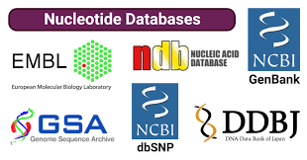
Nucleotide Databases
Nucleotide databases are a type of biological database containing genetic information, which includes DNA and RNA sequences that come from a variety of sources, including whole genomes and individual genes.

Slide 10
GenBank
One of the fastest growing repositories of known nucleotide sequences, GeneBank (Genetic Sequence Databank), has a flat file structure.
Besides sequence data, GeneBank files contain information such as accession numbers and gene names, phylogenetic classification and references to published literature

Slide 11
This database has been developed and maintained at the NCBI, Bethesda, MD, USA, as a part of International Sequence Database Collaboration (INSDC).
It is an open access sequence database.
It coordinates with individual laboratories and other sequence databases like EMBL and DDBJ.

Slide 12
It is an annotated collection of all nucleotide sequences that are available to the public.
The nucleotide database was divided into three databases at NCBI: CoreNucleotide database, Expressed Sequence Tag (EST) and Genome Survey Sequence (GSS).
CoreNucleotide database has most of the nucleotide sequences used. It also encloses all nucleotide records that are not in the EST and GSS databases.

Slide 13
File format of Genbank
1.Header:
Locus
Definition
Acession
Version
Source
Keywords
Organism References
Authors
Title
Journal
MedlineID: all published sources
Comment
2.Features:
3.Sequence:

Slide 14
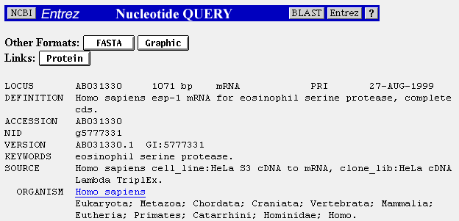
GenBank file format

Slide 16
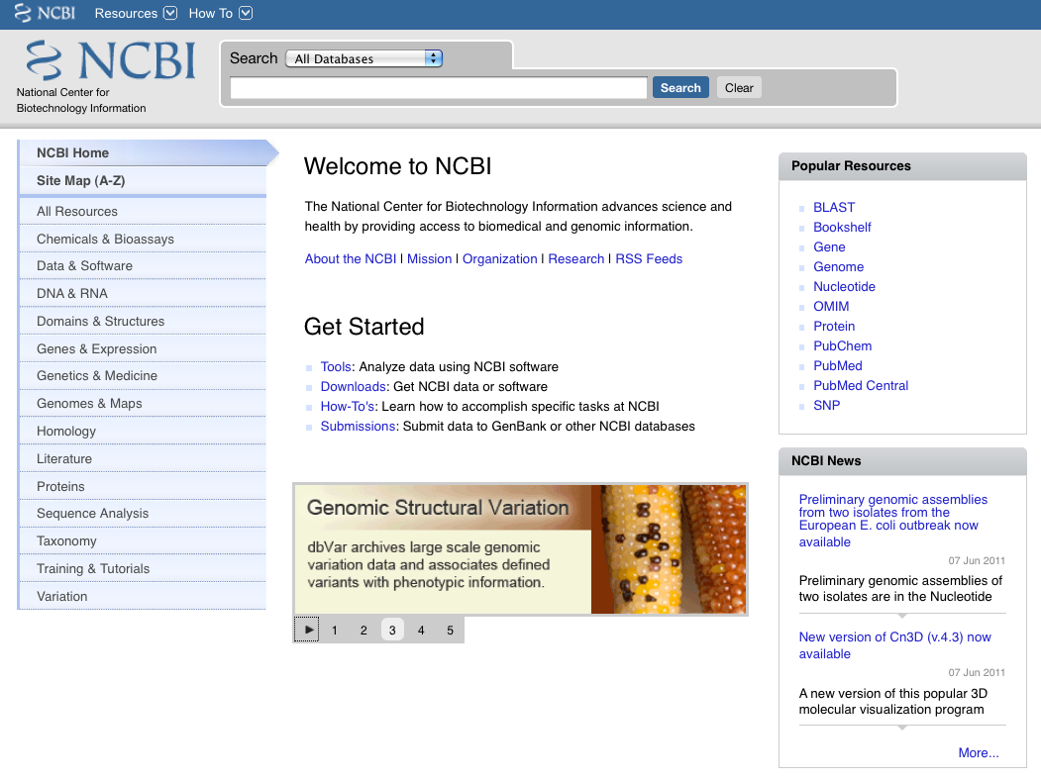

Slide 17
EMBL(European Molecular Biology Laboratory)
A comprehensive database of DNA and RNA sequences, EMBL nucleotide sequence database is collected from scientific literature, patient offices and is directly submitted by researchers. EMBL has been prepared in collaboration with GeneBank (USA) and the DNA Database of Japan (DDBJ).
•It is established in 1980.
•It is maintained by EBI (European Bioinformatics Institute)

Slide 18
3. DNA Data Bank of Japan (DDBJ)
The DNA Data Bank of Japan (DDBJ) is another nucleotide database that exchanges data with GenBank and EMBL as a member of INSDC.
DDBJ collects and exchanges nucleotide sequence data and manages bioinformatics tools for data submission and retrieval.
It also develops tools for biological data analysis and organizes Bioinformatics Training Courses in Japanese.

Slide 19
2.Protein data base
1.Swiss-Port
This is a curated protein sequence database that offers a high level of integration with other databases and also has a very low level of redundancy. Swiss-Port strives to provide protein sequences with a high level of annotation (for instance, the description of protein function, domain structure and post translational modifications, etc.).
It is established in 1986 and maintained collaboratively , since 1987, by the department of Medical Biochemistry of the University of Geneva and the EMBL data Library.
TrEMBL is a computer–annotated supplement of Swiss-Port that contains all translations of EMBL nucleotide sequence entries, which is not yet integrated in Swiss-Port.
Currently Swiss-Port have 0.5 and TrEMBL have 7.6 million sequences.

Slide 20
Protein Data base
2.Protein Information Resource(PIR)
PIR is an integrated public bioinformatics resource to support genomic and proteomic research and scientific studies.
Nowadays, PIR offers a wide variety of resources mainly oriented to assisting the propagation and consistency of protein annotations like PIRSF, ProClass and ProLINK.
3.PRF: Protein research foundation.

Slide 21
2.Secondary data base
The data stored in these types of databases are the analyzed result of the primary database.
Computational algorithms are applied to the primary database and meaningful and informative data is stored inside the secondary database.
The data here are highly curated (processing the data before it is presented in the database). A secondary database is better and contains more valuable knowledge compared to the primary database

Slide 22
Secondary databases are as follows:
1.PDB:
PDB (Protein data bank) is a repository for 3D structural data obtained by x-ray crystallography or NMR spectroscopy of proteins and nucleic acids.
•Research Collaboratory for Structural Bioinformatics (RCSB) PDB provides a variety of tools and resources for studying the structures of biological macromolecules and their relationship with other sequences, its function and diseases caused if any

Slide 23
2.MMDB:
Molecular modeling data base.
Dervied from experimental data in the form 3D molecular structure.

Slide 24
2.Domain and motif Databases
Motif Data bases
Protein sequence motif is a set of conserved amino acid residues that are important for protein function and are located within a certain distance from one another.
These motifs usually provide clues to the functions of otherwise uncharacterised proteins.
•The PROSITE database consists of documentation entries describing protein domains, families and functional sites as well as associated patterns and profiles to identify them.
•PRINT is a database for protein fingerprints. A fingerprint is a group of conserved motifs used to characterise a protein family.

Slide 25
Domain Database
A protein domain is an independently folded, structurally compact unit that forms a steady three- dimensional structure and shows a certain level of evolutionary conservation. Typically , a conserved domain contains one or more motifs.
•ProDom is a protein domain database automatically generated from the Swiss-Port and TrEMBL sequence database.
•SMART is a highly reliable and sensitive tool for domain identification.
•COG is a database and a convenient tool for motif and domain identification.

Slide 26
Domian and motif Data base
1.BLOCK:
It is collection of Protein block that can be used to compare a protein are DNA sequence with documented protein families.
It contains multiple alignments of conserved regions in protein families.
Ex: Google cloud persistent Disk.
2. COG: Clusters of Orthologous Genes
Established in 1997
Identify Protein Sequence
Phylogenetic ,Classification Of the Proteins encoded in 21 Complete geneomes of bacteria,archae & eukaryotes
1,187 Bacteria and 122 Archae mapped
Uses: Com parative evolutionary studies and enables the most specific inferences of tentative gene function.

Slide 27
Derived data bases
Gene expression databases:
GEO or Gene Expression Omnibus is a curated online resource and a gene expression molecular abundance repository for gene expression data browsing, query and retrieval.
•GXD or Gene Expression Database is a community resource for gene expression information.
•MGED or Microarray Gene Expression data contains microarray data, generated by functional genomics and proteomics experiments.
•ArrayExpress from European Bioinformatics Institute is a repository for transcriptomics data

Slide 28
Structural databases
SCOP (Structural Classification of Protein database) classifies protein 3D structures in a hierarchical scheme of structure classes. All the protein structures in PDB are classified her, and the updated new structures are deposited in PDB.
•The CATH database (Class, Architecture, Topology, Homologous) contains a hierarchical classification of protein domain structure.

Slide 29
Metabolic pathway databases
KEGG PATHWAY Database contains graphical pathway maps for all known metabolic pathways from various organisms.
•EcoCyc is an E. coli database , stores information regarding the genome and biochemical machinery of E. coli.
•LIGAND is a chemical database for enzyme reactions at the Institute for Chemical Research, Kyoto. It is composite database currently consisting of the COMPOUND, DRUG, GLYCAN, REACTION, RPAIR and ENZYME databases.
•MetaCyc is a non-redundant, experimentally elucidated metabolic pathway database.
•BRENDA is an enzyme database tat contains information on all aspects of enzymes and enzymatic reactions.

Slide 30
Genome databases
Genome databases give absolute information on the heritable properties of an organism. These databases help to identify genes and predict their functions. A few genome databases have links with specific organism databases.
•GOLD (Genomes Online Database at the University of Illinois, USA) contains a list of all the complete and ongoing genome projects worldwide.
•Genomes at NCBI (National Centre for Biotechnology Information, USA).
•TIGR database (TDB), at the institute for Genomic Research at Rockeville MD, USA.

Slide 31
Virological databases
A virological database contains all the sequences and related information of viruses of animals, plants, bacteria, fungi and archea; for example, the HIV protease database. A committee called The International Committee on Taxonomy of Viruses(ICTV) authorises and organises the taxonomic classification of viruses. ICTVdB contains taxonomic information for over thousands of virus species.

Slide 32
World biodiversity databases
Taxonomic databases are built to document all known species and make them available and accessible worldwide. These databases contain taxonomic hierarchies, species names, synonyms, descriptions, illustrations and references. For example: CCINFO, STRAIN and ALGAE

Slide 33
Database for various model organisms
•
Escherichia coli- E. coli Genome Centre(Wisconsin university, USA), The E.coli index (University of Birmingham, UK)
•Arabidopsis thaliana- TAIR (The Arabidopsis Information Resource)
•Homo sapiens- Human Genome Resources at NCBI, USA
•Oryza sativa (rice) -RGP (Rice Genome Research Programme, Japan)
•Drosaphila melanogaster -FlyBase (Drosophila Genome Database)
•Mus musculus (mouce)- Mouce Genome Informatics
•Danio rerio(zebrafish)- ZFIN (Zebrafish Information Network at the University of Oregon, USA)
•S. cerevisiae (Bakers yeast)- SGD ()Yeast Genome Database at Stanford, USA

Slide 34
Nucleic Acid Database (NDB)
The Nucleic Acid Database (NDB) is a collection of three-dimensional nucleic acid structures and their complexes obtained and curated from the Protein Data Bank (PDB).
The database acts as a centralized platform for storing and accessing structural information and annotations related to nucleic acids.
NDB includes annotations specific to the structure and function of nucleic acids. It also provides tools that allow users to search the database, download data and structures, analyze nucleic acids, and learn more about them.
The database includes RNA and DNA oligonucleotides with two or more bases. It also includes protein-DNA and protein-RNA structures.

Slide 35
Applications of nucleotide databases
Nucleotide databases are used to identify the gene or the function of a particular nucleotide sequence by comparing an unknown sequence with the known sequences in the database.
Nucleotide databases can be used to study and examine gene expression by using the sequence information stored in the databases.
Nucleotide databases are also used to identify potential drug targets and develop new therapies for genetic diseases.
Nucleotide databases also help in identifying genetic variations that may be linked to diseases, which ultimately helps in the development of diagnostic tools and treatments.
Nucleotide databases can be used in phylogenetic analysis to analyze the evolutionary relationships between organisms, by comparing and examining their DNA or RNA sequences.

Slide 36
NCBI:
http://www.ncbi.nlm.nih.gov
EBI:
http://www.ebi.ac.uk/
DDBJ:
http://www.ddbj.nig.ac.jp/

Slide 37
Literature Databases:
Bookshelf: A collection of searchable biomedical books linked to PubMed.
PubMed: Allows searching by author names, journal titles, and a new Preview/Index option. PubMed database provides access to over 12 million MEDLINE citations back to the mid-1960's. It includes History and Clipboard options which may enhance your search session.
PubMed Central: The U.S. National Library of Medicine digital archive of life science journal literature.
OMIM: Online Mendelian Inheritance in Man is a database of human genes and genetic disorders (also OMIA).

