Slide 1
Multiple Sequence Alignment
Multiple Sequence Alignment involves aligning multiple (three or more) biological sequences to achieve optimal sequence matching.
Multiple sequence alignments are used to identify conserved sequence regions and to construct phylogenetic trees, which help us understand the functional and evolutionary relationships between different species or groups of organisms.

Slide 2
TYPES OF MSA
.1. Dynamic programming
Computes an optimal alignment for a given score function. Because of its high running time , it is not typically used in practice.
2. Progressive method
This approach repeatedly aligns two sequences, two alignments, or a sequence with an alignment.
3. Iterative method
Works similarly to progressive methods but repeatedly realigns the initial sequences as well as adding new sequences to the growing MSA.

Slide 3
PROGRESSIVE ALIGNMENT
The progressive method, also known as the tree-based algorithm, is a step-wise assembly of multiple alignments based on pairwise similarity.
This method is called progressive because it aligns sequences in a step-wise manner
Progressive alignment methods require two stages: ‐
A first stage in which the relationships between the sequences are represented as a tree, called a guide tree .
Second step in which the MSA is built by adding the sequences sequentially to the growing MSA according to the guide tree

Slide 4
MSA USING CLUSTAL W
Works by progressive alignment.
Clustal W was introduced by Julie D. Thompson and Toby Gibson of EMBL, EBI.
Most closely related sequences are aligned first, and then additional sequences and groups of sequences are added, guided by the initial alignments .
Uses alignment scores to produce a phylogenetic tree.

Slide 5
MSA USING CLUSTAL W
Aligns the sequences sequentially, guided by the phylogenetic relationships indicated by the tree.
Gap penalties can be adjusted based on specific amino acid residues, regions of hydrophobicity, proximity to other gaps, or secondary structure.

Slide 6
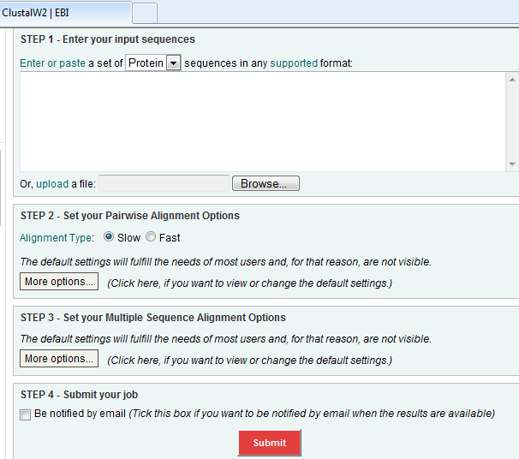
CLUSTAL W

Slide 7
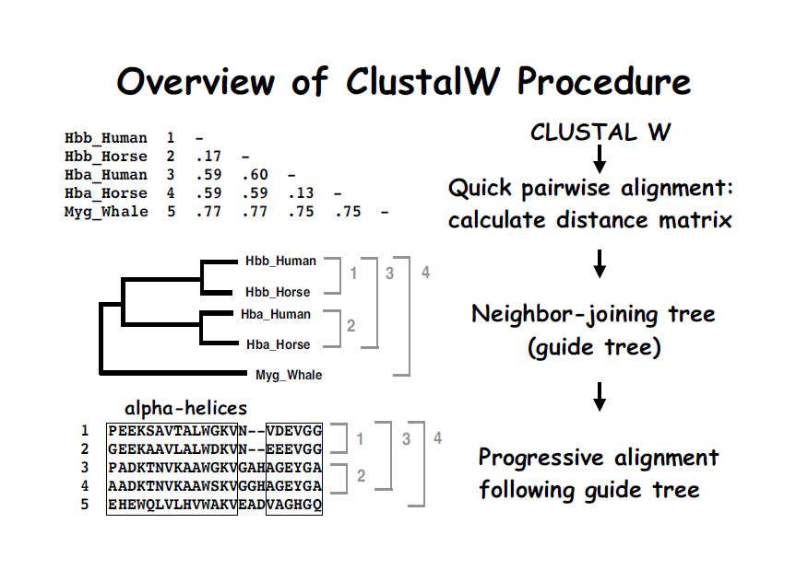

Slide 8
WORKING OF CLUSTAL W
First perform all possible pairwise alignments between each pair of sequences.
Calculate the ‘distance’ between each pair of sequences based on these isolated pairwise alignments.
Generate a distance matrix.
Generate a Neighbor‐Joining ‘guide tree’ from these pairwise distances.
This guide tree gives the order in which the progressive alignment will be carried out.

Slide 9
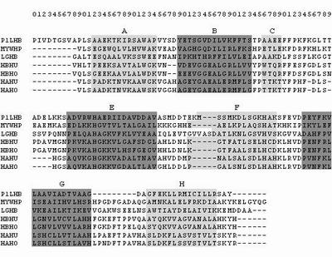
IMAGE OF CLUSTAL W OUTPUT

Slide 10
Applications of MSA
Sequence alignment can identify unknown sequences by comparing them with already known sequences in databases.
Sequence alignment can also produce phylogenetic trees and obtain information about the evolutionary relationship between the sequences aligned.
Sequence alignment can also predict proteins’ secondary and tertiary structures. It can also predict gene locations and new members of gene families.
Sequence alignment can also be used to develop degenerate PCR primers by analyzing multiple related sequences.

Slide 11
