Slide 1
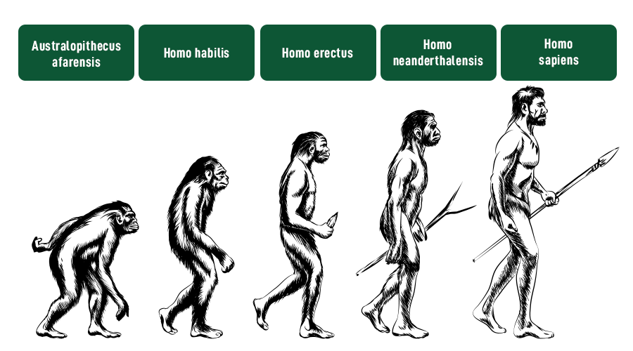
Evolution of humans

Slide 2
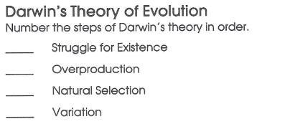
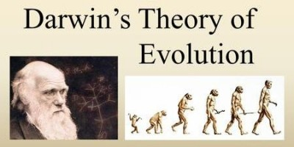
Evolution

Slide 3

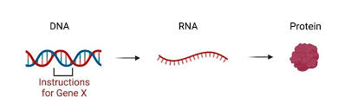
Molecular Evolution
Molecular evolution is the process of change in the sequence composition of cellular molecules such as DNA, RNA and protein across generations.
Molecular evolution uses principles of evolutionary biology and population genetics to explain patterns in these changes.
DNA-----RNA------Protein----------- changes in Generations.

Slide 4
History
Drawin first came up with the idea that living organisms are evolutionary related.
Molecular evolution became a science following discovery of DNA and crack of genetic code.
Insulin:first protein sequenced (sanger, 1955) and sequence compared across species.
Neutral theory: Motoo Kimura, thomas jukes(1968,69).
It started early 20th century with “Comparative biochemistry”.
Molecular evolution came -1960 s and 1970s.
Advent of protein sequencing allowed molecular biologists to create phylogenetic based on sequence comparison and to use the differences between homologous sequences as a molecular clock to estimate the time since the last common ancestor.
After 1970s nucleic acid sequencing allowed molecular evolution to reach beyond proteins to highly conserved ribosomal RNA sequences the foundation of early history of life.

Slide 5
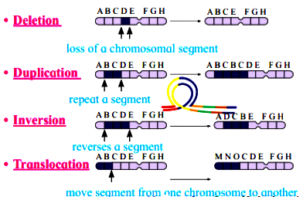
Evolution occurs due to mutations in an organisms. Mutations are different types .
Deletion
2.Duplication
Inversion
translocations

Slide 6
Phylogenetic Tree
A phylogenetic tree (evolutionary tree) is the graphical representation of the evolutionary history of biological sequences and allows us to visualize the evolutionary relationships between them.
Evolution explains the diversity of life on Earth, and understanding evolutionary relationships helps us understand the origin and relationships between different organisms.
Molecular phylogenetics is an important aspect of bioinformatics that helps us understand evolutionary history and relationships by using molecular data such as DNA or protein sequences to create phylogenetic trees.

Slide 7
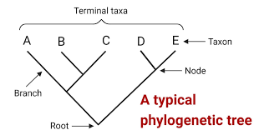

Slide 8
Terminology of phylogentic tree
1.Branches: the lines in the tree are called branches.
2.Root: point at the very bottom the tree is the root node which represents the common ancestor of all members the tree.
3.Node: connecting point where two adjacent branches join is called a node which represents an inferred ancestor of present day species.
4.Taxa: At the tips of the branches are present-day species or sequence known as taxa.

Slide 9
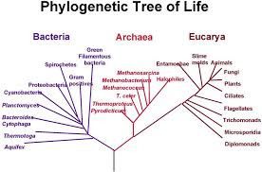

Slide 10
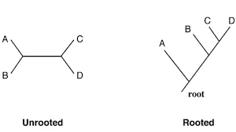
Types of Phylogenetic Tree
Rooted trees - trees that have a specified root node, which represents the common ancestor of all the organisms in the tree.
Unrooted trees- They do not have a specified root node and show only the branching pattern of the evolutionary relationships among taxa or OTUs, without any information about their common ancestor.

Slide 11
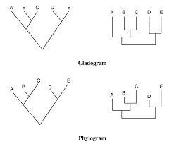
On the basis of topology
Cladogram is a type of phylogenetic tree that displays only the branching pattern of evolutionary relationships among organisms.
Cladograms are unscaled, which means that the branch lengths do not reflect the amount of evolutionary divergence between taxa or operational taxonomic units (OTUs).

Slide 12
Phylogram is a type of phylogenetic tree that represents the evolutionary relationships among organisms by showing both the branching pattern and the amount of evolutionary divergence.
Phylograms are scaled, which means that the branch lengths are proportional to the amount of evolutionary divergence.

Slide 13
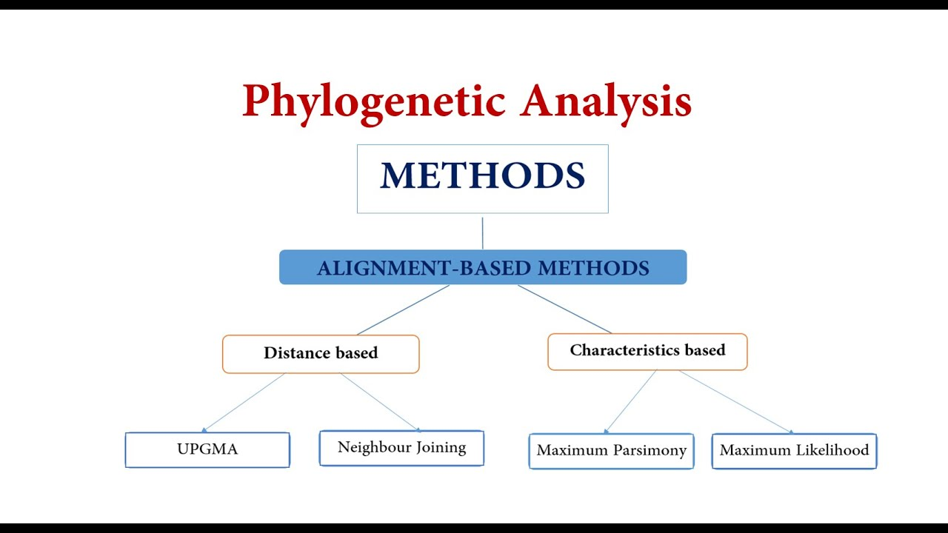

Slide 14
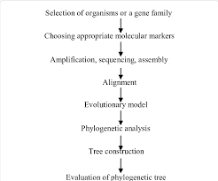
Construction of phylogenetic tree

Slide 15
Molecular phylogenetics tree construction can be divided into5 steps
1.Choice molecular marker.
2.Performing Multiple Sequence Alignment.
3.Choosing a model of evolution
4.Determing a tree building method.
5.Accessing tree reliability .
1. choice of molecular marker:
A.Nucleotide sequence
For studying closely related species, since they evolve more rapidly.
Use of mt DNA,r RNA sequence.
Sequence /codon biasness.
Different genetic code of mtDNA.
B.Amino acid sequence
For studying distantly related species, since they are relatively more conserved.
Degeneracy of genetic code
61codons ----- 20 amino acids.

Slide 16
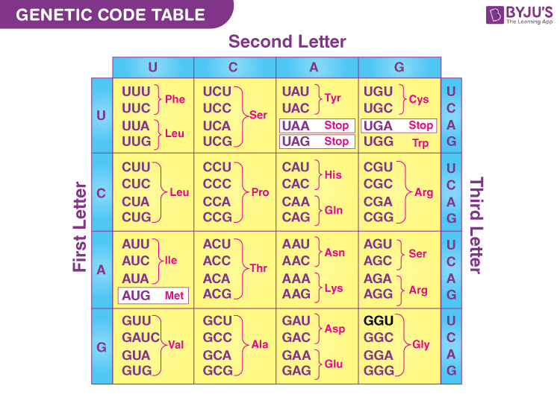

Slide 17
Alignment sensitivity, High signal to noise ratio in protein alignments.
Biological irrelevance when gaps are introduced in protein sequence alignment.
Synonymous and non synonymous substitutions in DNA sequences.
2.Alignment
1.Most critical step in constructing a phylogentic tree.
Correct alignment ---- genealogically relevant tree
Wrong alignment------wrong tree.
Multiple alignment methods should be used, inspected and compared carefully.

Slide 18
3.Choice of evolution model ; 2 models
Jukes –cantor model- equal substitution
Kimura model – transition more prevalent than transversion.

Slide 19
4. Tree building method:
Three main methods
1. Distance based method
2.Maximum parsimony
3.Maximum likelihood

Slide 20
1.Distance based method
Calculate the distance between each pair of sequence.
Sequence pairs that have the smallest changes between them are termed as neighbors.
Join the neighbors by a node and repeat the process.

Slide 21
Many variations but we will talk about three widely used ones,
1.Unweighted Pair Group Method with Arithmetic Mean (UPGMA)
2.Neighbor joining.
1.UPGMA:
Simple method
Assumes a molecular clock
1.Rate of change is constant in sister species
2.Hence branch lengths are equal.
Starts from a distance matrix
Pairs up the most closely related taxa
Treat this pair as new taxa

Slide 22
 | A | B | C | D
A | - | 17 | 21 | 27
B | - | - | 12 | 18
C | - | - | - | 14
D | - | - | - | -
2.Neighbours joining:
NO consideration molecular clock
Therefore, taxa is not equidistant from the root.
Strats from a distance matrix
NJ corrects for unequal evolutionary rates between sequences using a conversion step.
ri= ∑j Di,j/n-2
Where
Ri= compute ri value for terminal node
N= no of taxa

Slide 23
2.Character –based method :
Based on sequence character.
1.Maximum Parsimony:
The principle of parsimony dictates that a theory should provide the simplest possible (viable) explanation for a phenomena.
In phylogenetics:
The best tree is the one that has fewest evolutionary changes.
2. Maximum likelihood method ( ML):
It uses probabilistic models to choose the best tree that has the highest probability.
It finds the tree that most likely reflects the actual evolutionary process.
Exhaustive method
A. Searches for every possible tree topology
B.Consider every positions in an alignment
By employing substitution model, ML calculates the total likelihood of ancestral sequence evolving to internal nodes and eventually to existing sequences.

Slide 24
5.Accessing tree reliability
1. Bootstrapping
Repeatedly sampling trees through slight perturbed datasets.
2. Jackknifing
One half of the sites in dataset are randomly deleted creating datasets half as long as original.

Slide 25
Applications of phylogenetic tree
Evolutionary relationship
DNA sequencing,PCR
Identification of new species.
Identification of pathogenisity.
Identification of genetically diseases.

