Slide 1
DC GENERATORS

Slide 2


General Idea
Electrical Energy
Mechanical Energy
Electrical Machine
Losses

Slide 3








Types of electrical machines
Types of electrical machines
Rotating type
Stationary type
Motors and generators
Transformers
AC motors and generators
DC motors and Generators

Slide 4
An electrical generator is a machine which converts mechanical energy in to electrical energy.
Working Principle Of A DC Generator:
According to Faraday’s laws of electromagnetic induction, whenever a conductor is placed in a varying magnetic field (OR a conductor is moved in a magnetic field), an emf (electromotive force) gets induced in the conductor.
The magnitude of induced emf can be calculated from the emf equation of dc generator. If the conductor is provided with the closed path, the induced current will circulate within the path.

Slide 5
The direction of induced e.m.f. (and hence current) is given by Fleming’s right hand rule
As per Faraday's law of electromagnetic induction, whenever a conductor moves inside a magnetic field, there will be an induced current in it.
If this conductor gets forcefully moved inside the magnetic field, there will be a relation between the direction of applied force, magnetic field and the current. This relation among these three directions is determined by Fleming Right Hand rule

Slide 6
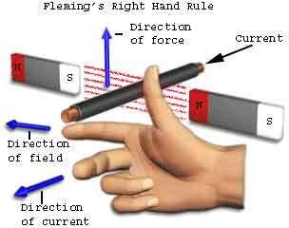

Slide 7
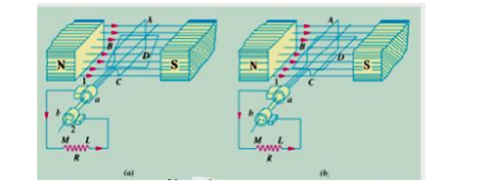
The basic parts of an electrical generator are:
i) A magnetic field
ii) A conductor which can so move to cut the flux.

Slide 8
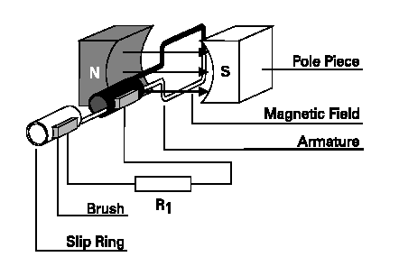
Basic Generator

Slide 9
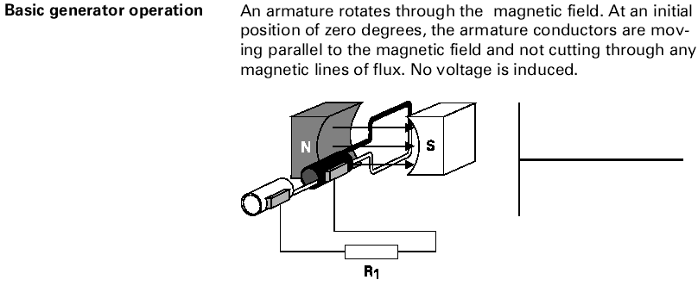

Slide 10
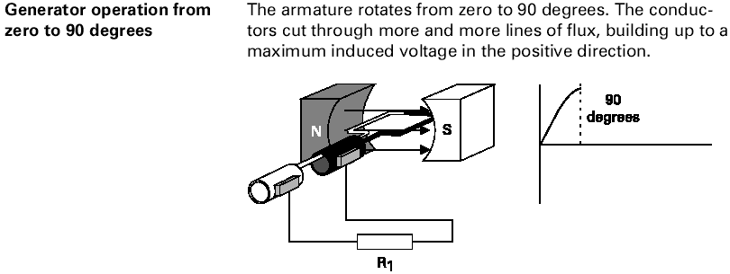

Slide 11
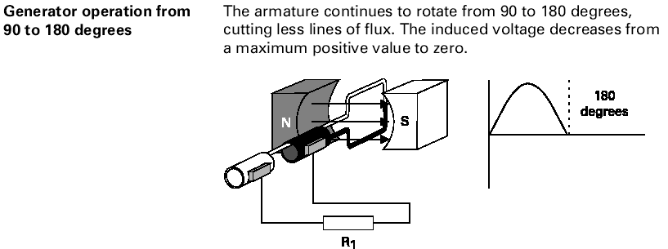

Slide 12
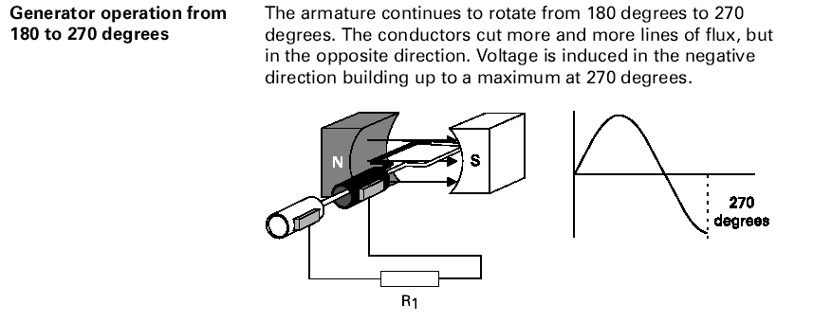

Slide 13
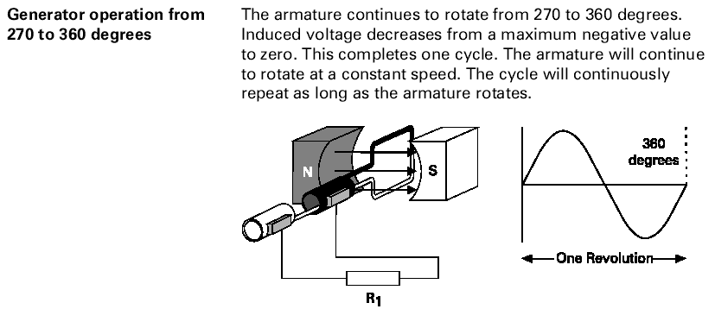

Slide 14
Simple Loop DC Generator
Consider a single turn loop ABCD rotating clockwise in a uniform magnetic field with a constant speed as shown in Fig.(1.1).
As the loop rotates, the flux linking the coil sides AB and CD changes continuously. Hence the e.m.f. induced in these coil sides also changes but the e.m.f. induced in one coil side adds to that induced in the other.
E.M.F. generated in the loop is alternating one. It is because any coil side, say AB has e.m.f. in one direction when under the influence of N-pole and in the other direction when under the influence of S-pole.

Slide 15
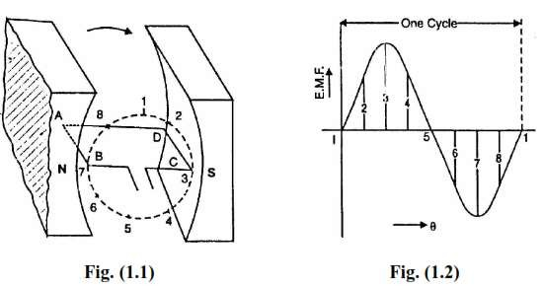

Slide 16
Step-1:when the coil position-1 that is right angles to lines of flux at that position the flux linked with the coil is maximum but the rate of change of flux linkages is minimum because the coil sides AB and CD links with the flux lines so there is no induced emf in the coil.
Step-2: as the coil continues rotating further, the rate of change of flux linkages increases so the emf starts increasing towards maximum value the maximum value of emf will exists when the conductor is at θ=900 and parallel to the flux lines
Step-3:the conductor further moving towards 180◦ the flux linked with the coil is gradually increases so the rate of change of flux linkages decreases so the emf will gradually come to zero value
Step-4:In the half revolution the current direction is from ABMLCD but in the next half revolution the current will passes from DCLMBA which is just reverse of the previous direction of flow so the next cycle will be in negative plane as shown in figure.

Slide 17
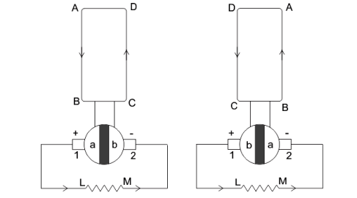
Action of commutator

Slide 18
The figure shows the commutator action of the motor AB, CD are the two sides of coil, ML is the load resistor, ab are the two split rings 1,2 are the two brushes.
The coil ABCD is connected to the split rings ab and the brushes 1,2. The main function of the brushes is to collect the current from the coil or commutator.
In the first half cycle the current will flow in the direction of “AB-a-1-LM-2-b-CD. The current flows here from +ve to –ve.
In the next half revolution the current will flow in the direction of DC-b-1-LM-2-a-BA the current direction form +ve to –ve.
For both half cycles the current will flows from +ve to –ve so the negative half cycle is also come in the +ve plane.
This current is unidirectional like DC current

Slide 19
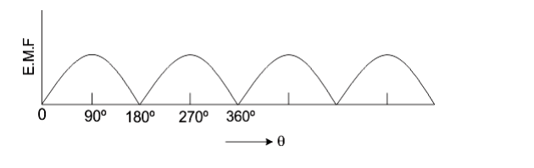

Slide 20
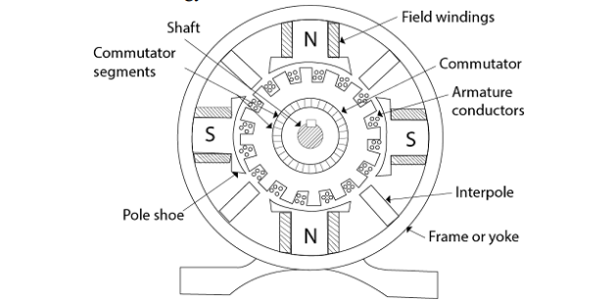
Construction of a DC machine
A DC machine consists of two main parts:
i) Stationary part. It is designed mainly for producing a magnetic flux
ii) Rotating part. It is called the armature, where mechanical energy is converted into electrical or electrical energy into mechanical

Slide 21
1) Magnetic Frame or Yoke:
It provides mechanical support for the poles and acts as a protecting cover for the whole machine
It carries the magnetic flux produced by the poles
The material used for yoke is cast iron silicon steel
2) Pole core and pole shoes:
Pole shoe will serve two main purposes
They spread out the flux in the air gap and also being of larger cross section, reduce the reluctance of the magnetic path
They support the exciting coils or field coils
Pore core itself may be a solid piece made out of either cast iron or steel and it is laminated with small piece

Slide 22
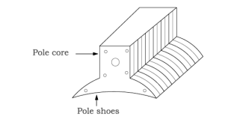
Pole coils
The field coils or pole coils which consist of copper wire called as a field winding When current is passed through these coils they electro magnetise the poles which produce the necessary flux.

Slide 23
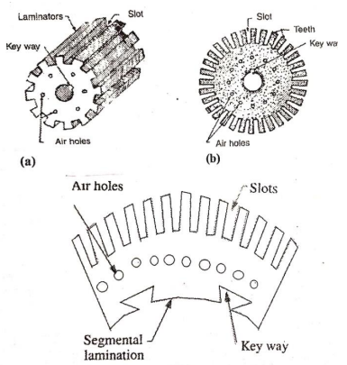
3) Armature core:
It houses the armature conductors or coils and causes them to rotate and hence cut the magnetic flux of the field magnets in addition to this its most important function is to provide a path of very low reluctance to the flux through the armature from a N pole to S pole

Slide 24
The armature conductors are placed in the slots The armature core is also a thin laminated core.
4) Armature windings:
Armature windings are made up of Copper material.
The armature winding is housed in slots on the surface of the armature. The conductors of each coil are so spaced that when one side of the coil is under a north pole, the opposite is under a south pole. There are two types of windings: a) lap winding b) wave winding
For lap winding, number of parallel paths always equal to no. of poles (A=P). This is used for high current, low voltage applications.
For wave winding, number of parallel paths equal to two (A=2). This is used for high voltage, low current applications.

Slide 25
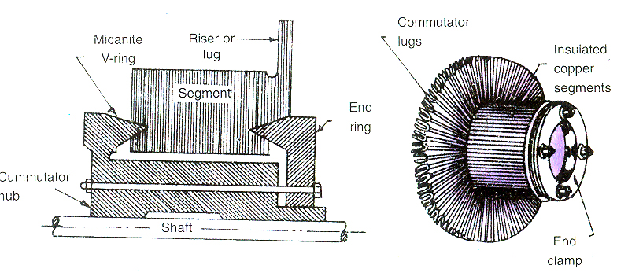
5)commutator
Hard drawn copper bars segments insulated from each
other by mica segments (insulation)
-- Between armature & External circuit
-- Split-Rings (acts like Rectifier AC to DC )

Slide 26
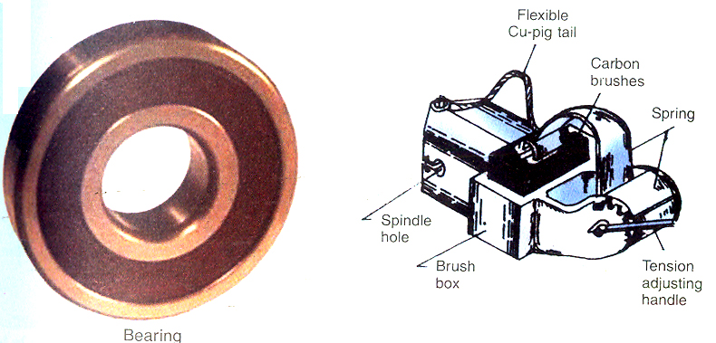
6) Brushes and bearings:
The function of the brushes to collect the current from commutator and are usually made of carbon or graphite Bearings are used form sooth operation

Slide 27
EMF Equation of a DC Generator:
Let, P = Number of poles of the generator
Φ = Flux produced by each pole in webers (Wb)
N = Speed of armature in r.p.m
Z = Total Number of Armature Conductors
A = Number of parallel paths in which the 'Z' number of conductors are divided
So A = P for lap type of winding
A = 2 for wave type of winding

Slide 28

Now e.m.f. gets induced in the conductor according to Faraday's law of electromagnetic induction.
Hence average value of e.m.f. induced in each armature conductor is,
e = Rate of cutting the flux = dΦ/dt Now consider one revolution of conductor.
In one revolution, conductor will cut total flux produced by all the poles
i.e. Φ*P.
While time required completing one revolution is 60/N seconds as speed is N r.p.m

Slide 29

This is the e.m.f. induced in one conductor.
Now the conductors in one parallel path are always in series.
There are total Z conductors with A parallel paths, hence Z/A number of conductors are always in series and e.m.f. remains same across all the parallel paths. . . .
Total e.m.f. can be expressed as,

Slide 30
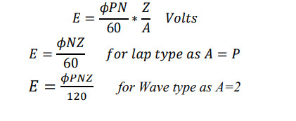
This is nothing but the e.m.f. equation of a d.c. generator.

Slide 31
Types of DC Generators
There are mainly two types
Separately excited DC generator
2) Self-excited DC generator
a) Series wound DC generator
b) Shunt wound DC generator
c) Compound wound DC generator
i) Long shunt compound wound DC generator
ii) Short shunt compound wound DC generator

Slide 32
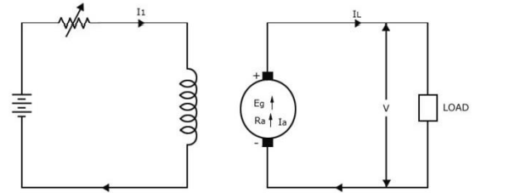
Separately excited DC generator:

Slide 33
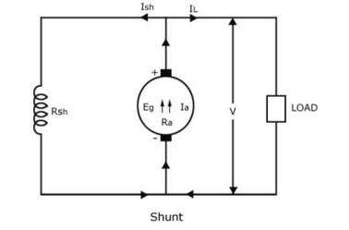
In separately excited DC generators there is no connection between armature and field windings.
In this machine the field winding is excited by a separate DC source. Like battery.
Self-excited DC generator:
Shunt wound DC generator:

Slide 34
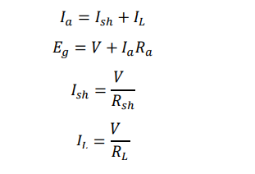
In this type of machine the field winding is connected in parallel to the armature winding then the machine is called DC shunt machine.

Slide 35
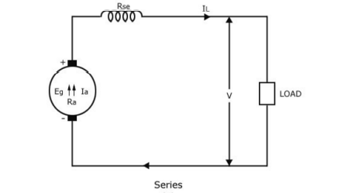
Series wound DC generator:

Slide 36
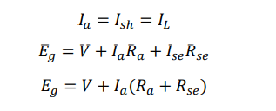
In this generator armature winding is connected in series with the field winding.

Slide 37
Compound DC generator:
The combination of two windings that is series winding and shunt winding is considered as compound DC generator.
Based on the type of connection of the shunt field to the armature and series field it is classified as
Long shunt DC compound generator
Short shunt DC compound generator

Slide 38
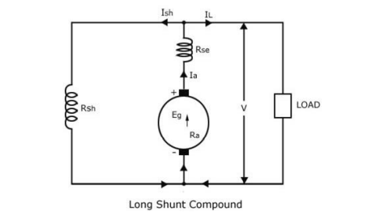
Long shunt DC compound generator:

Slide 39
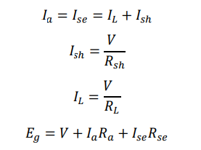
In this type of machine the series current and armature current is made same and the shunt connection is made after the series connection

Slide 40
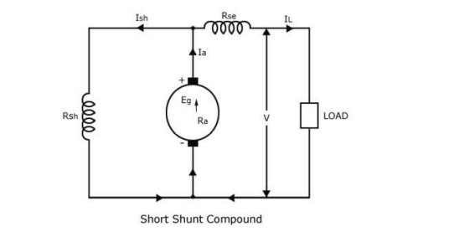
Short shunt DC compound generator:

Slide 41

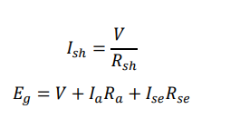
In this type of machine the series field current is made same to that of the load current.

Slide 42
APPLICATIONS OF A DC GENERATOR:
The applications of the various types of DC Generators are as follows:-
Separately Excited DC Generators
Separately excited DC Generators are used in laboratories for testing as they have a wide range of voltage output.
Used as a supply source of DC motors.
Shunt wound Generators
DC shunt wound generators are used for lighting purposes.
Used to charge the battery.
Providing excitation to the alternators. Series Wound Generators

Slide 43
DC series wound generators are used
in DC locomotives for regenerative braking for providing field excitation current.
Used as a booster in distribution networks.
Over compounded cumulative generators are used in lighting and heavy power supply.
Flat compounded generators are used in offices, hotels, homes, schools, etc.
Differentially compounded generators are mainly used for arc welding purpose.

